Slide 1
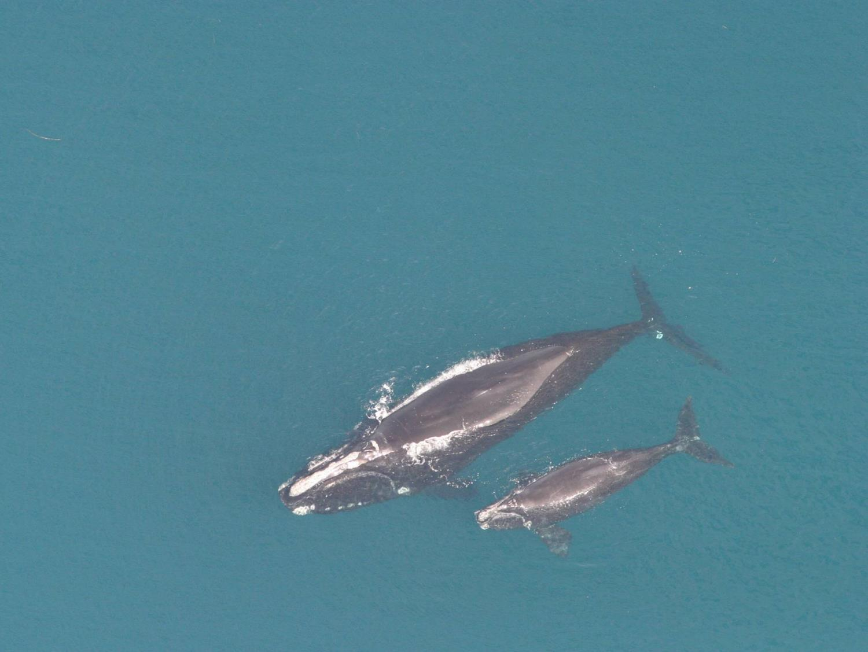
Coastal Nongame Conservation Section
Wildlife Resources Division
Georgia Department of Natural Resources
Conserve nongame wildlife by implementing species recovery plans, conducting species research and surveys, identifying, protecting and managing critical habitats.
Notes:
Regulatory power over all wildlife not hunted or fished….conserve in two primary ways; implementing the ESA for individual species, difficult and costly. Our preferred method, keeping commons species common by anticapting or recoginizing wildlife conflicts/threats and acquiring or managing habitat to mitigate those effects
1

Slide 2
Nongame Conservation
Two primary methods
Managing recovery programs of species already listed on ESA (Section 6)
Keeping common species common, BEFORE they are listed.
  SWG
  Land Acquisition (NAWCA/NCWCG/etc)
Notes:
1- auspices of ESA Section 6
2-We do this through State Wildlife Grants, monitoring Ga wildlife to anticipate problems, and taking actions such as acquisitions

Slide 3
Habitat Analysis
Utilize data to determine what habitats are threatened, abundant, degraded
Which species depend on those habitats
State Wildlife Action Plan

Slide 4
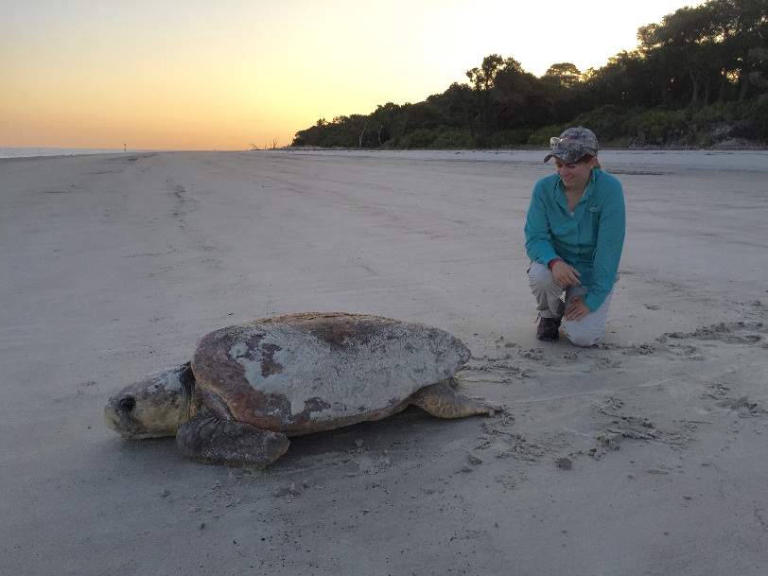
Loggerhead Nesting Trend in Georgia, 1989-2016
Comprehensive Statewide Surveys (n=28)
-Georgia DNR has coordinated comprehensive nesting surveys since 1989 (n=28 years)
-Significant increasing trend in nesting and adult females (3% annually).
-Surpassed NOAA/USFWS recovery goal of 2,800 nests in 2016.
-Other demographic criteria must be met prior to delisting, but nesting data shows a recovering population.

Slide 5
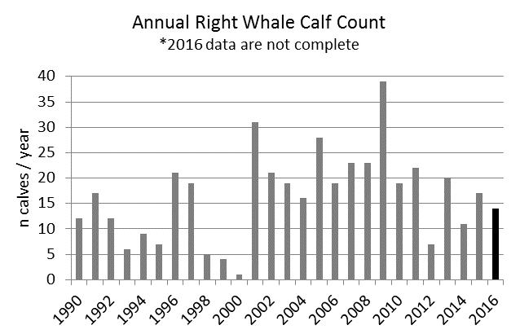
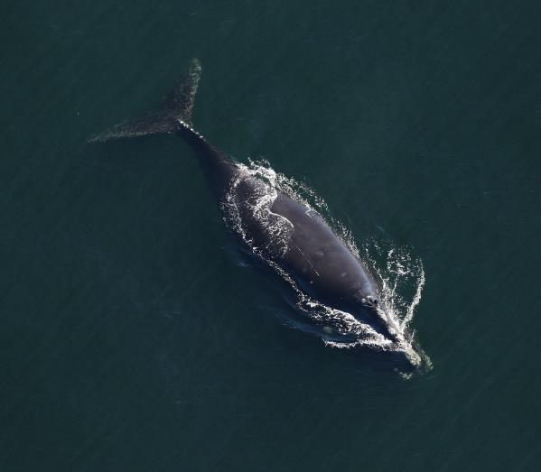
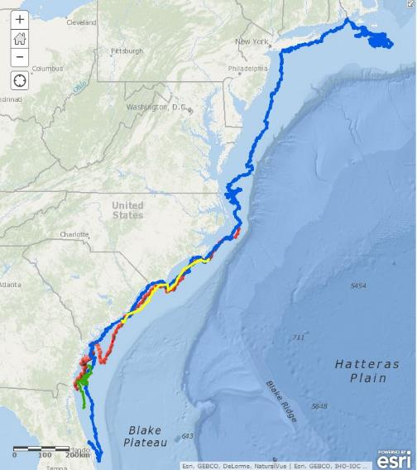
Southeast Right Whale Project- Section 6
DNR, Florida FWC, Sea to Shore Alliance, NOAA and other partners
At least 475 whales, increasing at 2.8% per year as of 2011
Low number of calves and total sightings in Southeast in recent years
Unclear if recent declines will impact population growth
Primary threats remain:
  Ship strikes
  Commercial fishery entanglement
Emerging threats:
  Anthropogenic noise
  Climate change
  Other habitat impacts
Current projects:
  Aerial and boat surveys
  Genetic sampling
  Satellite telemetry
  Drone photogrammetry
Satellite Tracks
2015:
― S078
― Eg4092
2016:
― Eg4040
― Eg4094

Slide 6
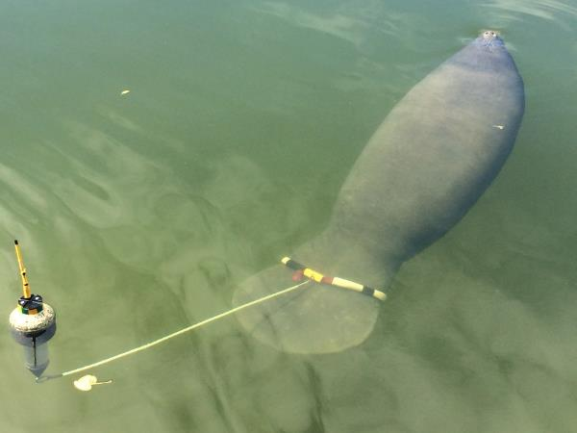
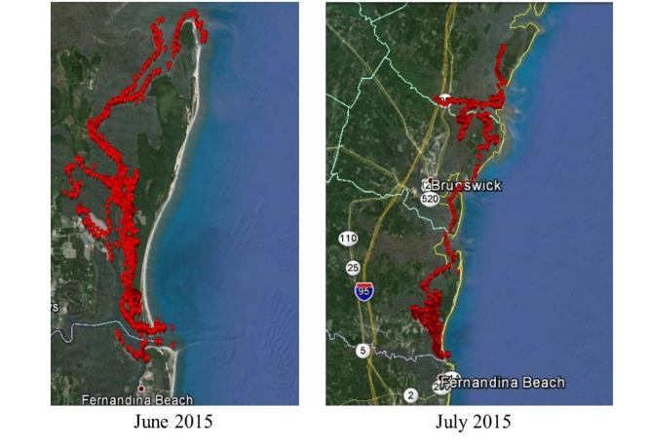
Manatee Project- Section 6
DNR, Florida FWC, Sea to Shore Alliance, FWS and other partners
At least 6,250 manatees, all subpopulations stable or increasing
Average around 50 per year in GA
Proposed for down-listing to threatened
Primary threats remain:
  Boat strikes
  Red tides
  Warm water availability
  Habitat degradation
Current projects:
  Kings Bay satellite telemetry
  Photo-ID
  Monitoring artificial warm water outfalls
Manatee #TGA011 GPS Positions

Slide 7
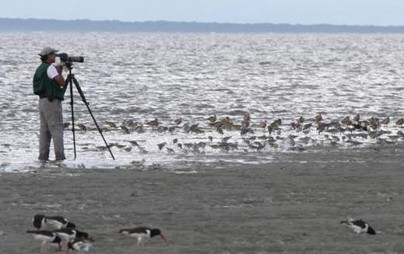
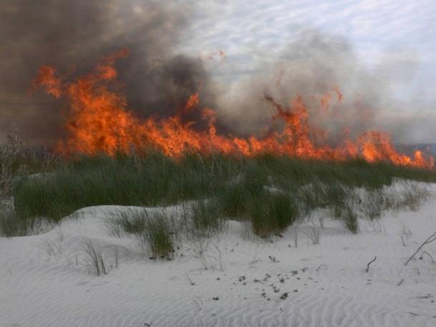
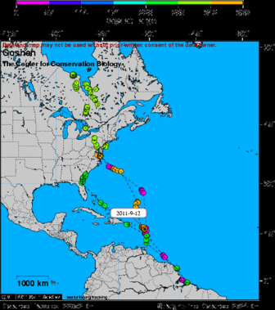
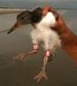
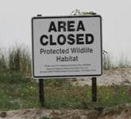
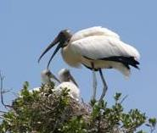
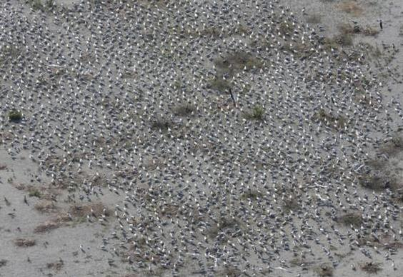
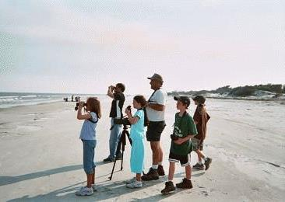
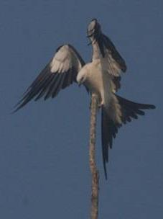
Coastal Bird Conservation and Management
Research
Management
Monitoring
Education
Notes:
7
Mix of Section 6 and SWG

Slide 8
Marine and Maritime
Habitat Management
Regulate fisheries (ESA; for example TEDs)
Saltmarsh (MPA)
Development (SPA and Land Acquisition)
Water Quality and Quantity (CWA; EPA, local govn’s)
Notes:
So we have a substantial impact on marine habitats

Slide 9
Marine and Maritime
Habitat Status
Coastal Wildlife populations indicate relative favorable health for beach/shore, marsh and marine habitats.
What reference point?
Oyster populations are a fraction of pre-colonial #s
Notes:
So we have a substantial impact on marine habitats

Slide 10
Marine and Maritime
Habitat Status
Over 617k people in Coastal Ga. 6% past 5 years
Connected biologically to many parts of the world (migratory birds, migratory whales, fisheries) and through 2 major Ports
Notes:
So we have a substantial impact on marine habitats
580k in 2010

Slide 11
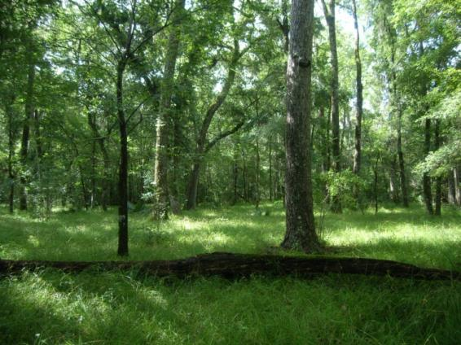
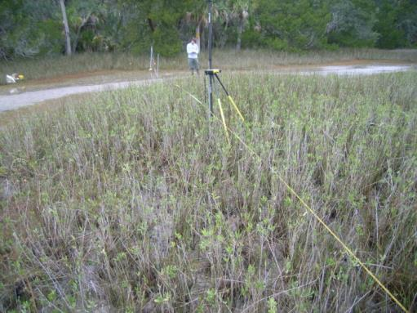
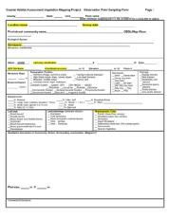
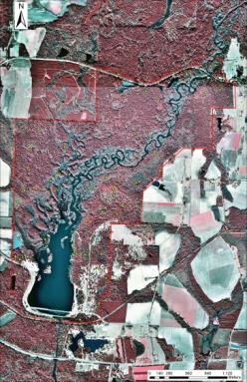
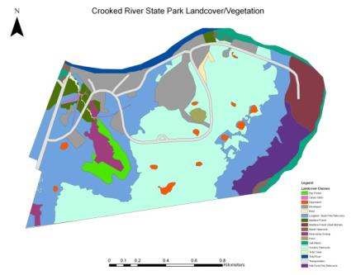
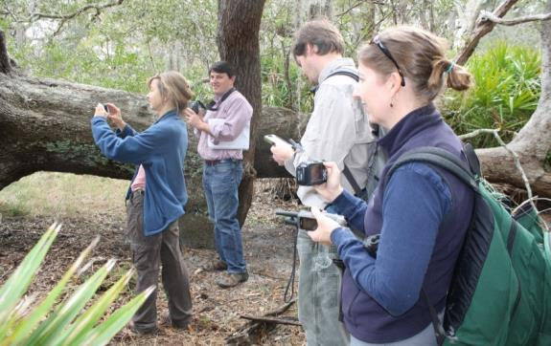
Habitat and Rare Plant Conservation and Monitoring
Natural Community and Rare Plant Surveys
Vegetation Monitoring
Habitat Mapping
Conservation Planning
Notes:
Which brings us to. other Habitat we are fortunate to have substantial intact. For instance we probably have majority reser4ves of maritime forest in conservation…. A lot of protecting the GA coast is trying to conserve what habitat we have left, and also restore or enhance what we do. For that, we are lucky to have one of the most detailed habitat maps available for an area this size. Mapped to the USNVC association and alliance level, we know with certainty what natural communities we have on the coast, what their extent and relative extent is, and so decisions related to management are considerably more accurate and easy for us.
Since we also know what faunal and floral species utilize those habitats, this also enables us to do regional conservation planning and acquisition to great effect from a wildlife standpoint.
Monitor and manage rare plant populations.
Conceived as a comprehensive and unifying way to keep common species common; by knowing location and extent of native habitats, we can better understand and address the issues facing coastal wildlife.

Slide 12
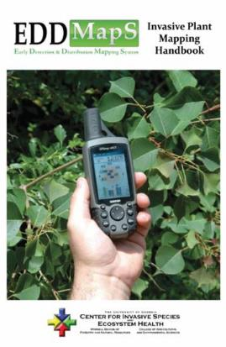
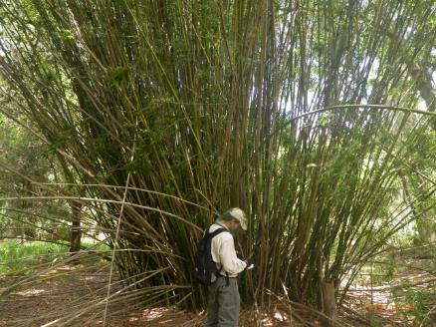
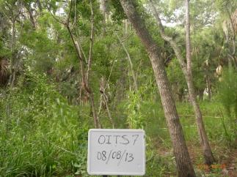
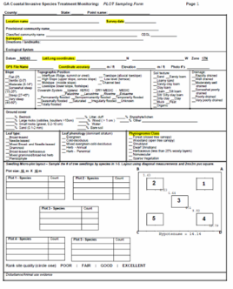
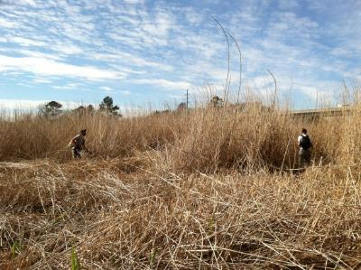
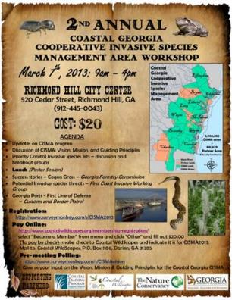
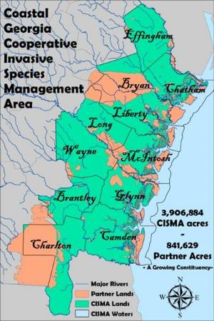
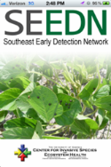
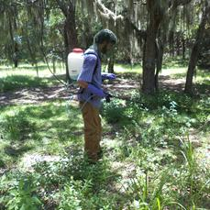
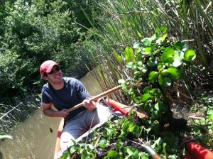
Invasive Species Assessment and Management
Assessment (Mapping)
Monitoring (Treatment effectiveness)
Management (Control)
Education & Outreach
Notes:
Lastly we have the invasive program, which, like the habitat program, overlaps all programs and wildlife considerably. Invasives second largest threat to native species and being close to Fl we are on frontlines for invasion… we are using a variety of approaches to prevent future invasions by working with GA Ports/Customs and other groups, and are also active in control of spp. already here. $150 billion per year, and with Climate Change we don’t expect things to improve. Promote NATIVES

Slide 13
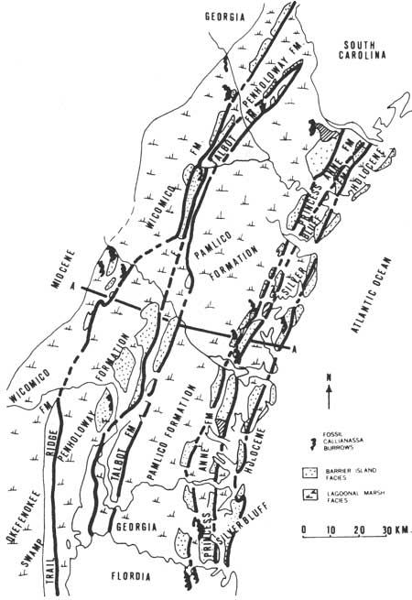
Notes:
Do not find beach sediments on back sides of barrier islands. All within the past 2 M years, including up to 60 miles off shore (the continental shelf). When seas are rising, the true barrier islands roll back, always existing at MSL. When the MSL drops, they are abandoned by the sea, so we know that the further inland a barrier chain is, the older it is. The current barrier island is a combination of the Silver Bluff Shoreline from 50 k ya, and the Holocene, which has been unprecedentedly stable for 18k years.

Slide 14
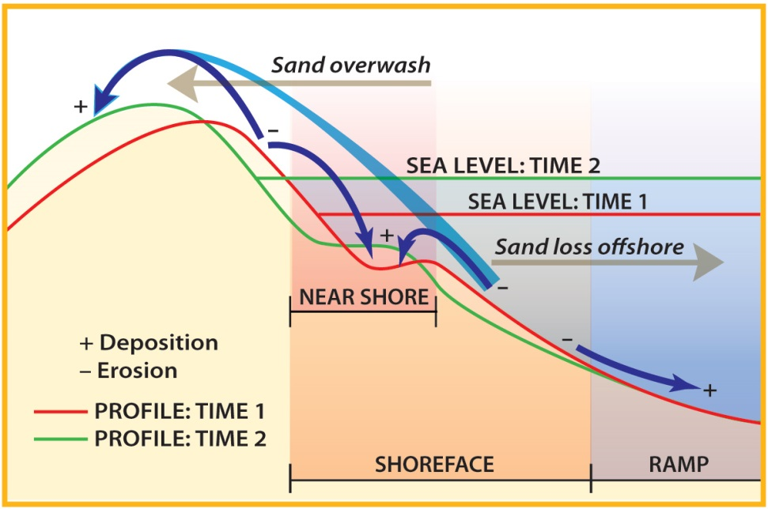
SLAMM?
Notes:
the predictability of SLAMM?
This is typical diagram of what is supposed to happened with barriers. Probably true for lower islands, and low parts of islands. But what about 20 foot Pleistocene islands? Low tide here fosters high dune development.

Slide 15
Beaches and Marsh
Exist at MSL under favorable conditions
Due to conservation lands, lack of shoreline hardening, and natural topography, conditions are favorable here for several feet of SLR

Slide 16
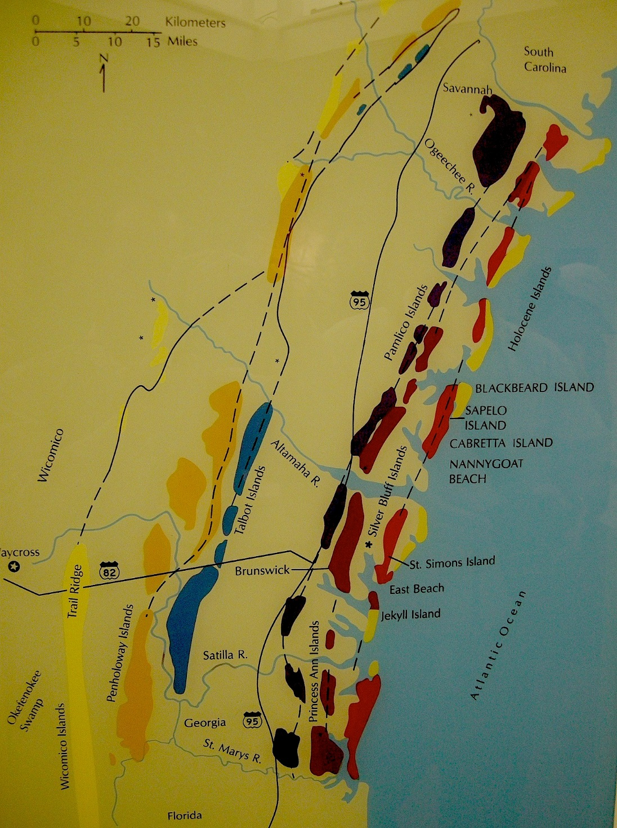

Slide 17
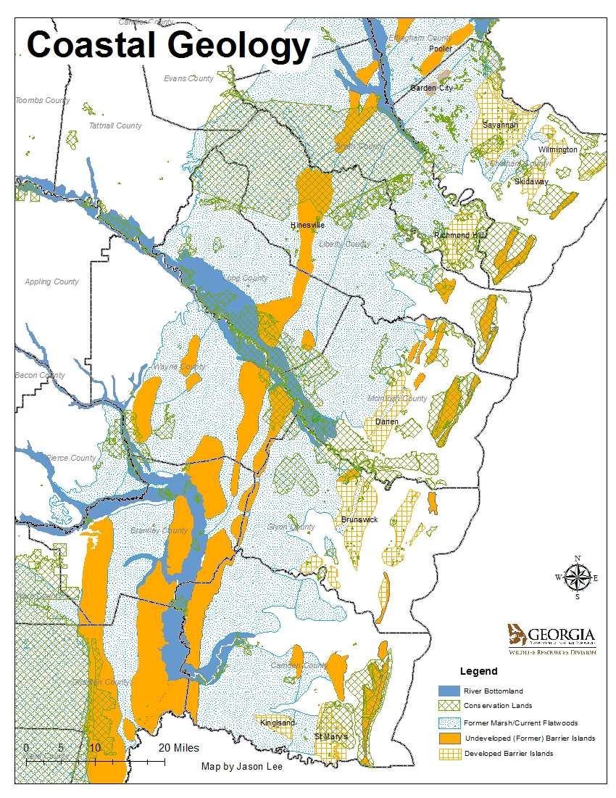
Tier 1 (barrier and marsh islands) 36% developed
Tier 2 (adjacent to coast) 86 % developed
Coast consists of barrier islands, former barrier islands (now upland sand ridges), saltmarsh and former salt marsh (now flatwoods).
Former marshes (now flatwoods) are poorly drained and not easily developed, especially close to the coast.
Notes:
The Coast of Georgia, geologically, consists of north-south strings of Barrier Islands (see Figure 1) that are developable uplands surrounded by either saltmarsh, wetlands or flatwoods. Of that first string (which includes Georgia’s beachfront islands and also islands surrounded by saltmarsh), 36%, or 30,359 out of 83,627 acres, are developed either low or high density. The second tier, which includes the cities of Brunswick, Savannah, Darien, St. Mary’s, Richmond Hill and others is 86% developed or 132000 out of 154226 acres.

Slide 18
Coastal Habitats
Desirable for Development, yet:
  Contains the most contiguous protected area in GA (Barrier Islands and Saltmarsh)
  adjacent Coast is a mix of development, conservation, agriculture and forestry

Slide 19
Coastal Habitats
result is that many coastal habitats, although not pristine, are abundant and thriving here
Some are diminishing or threatened

Slide 20
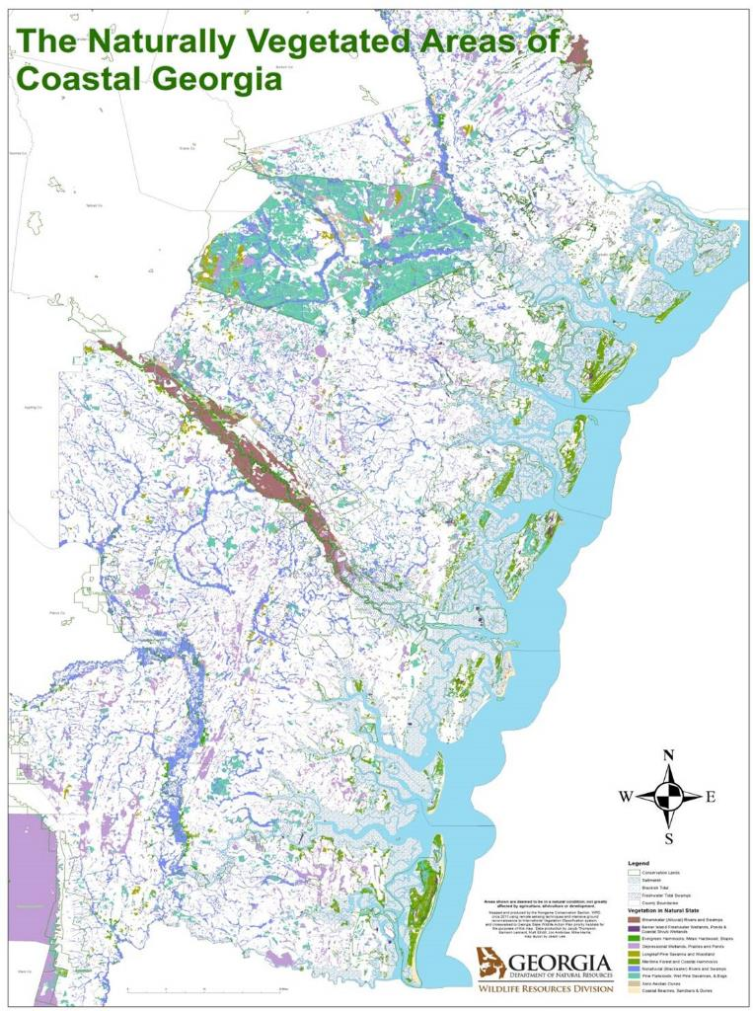
USNVC Alliance Level on immediate Coast
Association Level near Coast
Notes:
trying to merge shorebird, sea turtle needs, determining relative threat on a regional scale and in a changing climate (or changing sea level). Again, that broad overview is key to understanding which species are most vulnerable, and what can be done about it.
Notable here is the proportion of wetlands (purple & blue) to uplands (green) that are still in natural vegetation (what’s supposed to be there is there). So we need to protect more uplands…
Another statistic we derived- 2350 miles of marshfront property, and only 740 miles of that in protection.
20

Slide 21
3.9 M total acres
1.57 M acres natural vegetation (including saltmarsh)
  370 K upland acres
  1.2 M wetland acres
736 K acres (20%) total conservation (not including saltmarsh)
509 K (14%) natural vegetation in conservation (not including saltmarsh)
Notes:
200,000 acres of depressional is okefenokee
736k/(3.9M-350k )= 20% 509k/(3,550,000)= 14%
736 k- a lot of State and city parks, Ft Stewart infrastructure, clearcuts

Slide 22
Acres of Natural Vegetation, Coastal Georgia
Notes:
200,000 acres of that deprissonal is Okefenokee. 1.57 M acres natural vegetation (including saltmarsh) 370 K upland acres, 1.2 M wetland acres
trying to merge shorebird, sea turtle needs, determining relative threat on a regional scale and in a changing climate (or changing sea level). Again, that broad overview is key to understanding which species are most vulnerable, and what can be done about it.
Notable here is the proportion of wetlands (purple & blue) to uplands (green) that are still in natural vegetation (what’s supposed to be there is there). So we need to protect more uplands…
Another statistic we derived- 2350 miles of marshfront property, and only 740 miles of that in protection.

Slide 23
What happened?
1.6 M acres natural vegetation (including 400K acres of saltmarsh)
  370 K upland acres
  1.2 M wetland acres
2.3 M acres (60%) converted to anthropogenic uses (mostly uplands, flatwoods and depressional wetlands
Originally there were appx 530K longleaf uplands and 2 Million acres of flatwoods and depressional wetlands

Slide 24
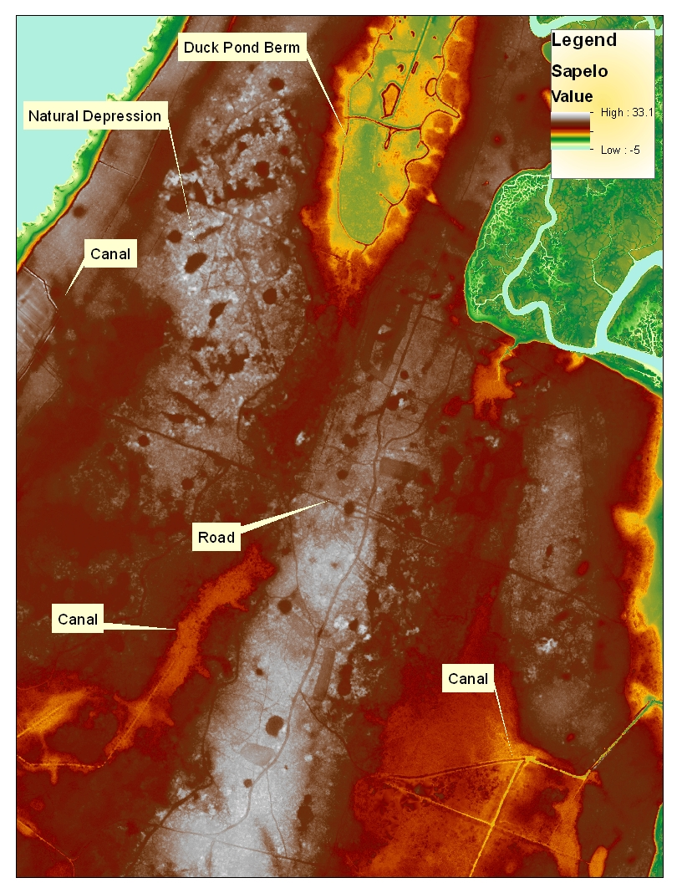
What happened?
  Ditching and draining work on depressional wetlands
  Riverine harder to drain, but depressional (and other) draining does affect all habitat types by lowering water table

Slide 25
Terrestrial Impacts
The great longleaf pine savannah, only remnants left
Longleaf flatwoods habitat, significantly reduced/degraded
Isolated wetlands significant but unknown loss

Slide 26
Biological processes
Fire has been mostly removed
Fragmentation/landuse
Hydrology has been greatly affected in all habitats (ditching, draining, impervious)
Climate is shifting
Invasive species

Slide 27
Biological processes
Coastal processes mostly intact
Fisheries

Slide 28
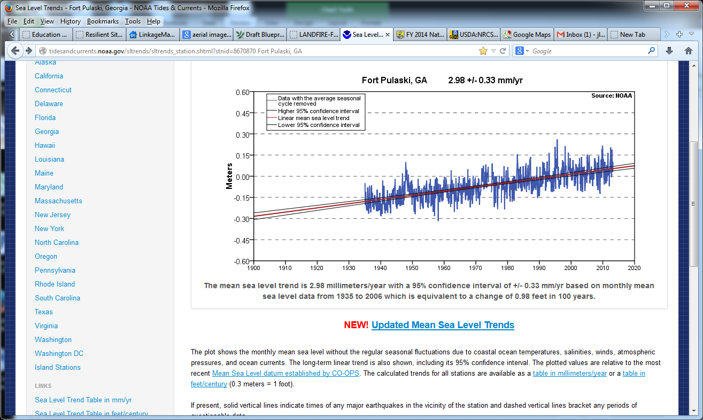
Notes:
71 years of data, 10 inches of recorded rise. 2.9 mm or 0.1 “ per year.

Slide 29
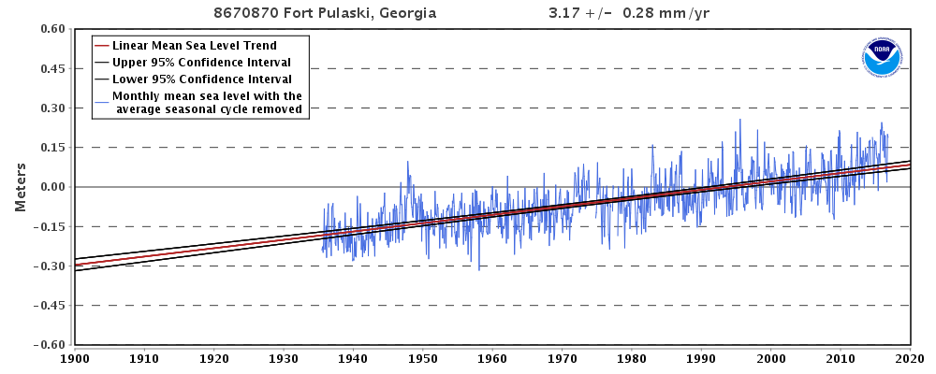
The mean sea level trend is 3.17 millimeters/year with a 95% confidence
interval of +/- 0.28 mm/yr based on monthly mean sea level data from
1935 to 2015 which is equivalent to a change of 1.04 feet in 100 years
Notes:
80 years of data, 12 inches of recorded rise. 3.1 mm or 0.12 “ per year.

Slide 30
Past Decade
6 inches!
Notes:
Exponential growth of MSL yearly average. In 2006, near 0 MSL, in 2016 0.15 MSL (meters). That is 6 inches!!!

Slide 31
Notes:
polynomial

Slide 32
What are we focusing on?
Conserve and restore rare habitats/species
Conserve and restore Uplands
Preserve and Create Connectivity

Slide 33
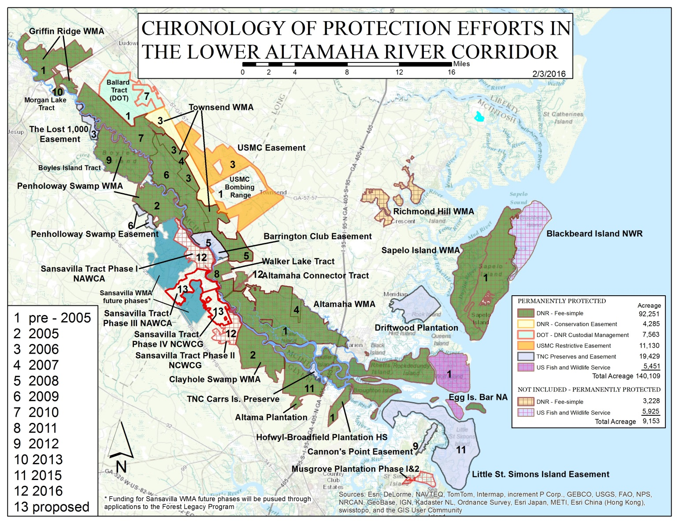

Slide 34
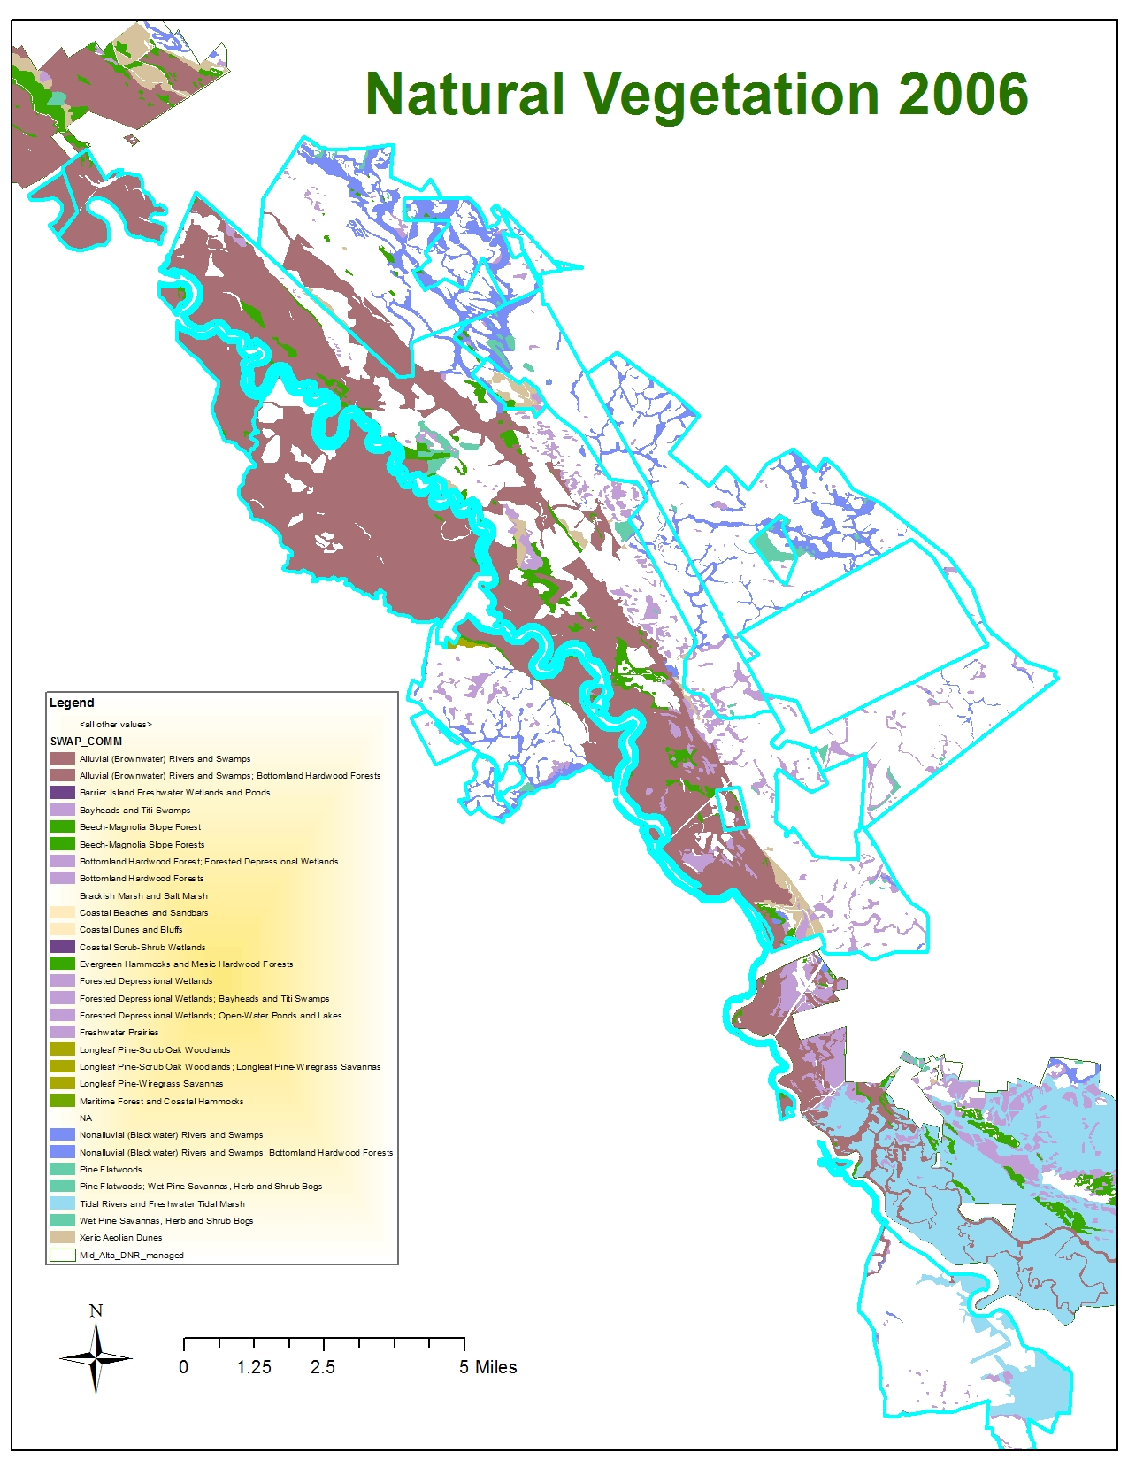
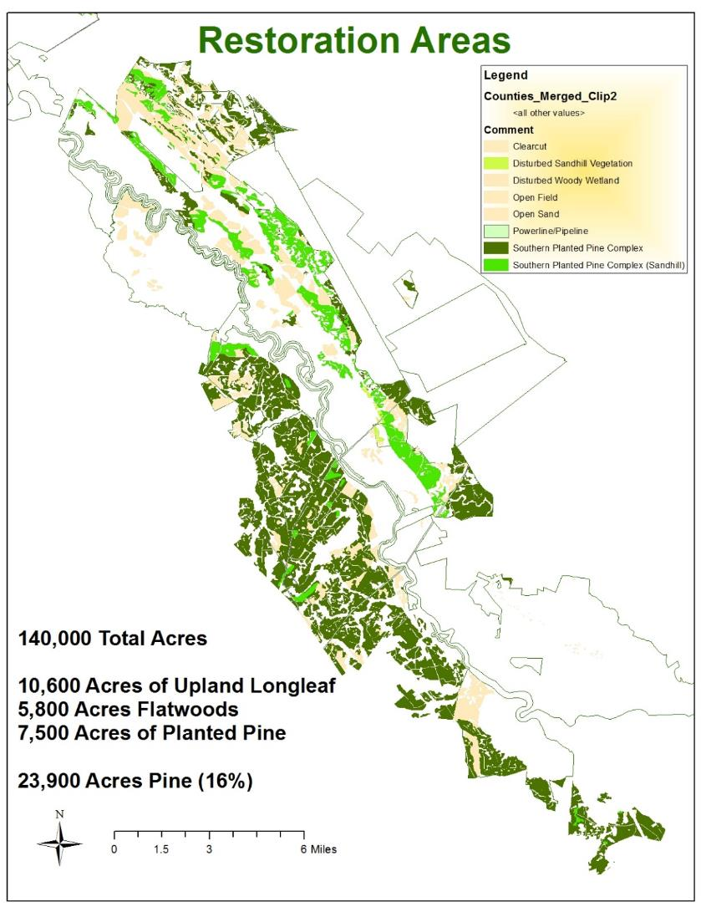

Slide 35
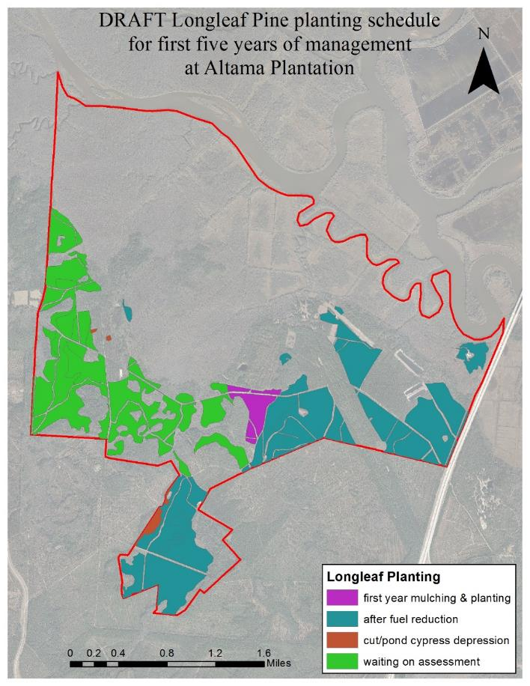
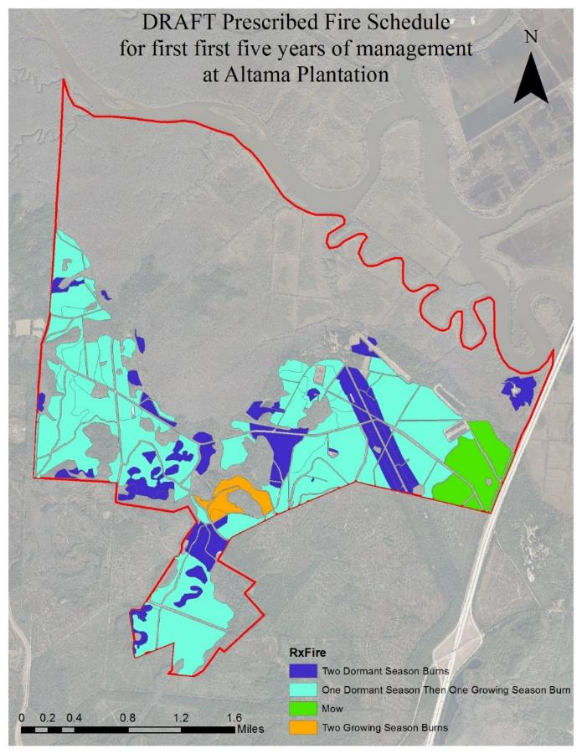

Slide 36
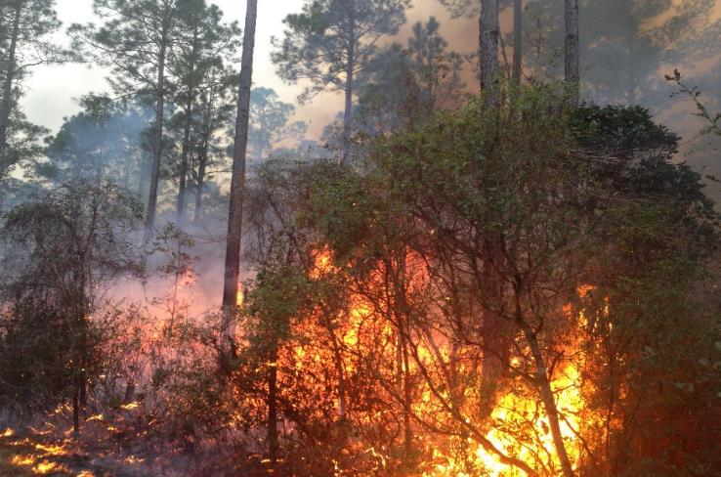
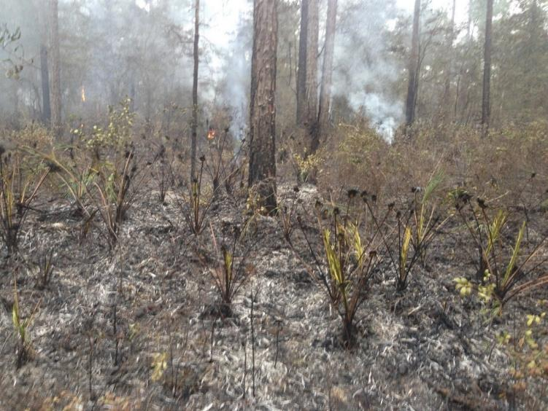
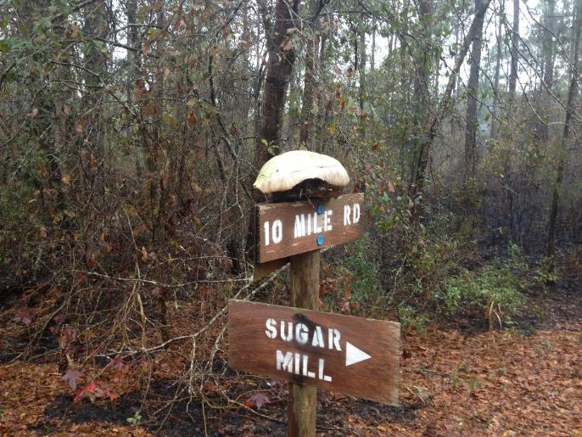
Altama Restoration & Monitoring

Slide 37
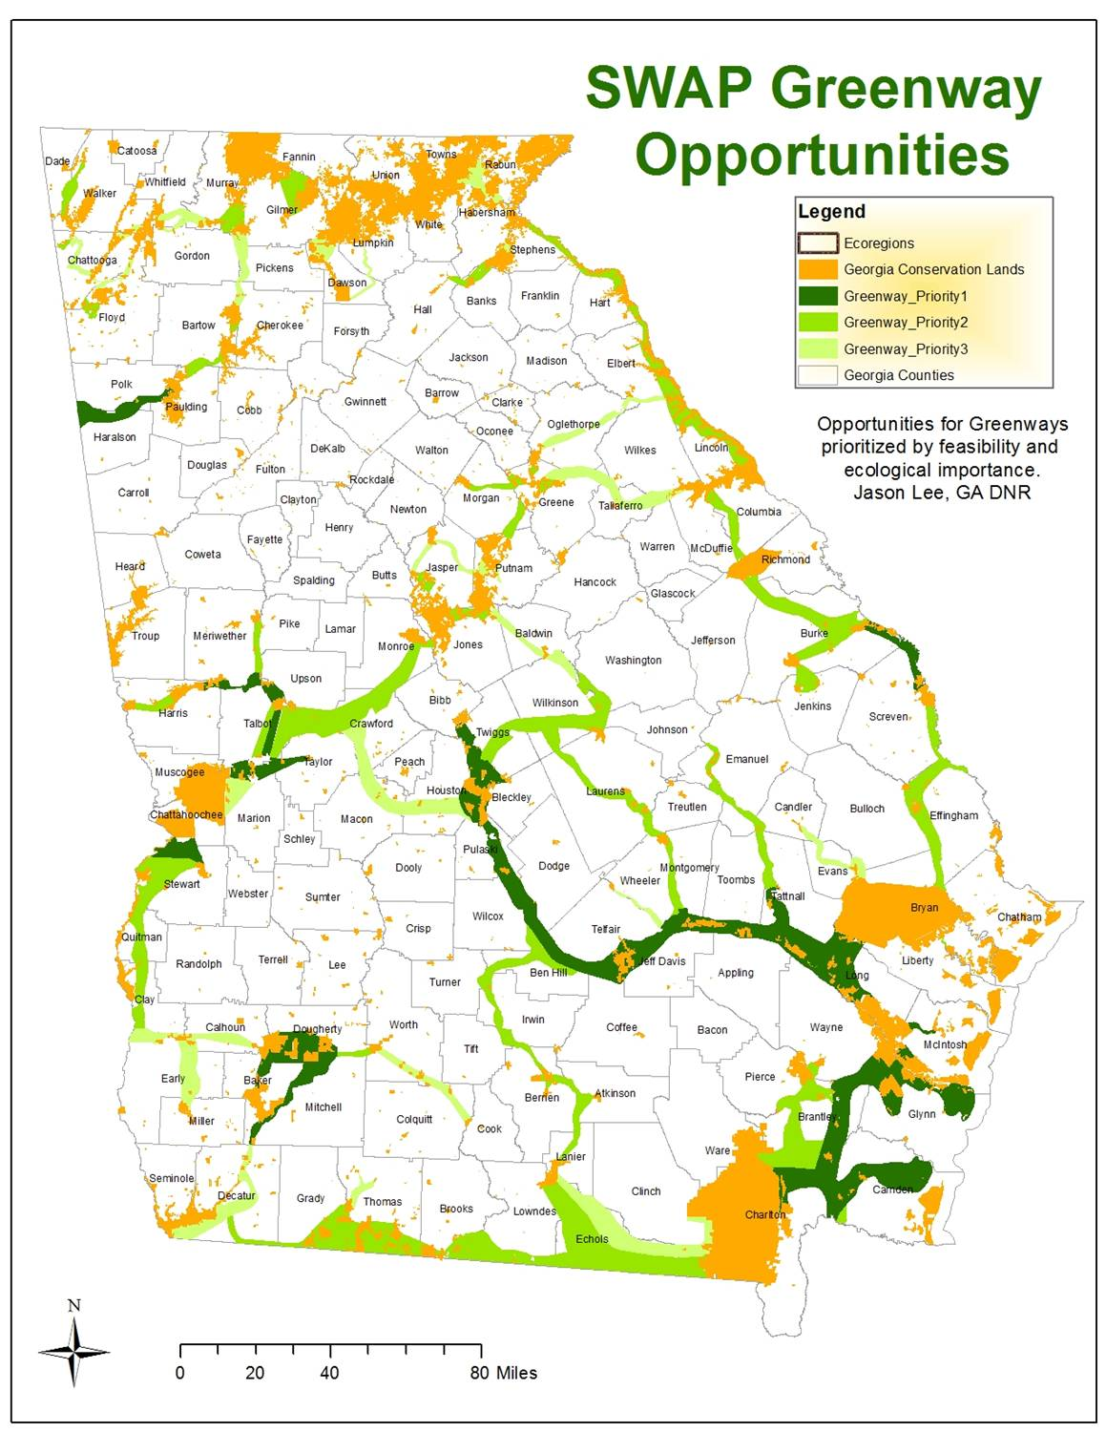
Currently 8.5%, or 3.1 M acres out of State's 37 M in Conservation
Each Priority level is 1 M acres, totaling 16% of State
Serve as corridors for many threatened and common species: RCW, Indigo Snake, Gopher Tortoise, Black Bear
Connect up to Florida’s planned Corridor System

Slide 38
Questions?

Slide 39
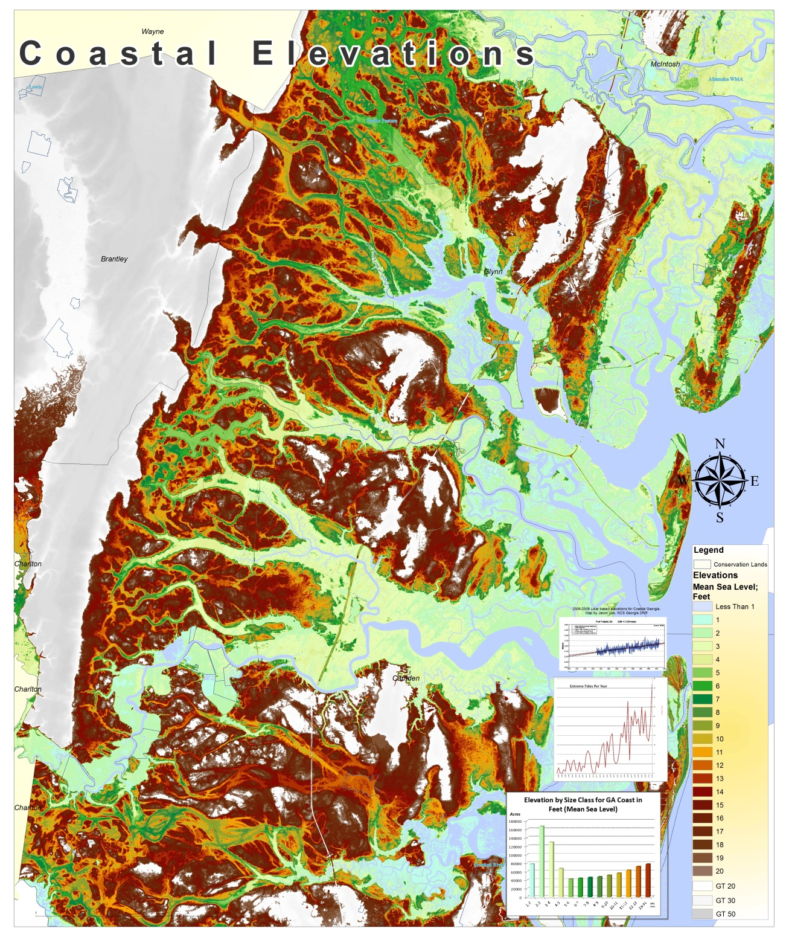
Notes:
Can’t harden all of this! These are inland however. Most areas are privately held. Most likely that ownership will be maintained, but we will have jurisdiction over these areas (permit required for action). Need clarity here.

Slide 40

Notes:
Set at todays MSL. Areas etc of occurrence
What does raw data say? Where does marsh occur?

Slide 41

Notes:
Example of good area

Slide 42

Notes:
Lots of uncertainty with slr and its impacts, Ten minute hour.
Working with T&E section of DNR, My Job is to try to understand how all spp will be affected and try to mitigate for that. 2 defined , primary threats to coast- development and everything associated with that, and climate change/slr. both can be mitigated by conservation acquisition, so that is our biggest tool. Even thought we have limited resources relative to what needs to be done
> What is a coastline, it is interface of land and ocean. In many respects it is the very definition of chang: tides, erosions, constant flux. But for recent history, we can say the more things change, the more they stay the same- erosion here, sedimentation there, marshes erode and form . Call them coastal processes and they are a give an take arrangement. Slrising is a coastal process, it is tied to polar ice caps and global climate through the millennia. Flora and fauna adapt, that is what life does, it adapts. It's is very good at it, as long as something (like us) doesn't get in the way. So what we are trying to do is give coastal habitats the room and topographic diversity to migrate upland.
Show dem of coast- specifically enough room and enough diversity to account for range of impacts and outcomes. Explain elevations. Where is development. Marsh drowning. Areas of diversity as targets, marsh migration.
Show natural veg map and need to direct funding at uplands. show coastal conservation map,
Show corridor map ---
So, the good news is we know what we need to do (where to target), we are doing a lot already with resources we have and we are hopeful to do even more ... TNC, local land trusts, groups like this

Slide 43
Acres by Elevation Class
Notes:
How much lag time? Centuries? We’ve measured accretion rates trimble era. Maybe marshes have manipulated a favorable env. To produce optimal elevations over past 5000 years.
Essentially thi coast is naturally hardened (lots of bluffs)
This also means most development is safe, unlike other areas most is above 10 ft.

