Slide 1
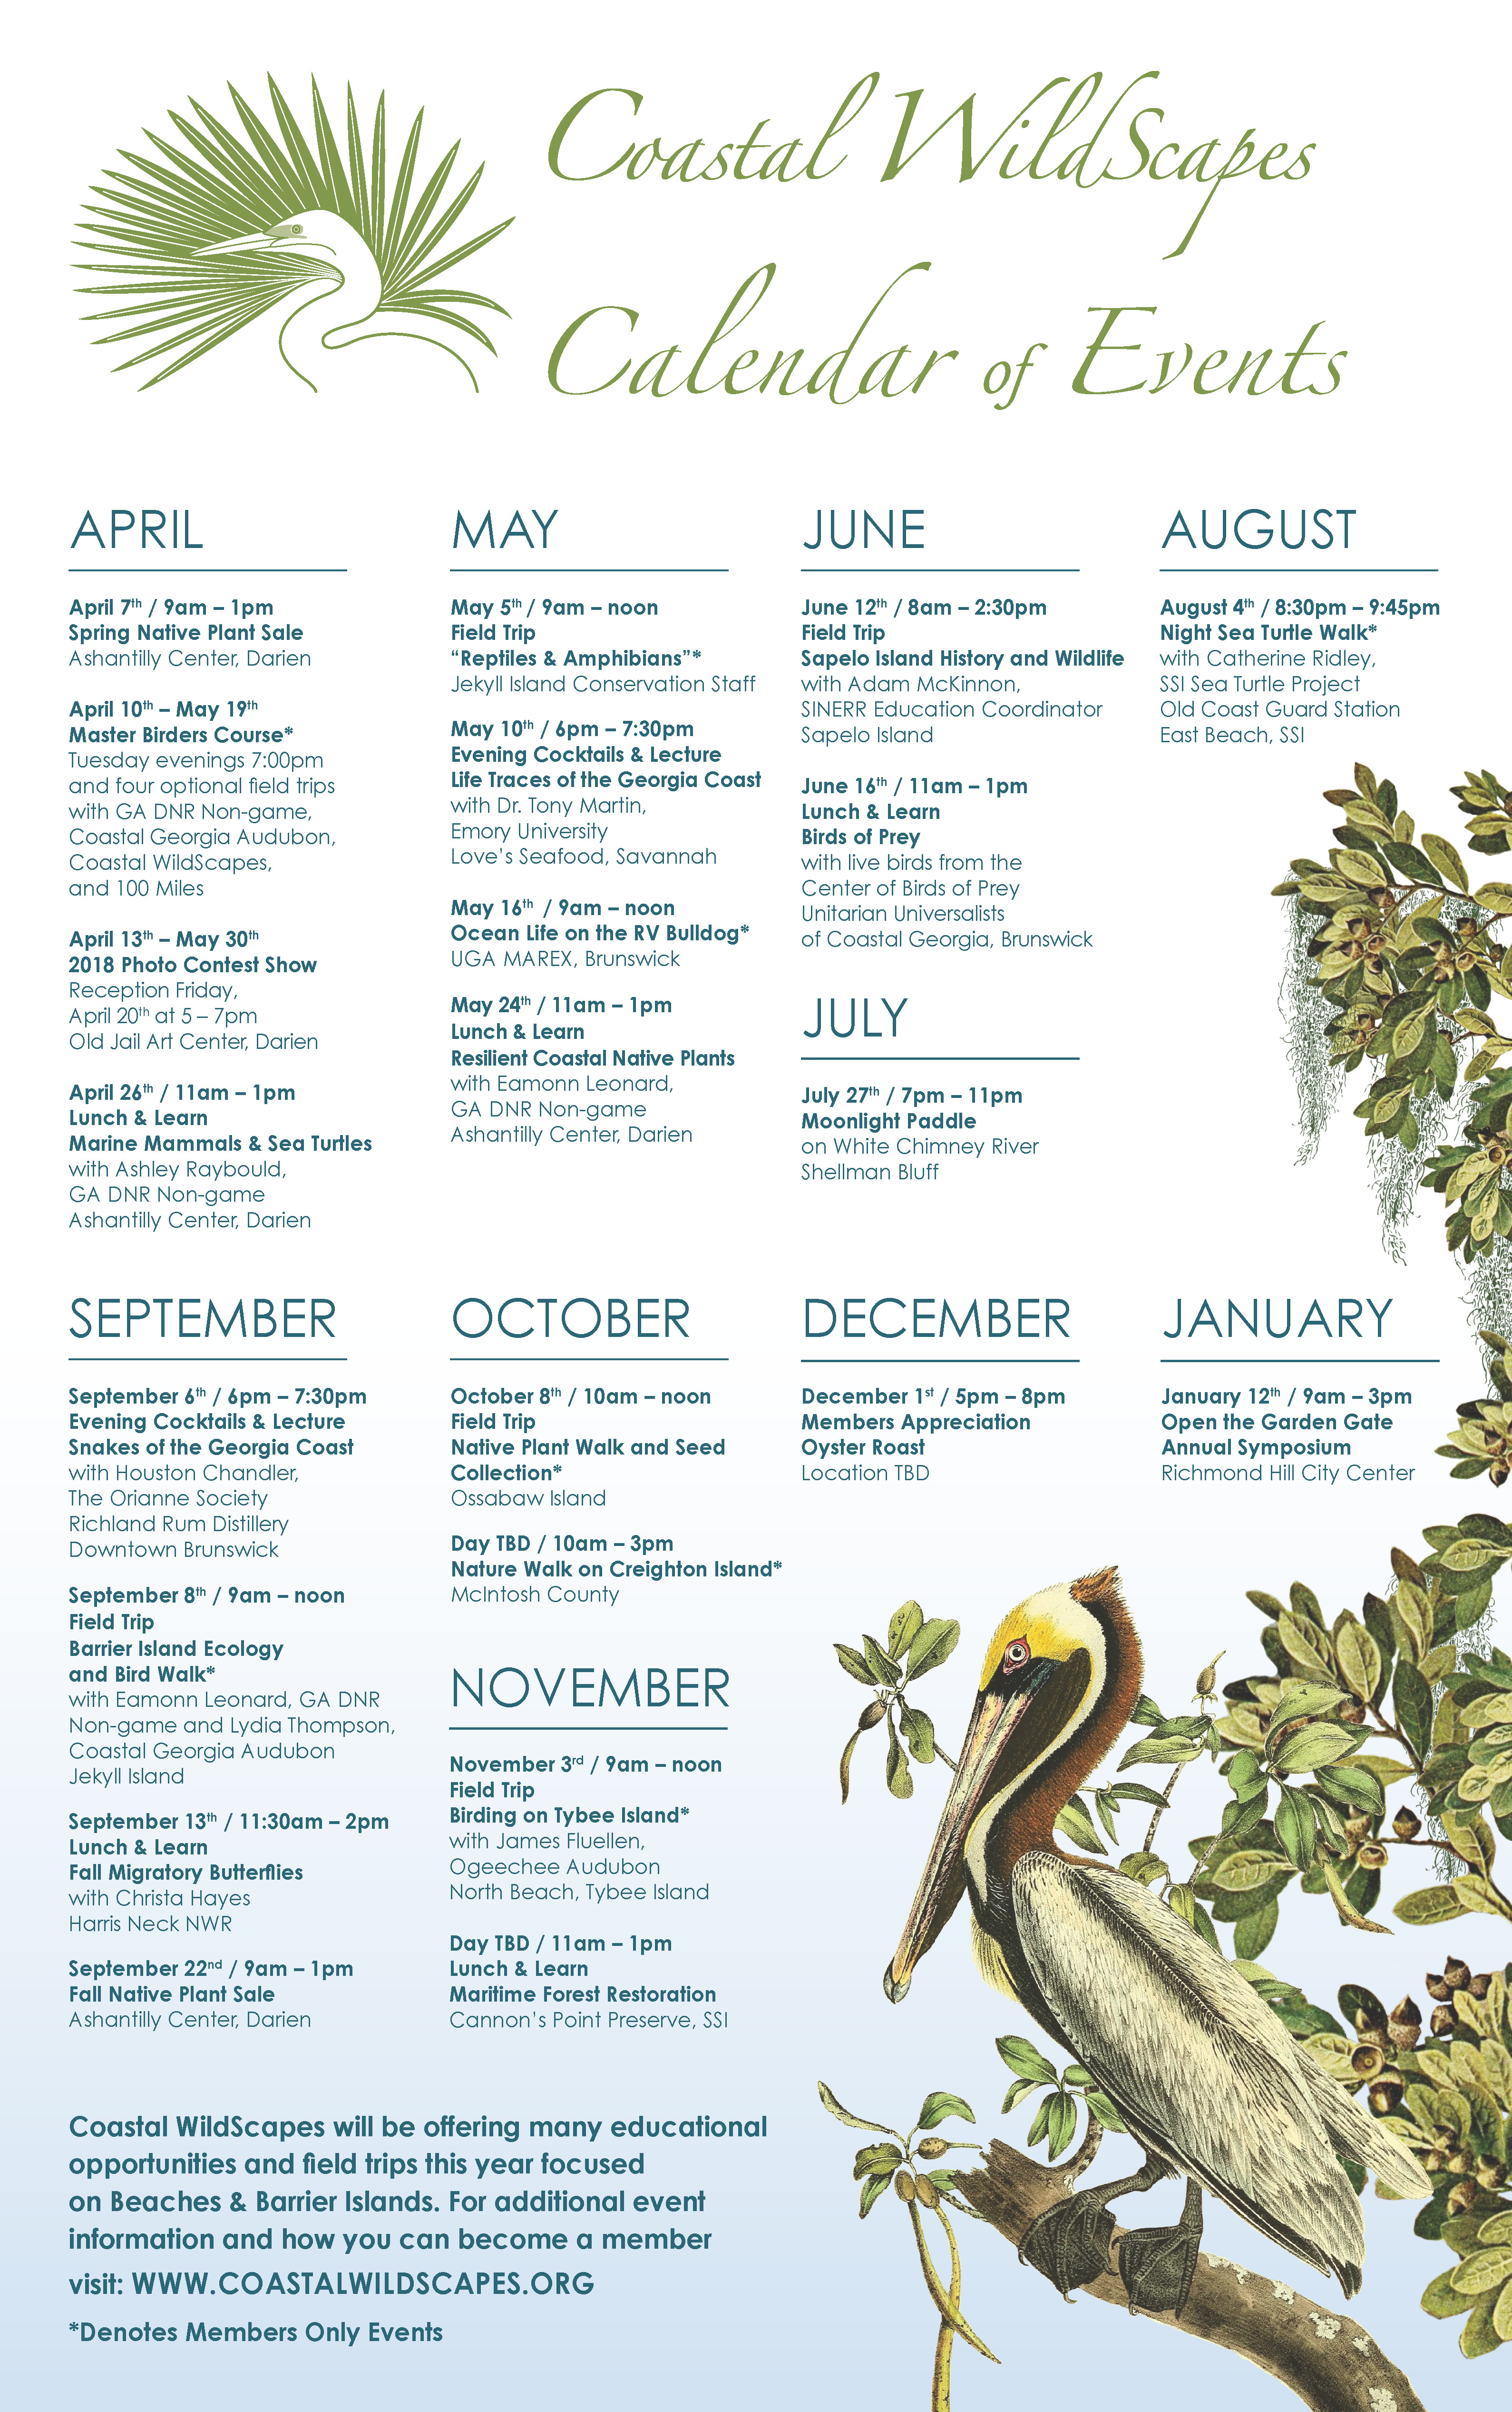
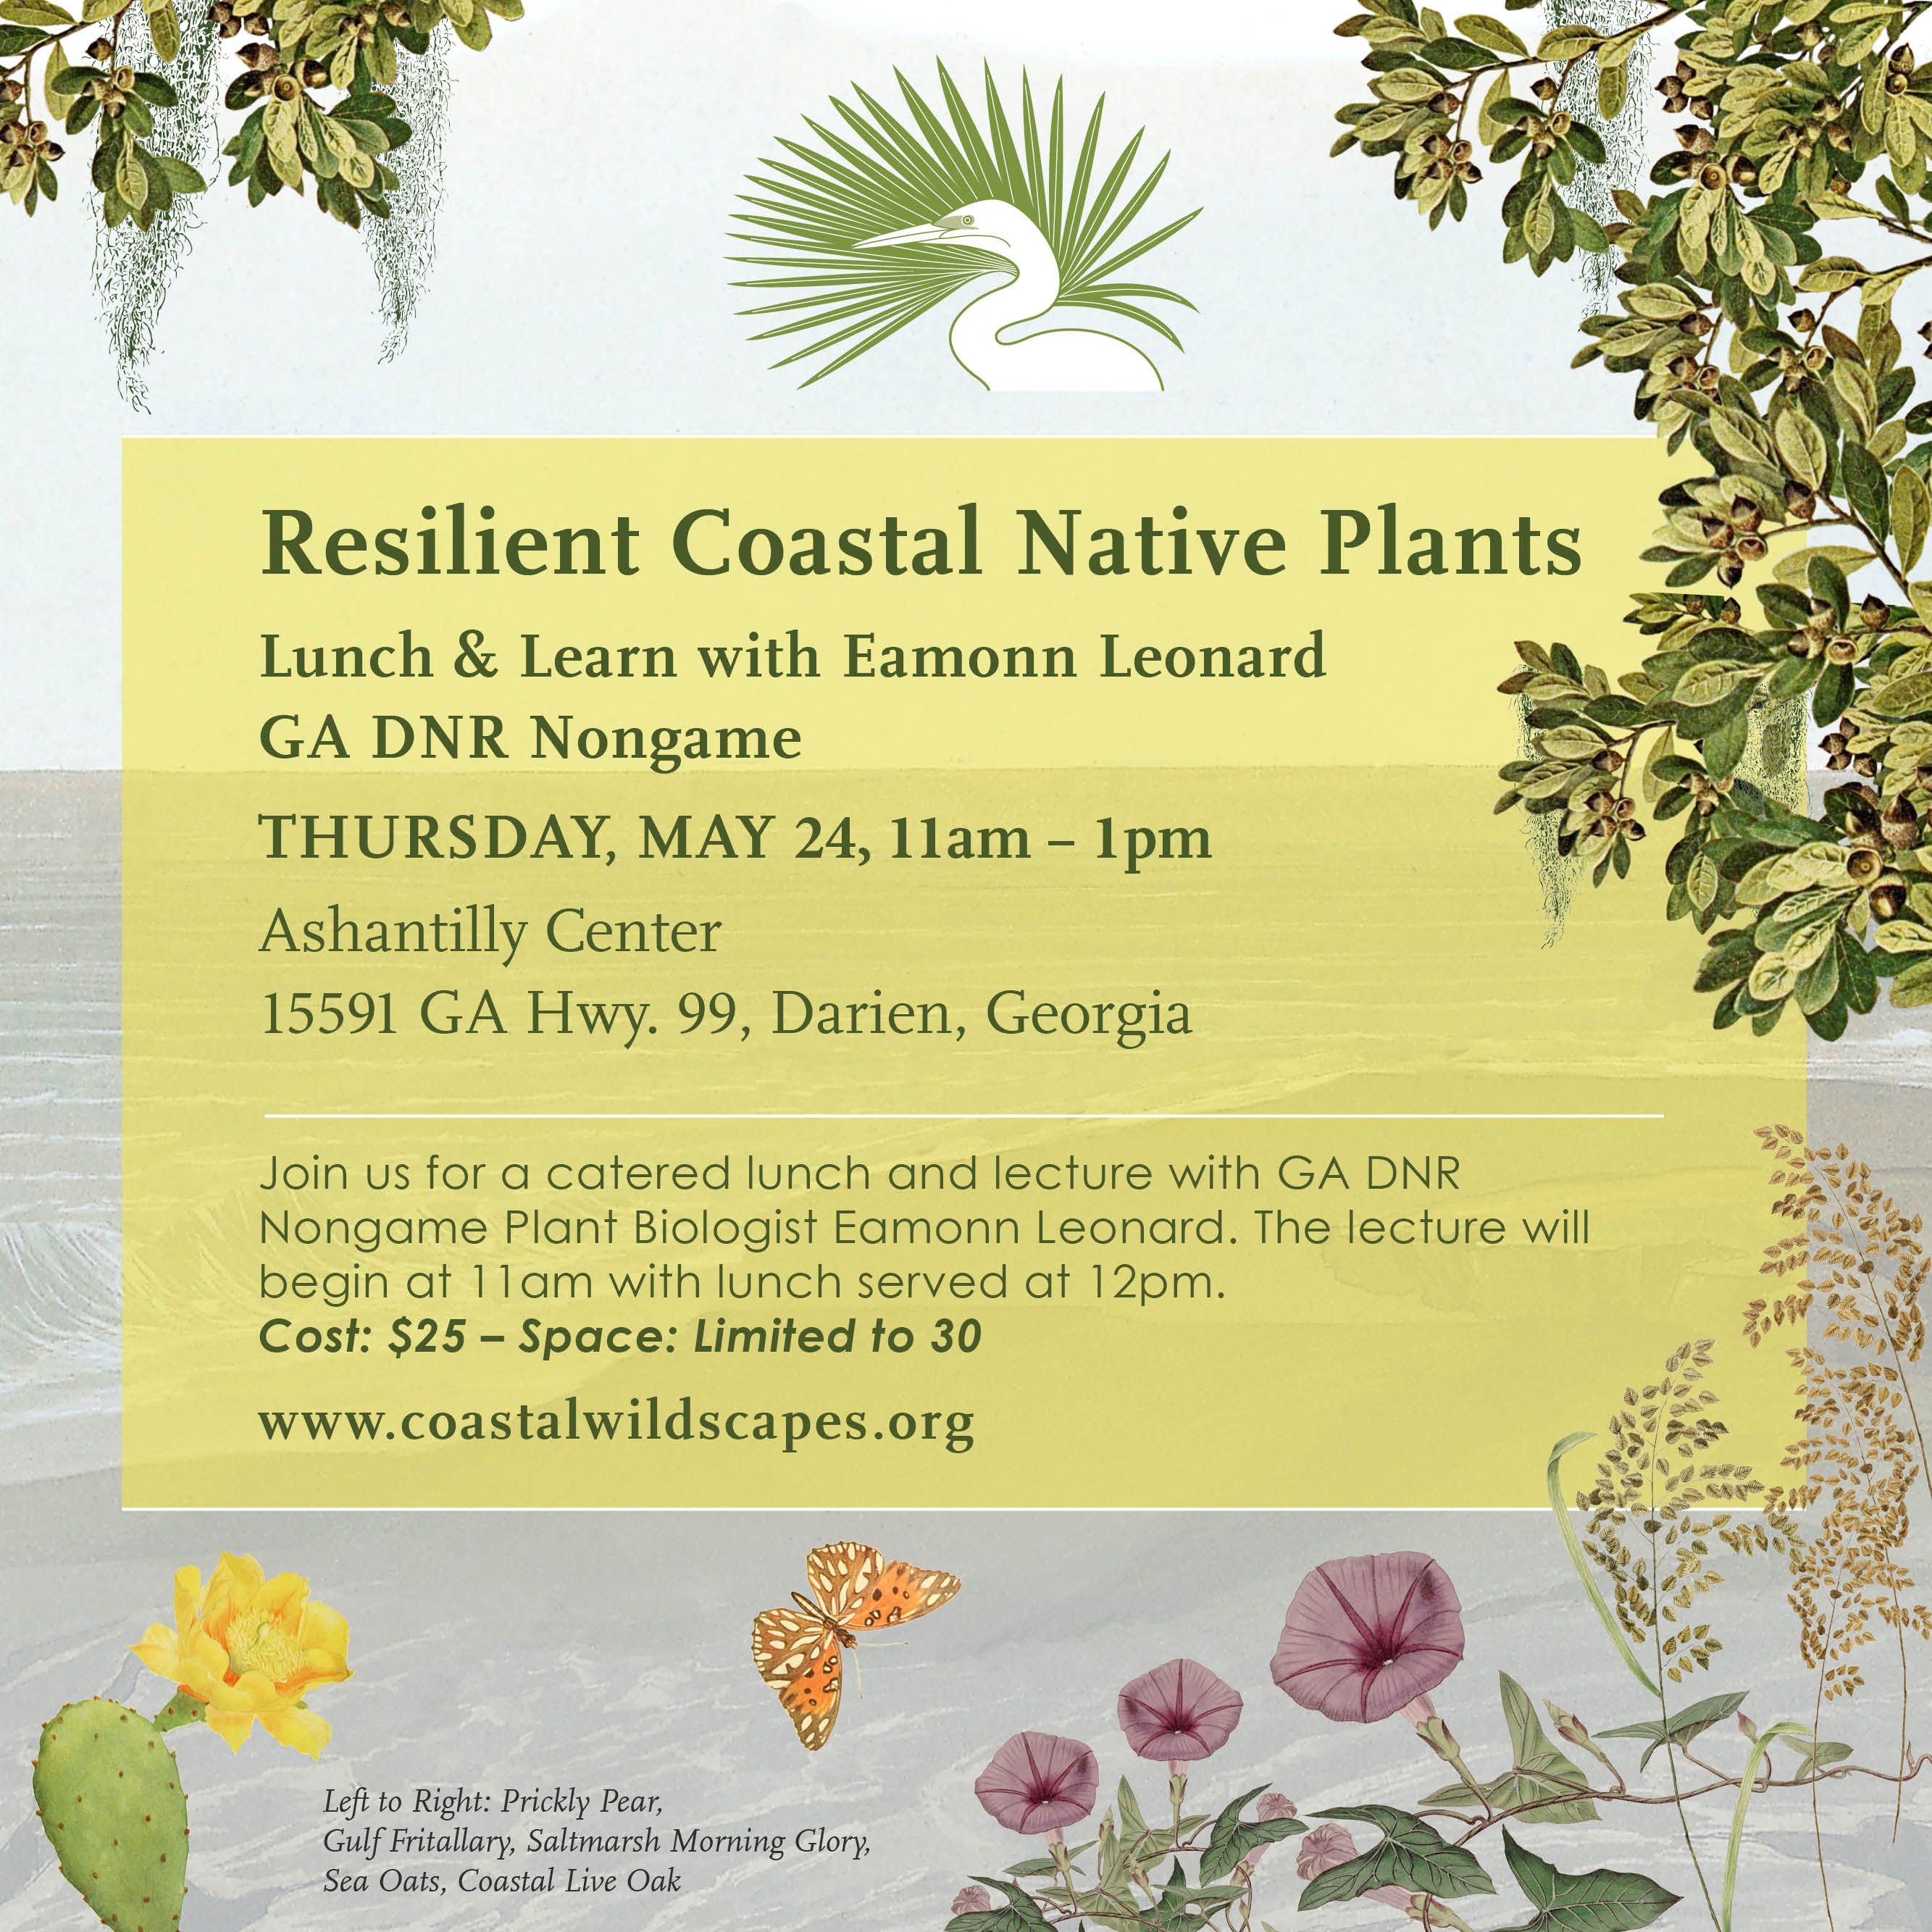

Slide 2
Resilient Coastal Native Plants
May 24th 2018
Eamonn Leonard

Slide 3
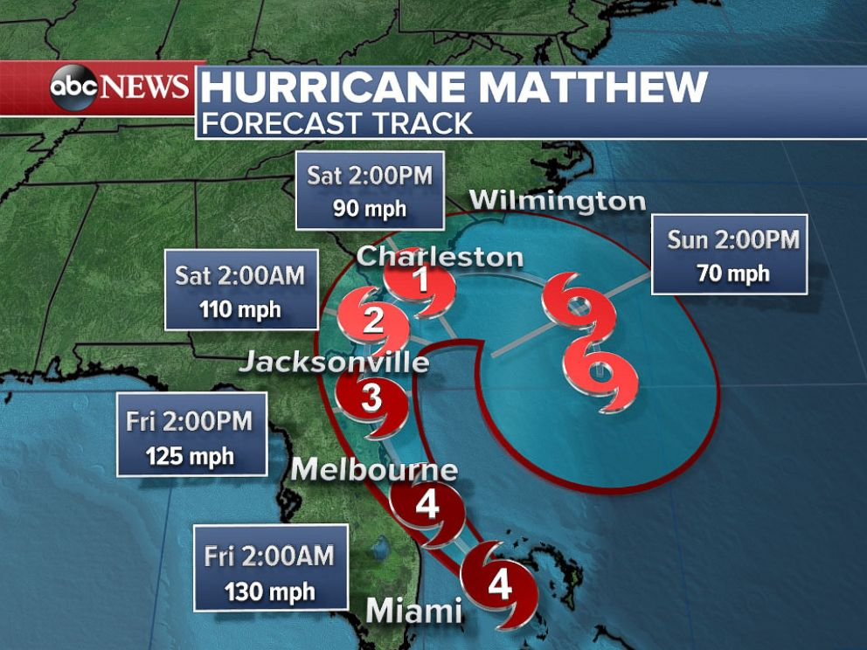
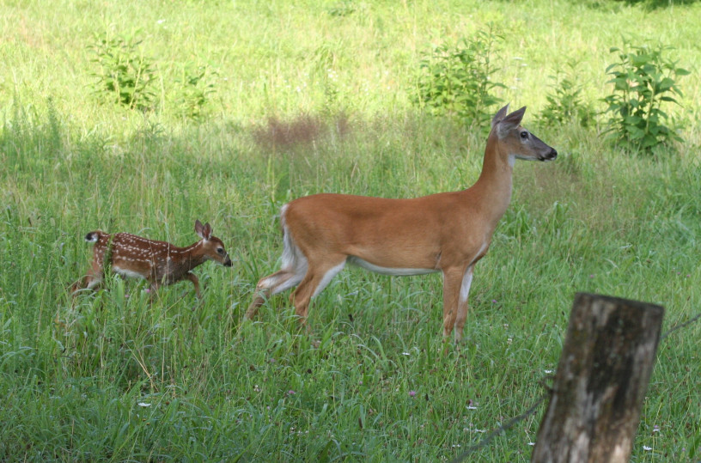
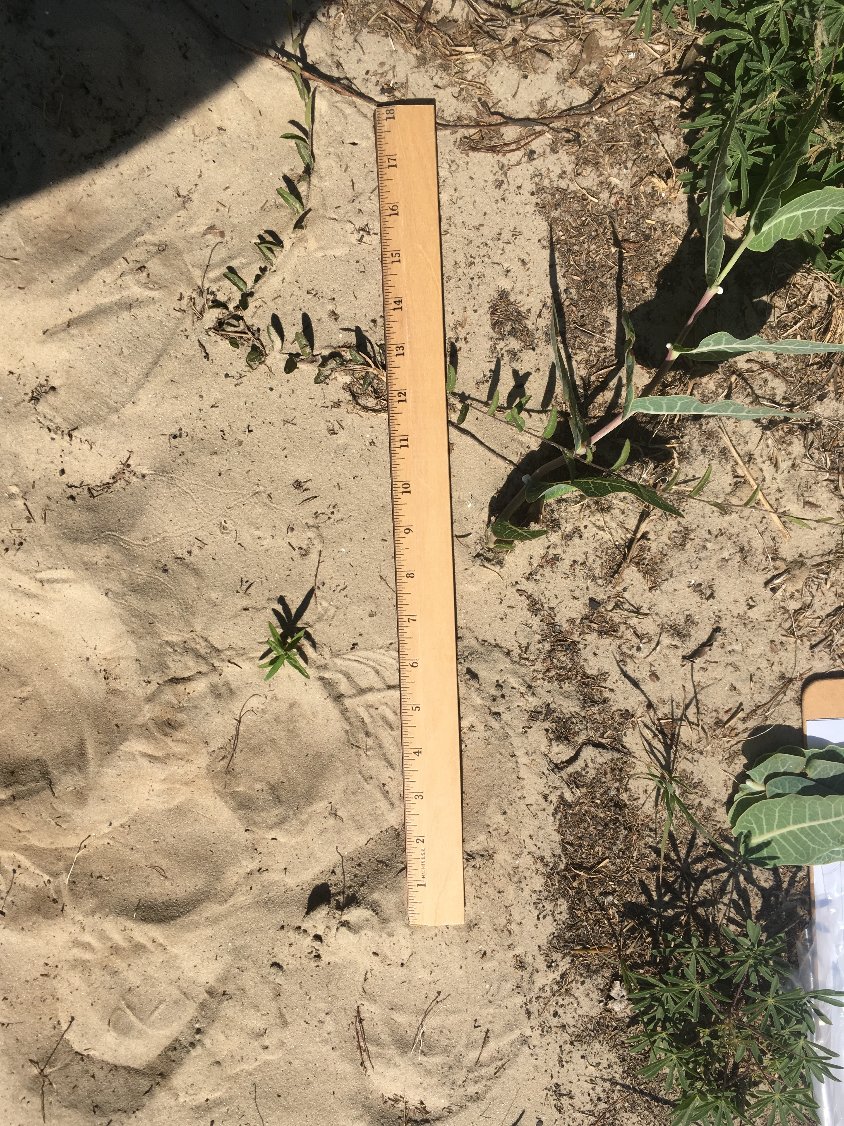
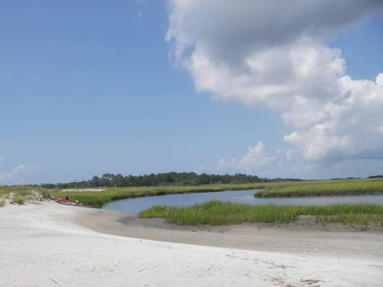
Coastal Conditions - Challenges
Poor soils
Deer
Blowing sands
High Temperatures
Storms
Salt Spray

Slide 4
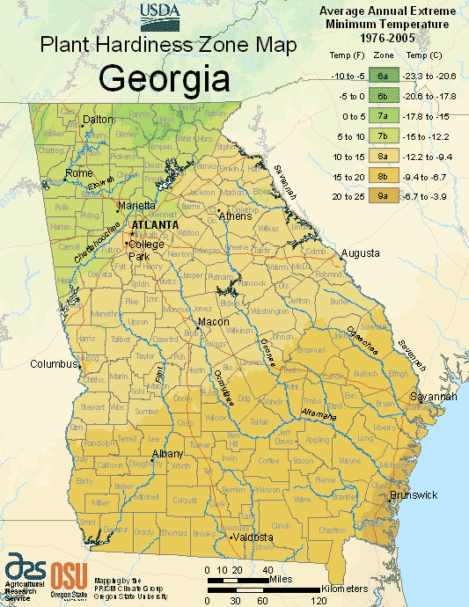

Slide 5
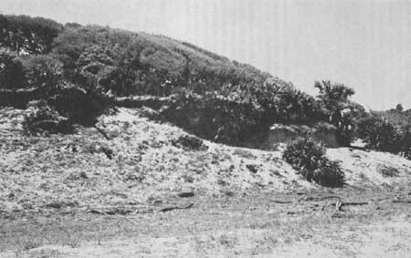
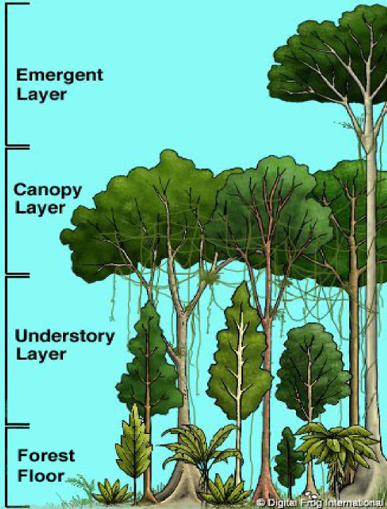
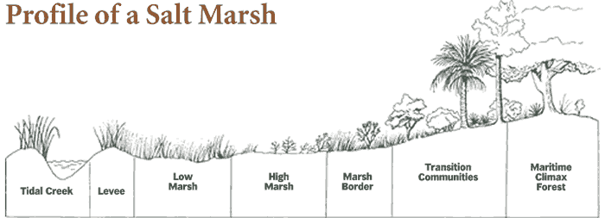
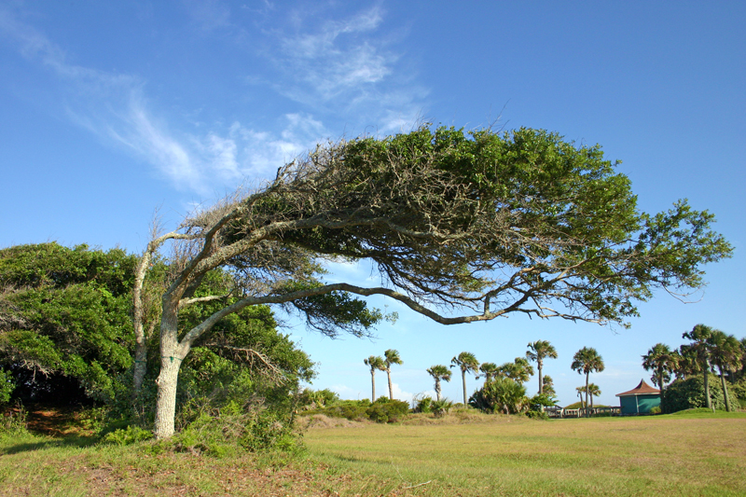
Storm resistant Species?
Proper Tree care
- Healthy root system
- Good limb structure
- Right species right site
Tree position
- Ocean side (full force of the winds)
- Landward side (some wind protection)
- Canopy Structure
- Intact composition
- Emergent trees

Slide 6
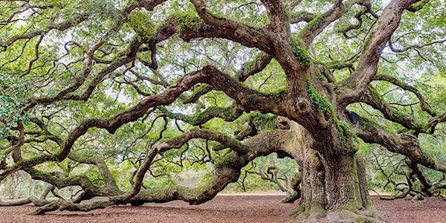
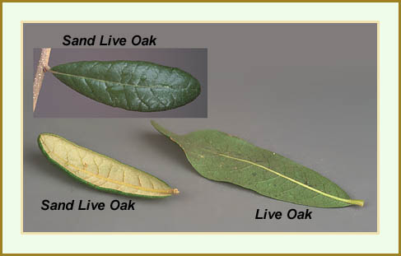
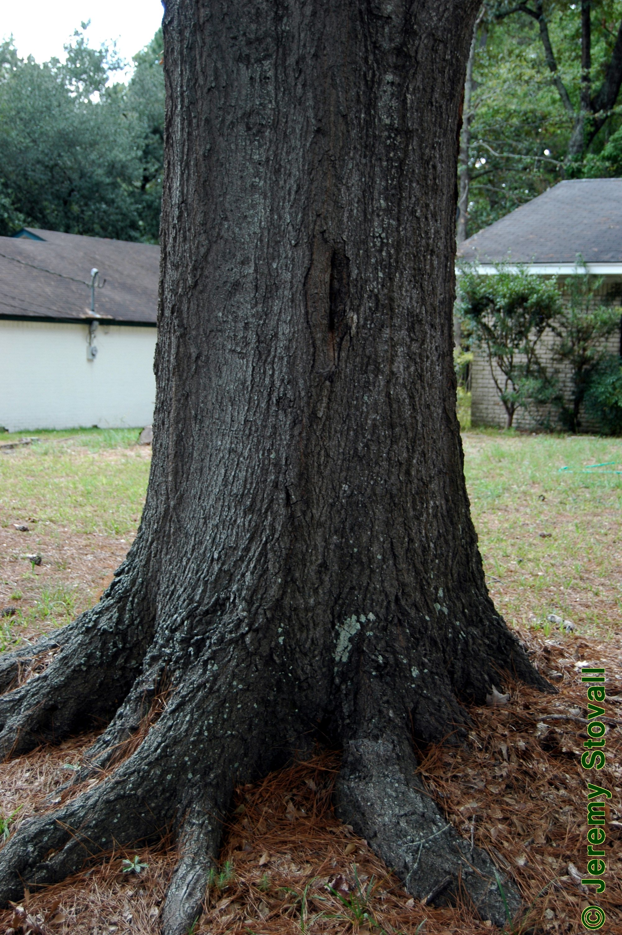
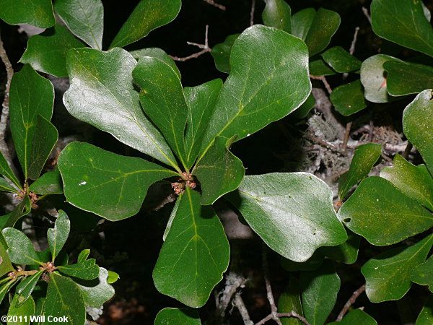
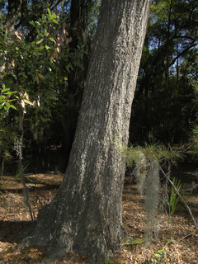
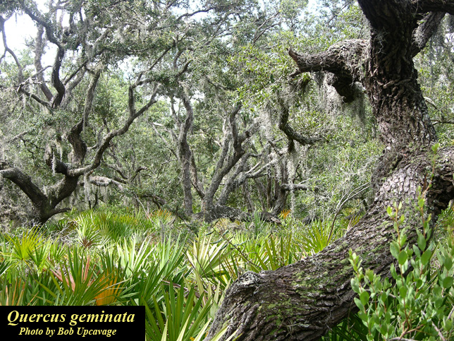
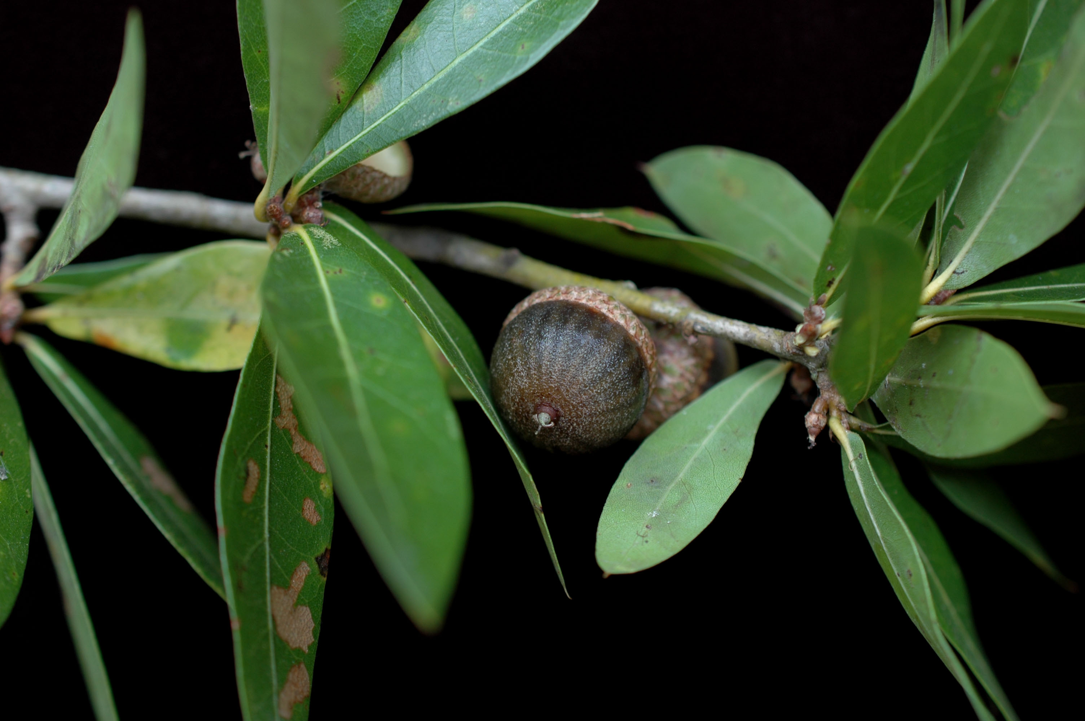
Storm resistant Species?
Specific Species Recommendation
Oak species – tend to be strong
Live Oak (Quercus virginiana), Sand Live oak (Q. geminata)
Exceptions: Water Oak (Q. nigra, Sand Laurel Oak (Q. hemisphaerica).
Live Oak
Water Oak
Sand Laurel Oak
Water Oak
Sand Live Oak
Sand Laurel Oak

Slide 7
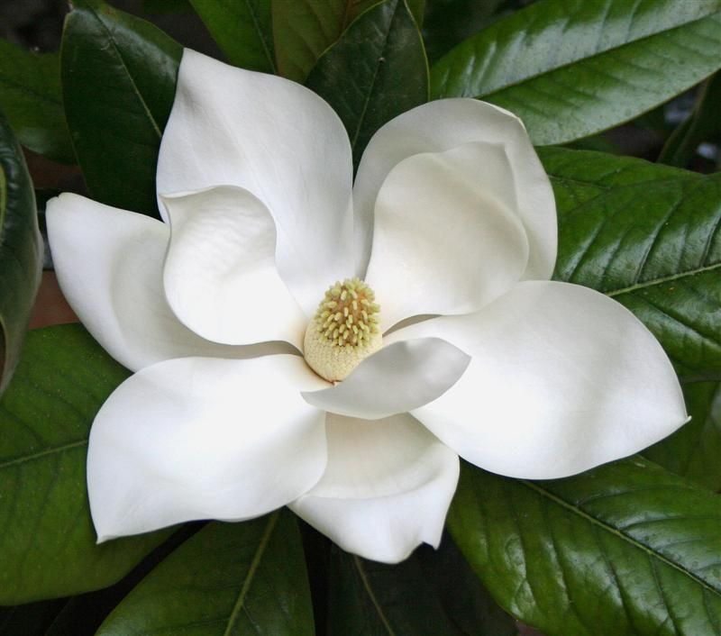
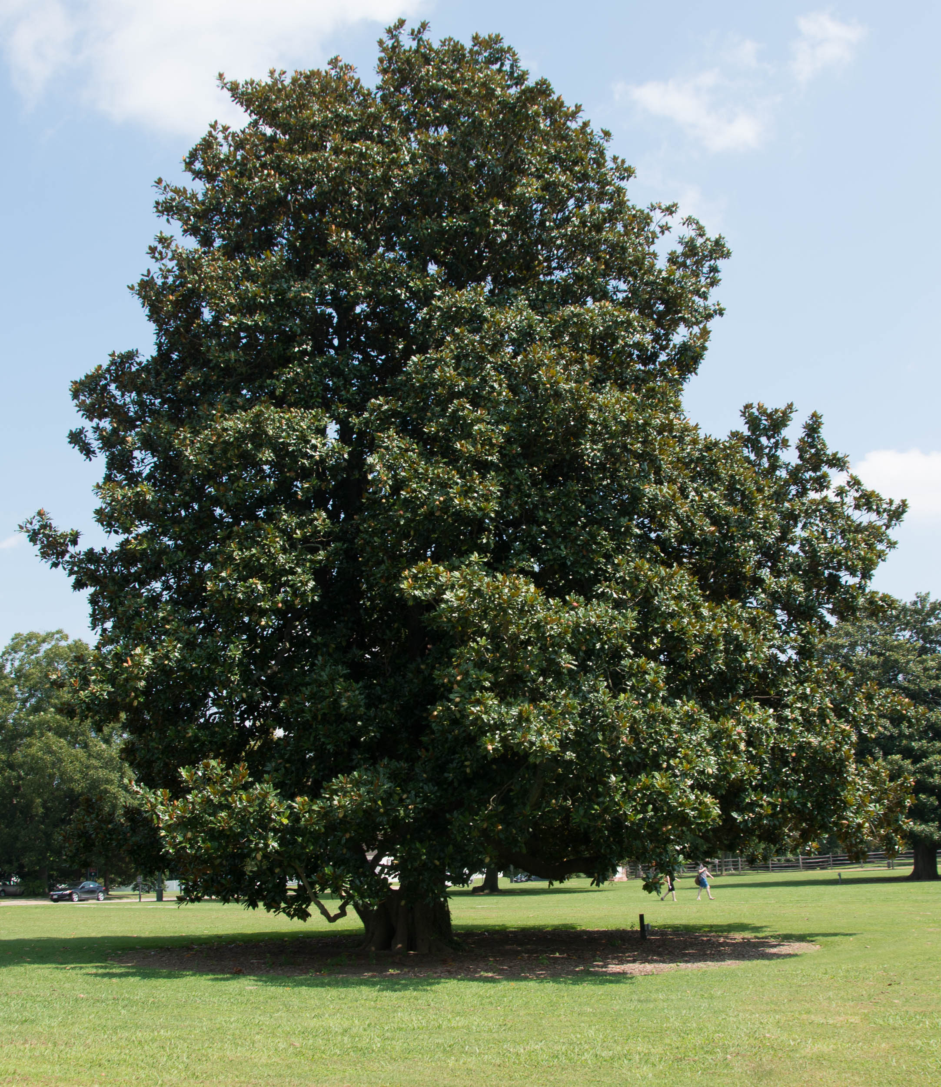
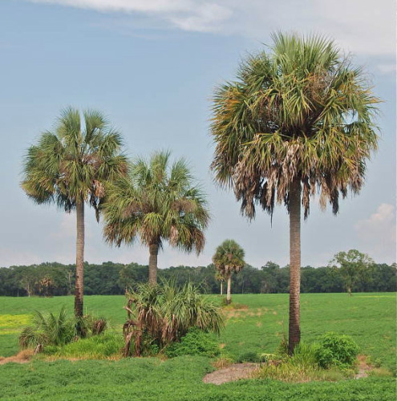
Storm resistant Species?
Specific Species Recommendation
Other Species
Southern Magnolia (Magnolia grandiflora)
Cabbage Palmetto (Sabal Palmetto)
Southern Magnolia
Cabbage Palmetto
Southern Magnolia

Slide 8
Salt Tolerant – Salt spray vs Soil salinity (inundation)

Slide 9
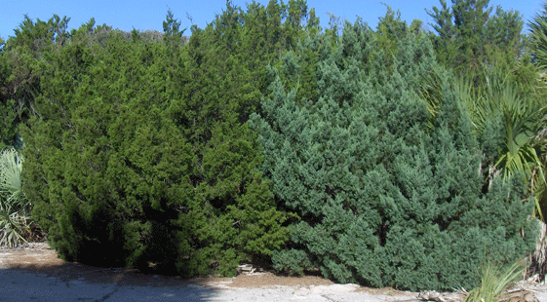
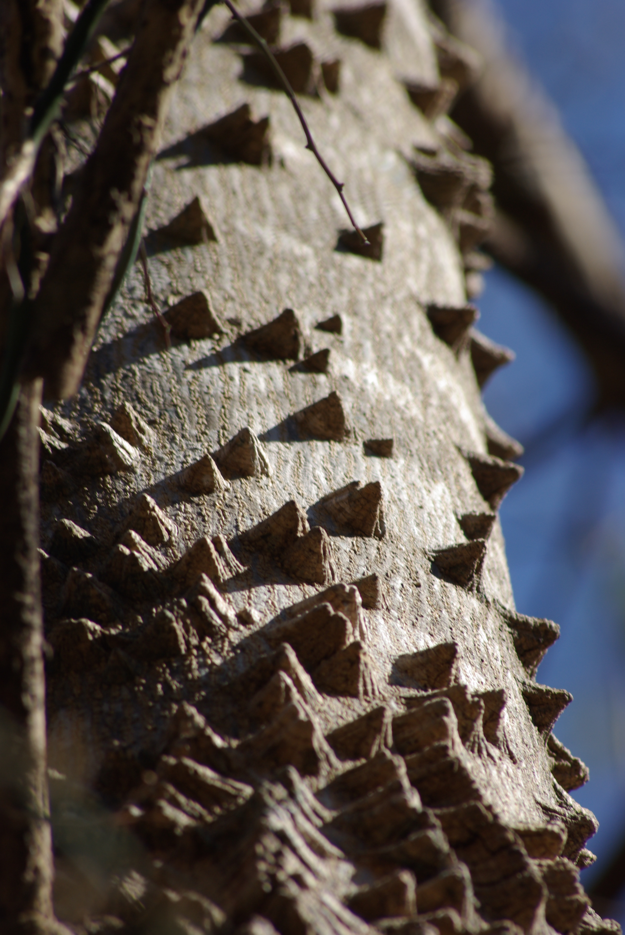
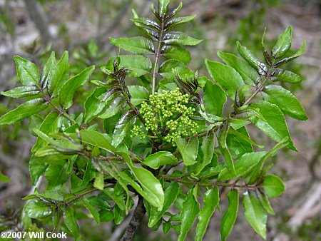
Salt Tolerant - Trees
Specific Species Recommendation
Coastal cedar (Juniperus silicicola) – high salt spray & moderate soil salinity tolerance
Hercules’ club (Zanthoxylum clava-herculis) – moderate salt spray
Live Oak (Quercus virginiana) – high salt spray tolerance & moderate soil salinity tolerance
Sand Live Oak (Q. geminata) – moderate salt spray tolerance & low soil salinity tolerance
Southern Magnolia (Magnolia grandiflora) – moderate salt spray & soil salinity tolerance
Cabbage palm (Sabal palmetto) – high salt spray & low soil salinity tolerance
Coastal Cedar
Southern Magnolia
Hercules’ club
Live Oak
Sand Live Oak
Cabbage Palmetto

Slide 10
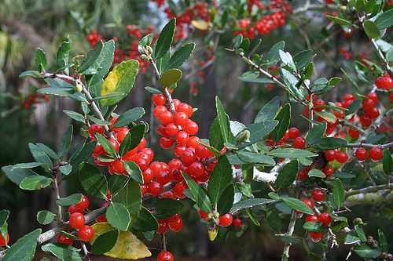
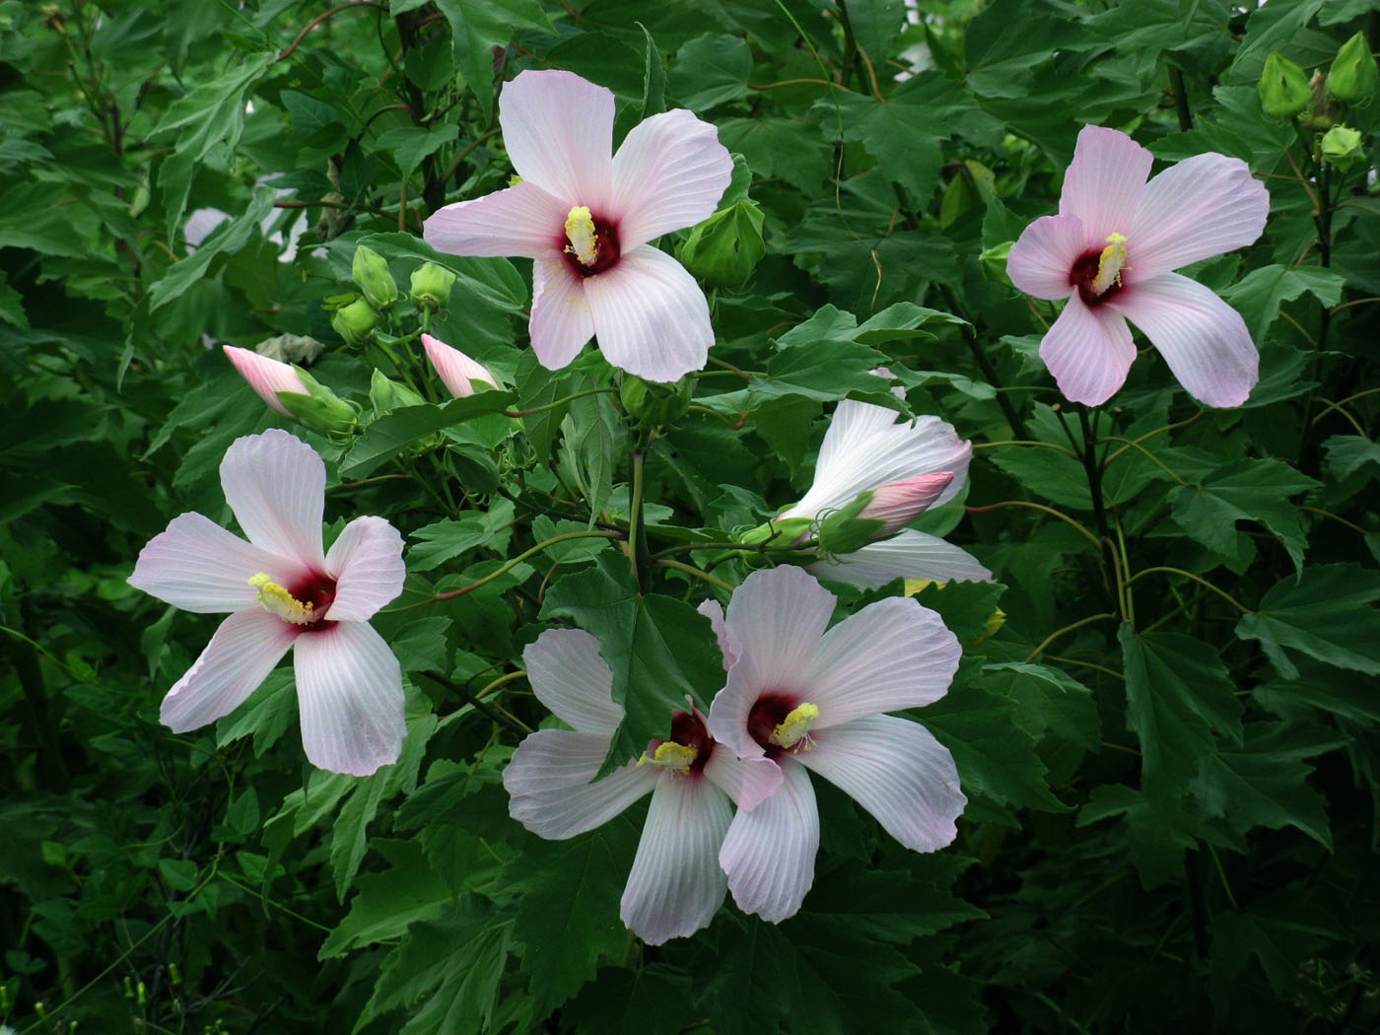
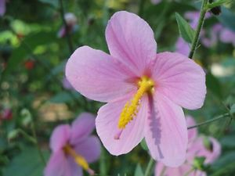
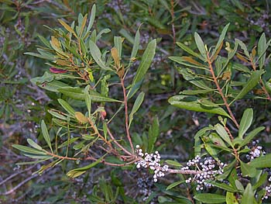
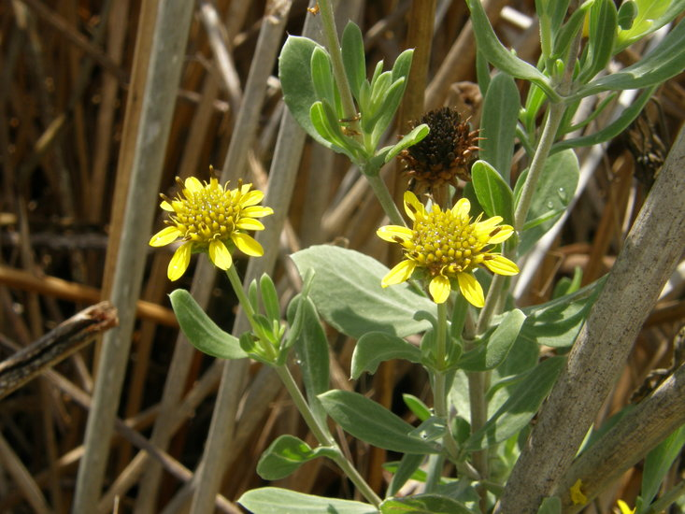
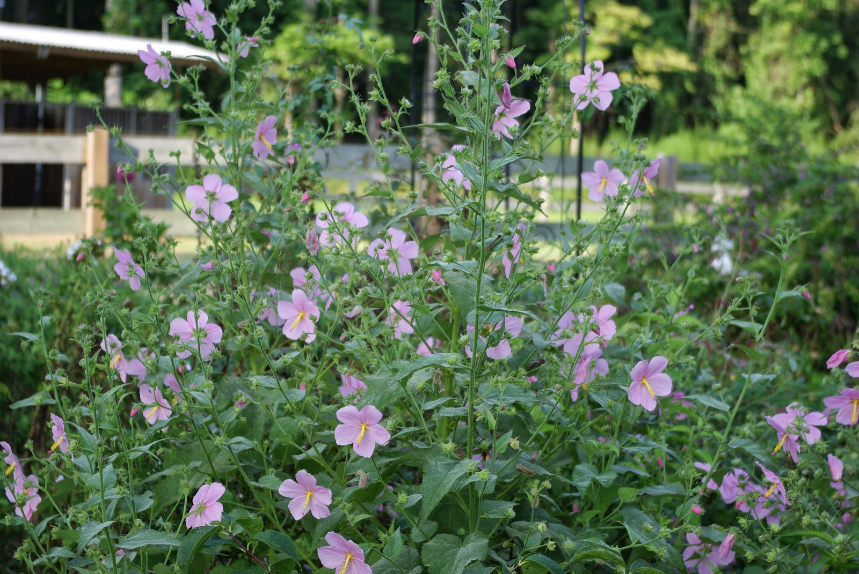
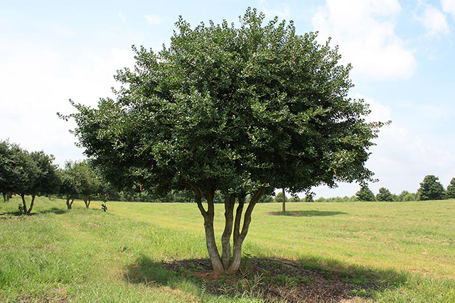
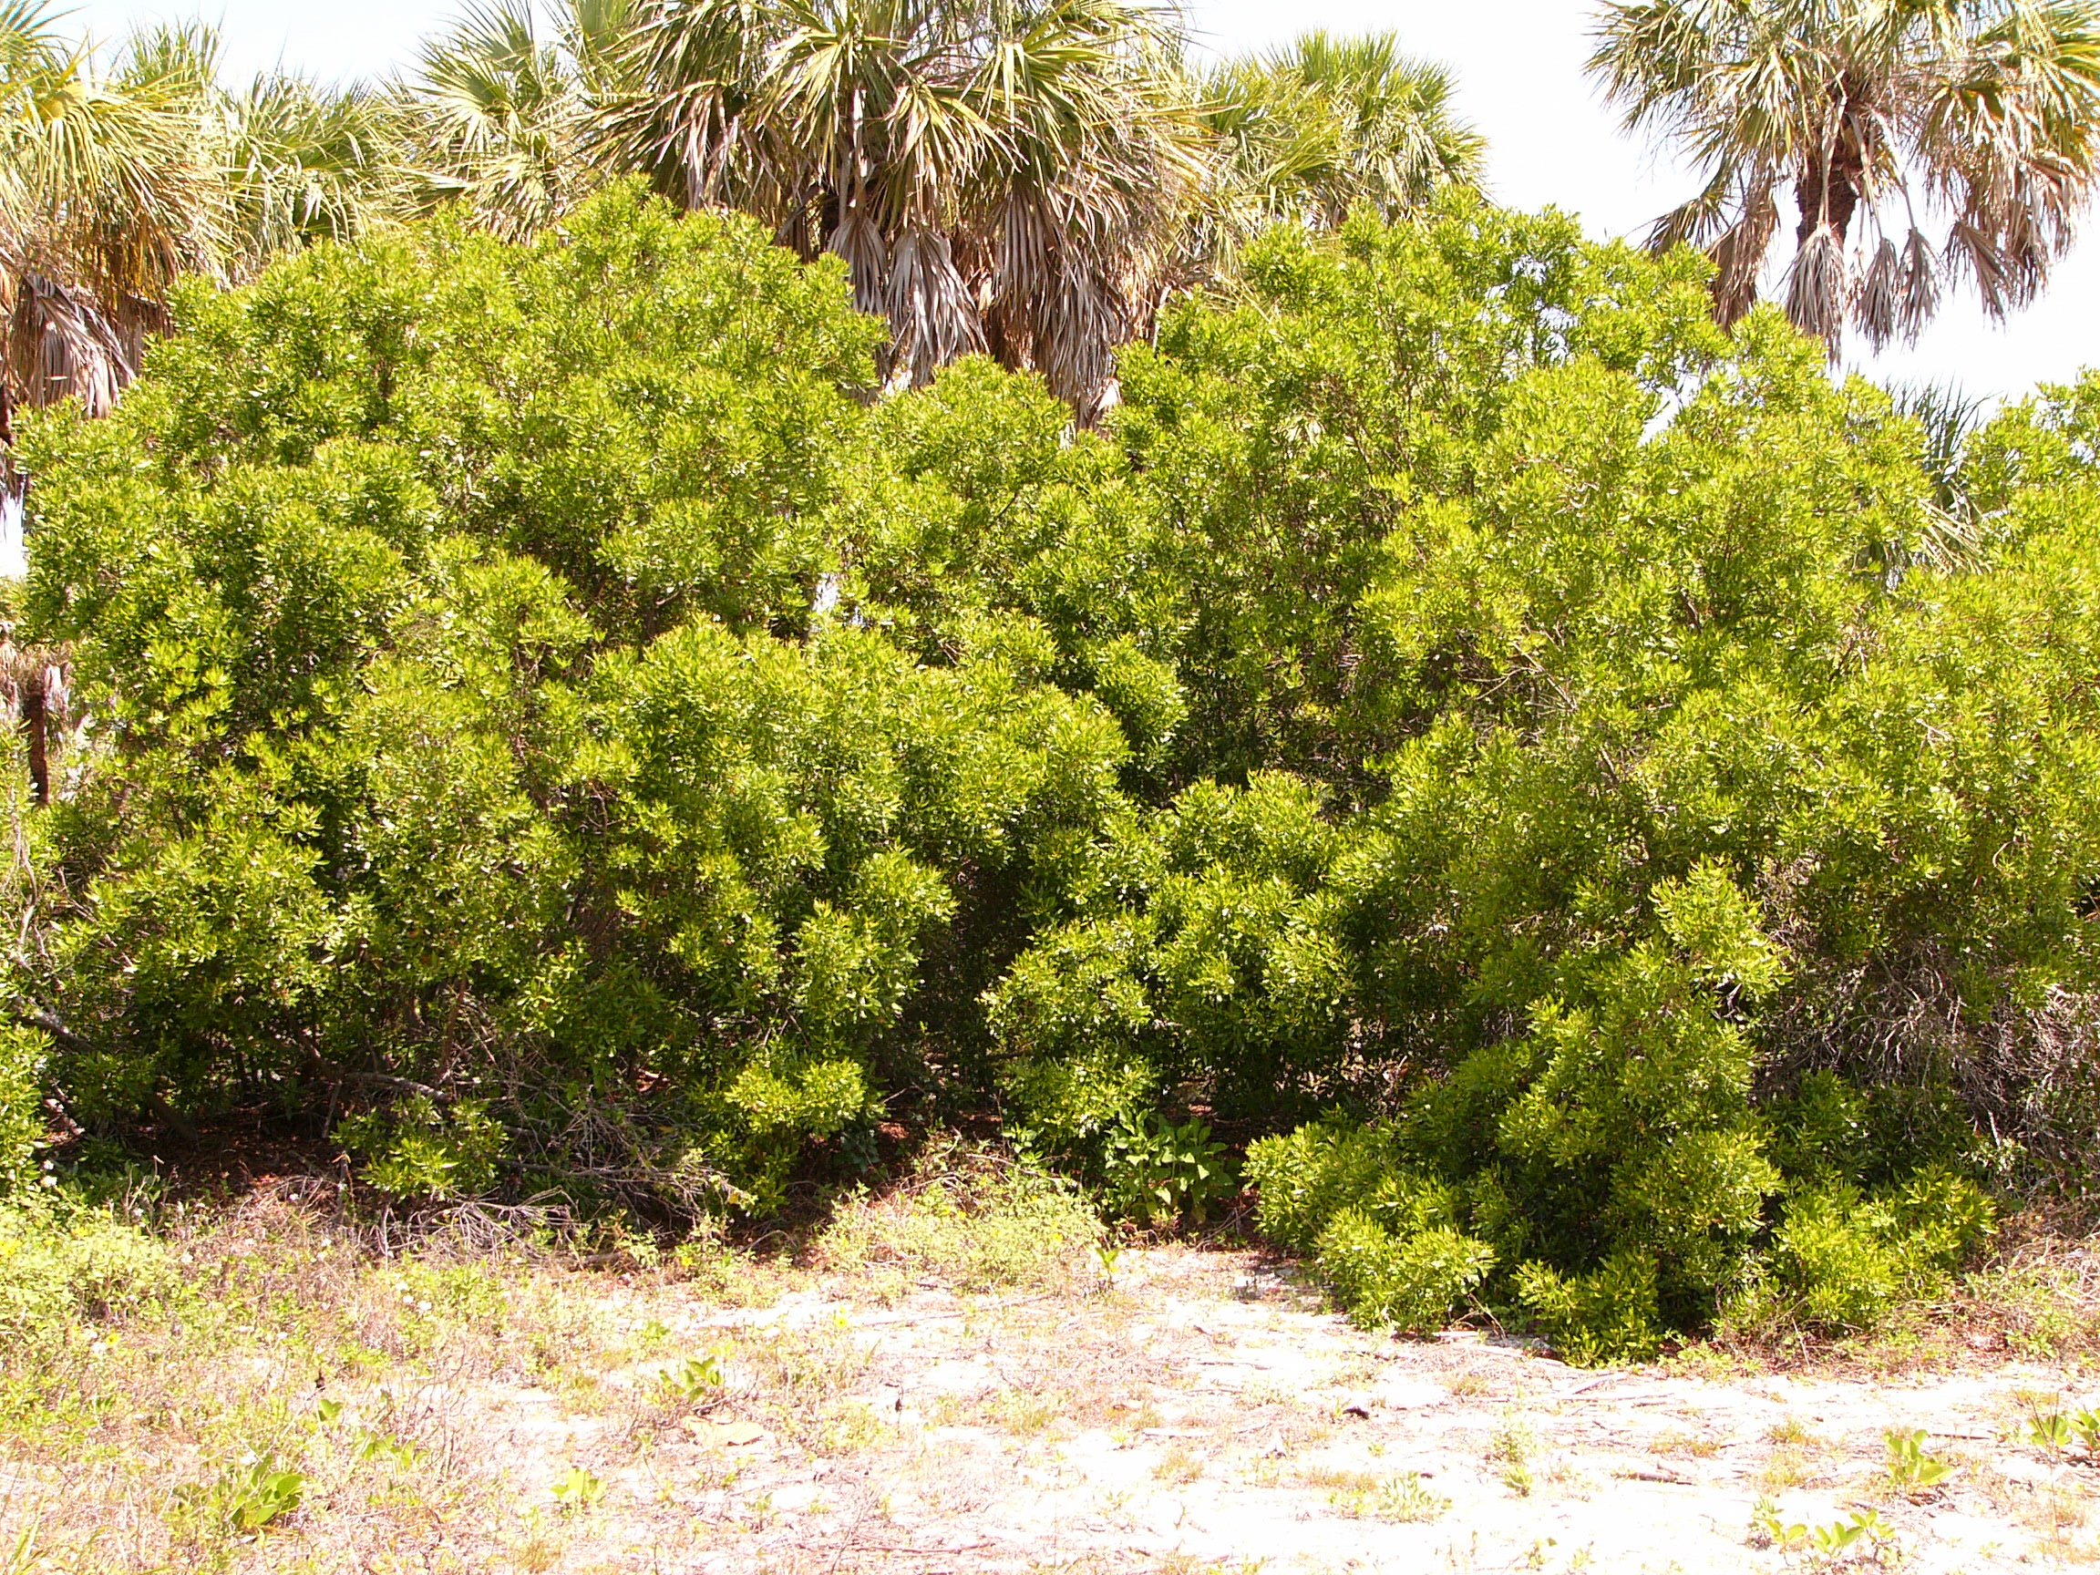
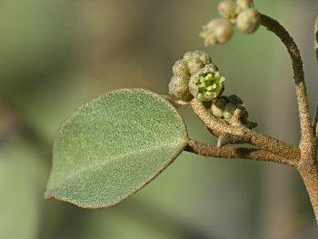
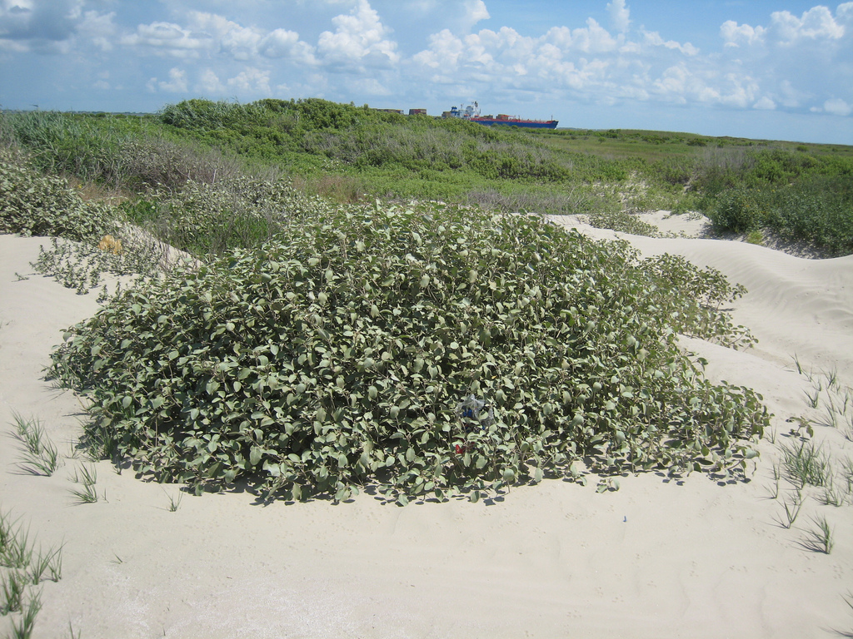
Salt Tolerant - Shrubs
Specific Species Recommendation
Seashore Mallow (Kosteletzkya virginiana) – saline and brackish tolerant & salt spray
Yaupon Holly (Ilex vomitoria) – moderate soil salinity & salt spray tolerant
Wax myrtle (Morella cerifera)– high salt spray & moderate soil salinity tolerance
Swamp rosemallow (Hibiscus grandiflorus) – moderate soil salinity & spray?
Gulf croton (Croton punctatus) – low salt water tolerance & moderate salt spray
Sea oxeye daisy (Borrichea frutescens) – high salt spray tolerance & brackish water inundation.
Swamp rosemallow
Sea oxeye daisy
Gulf croton
Yaupon holly
Seashore mallow
Wax myrtle

Slide 11
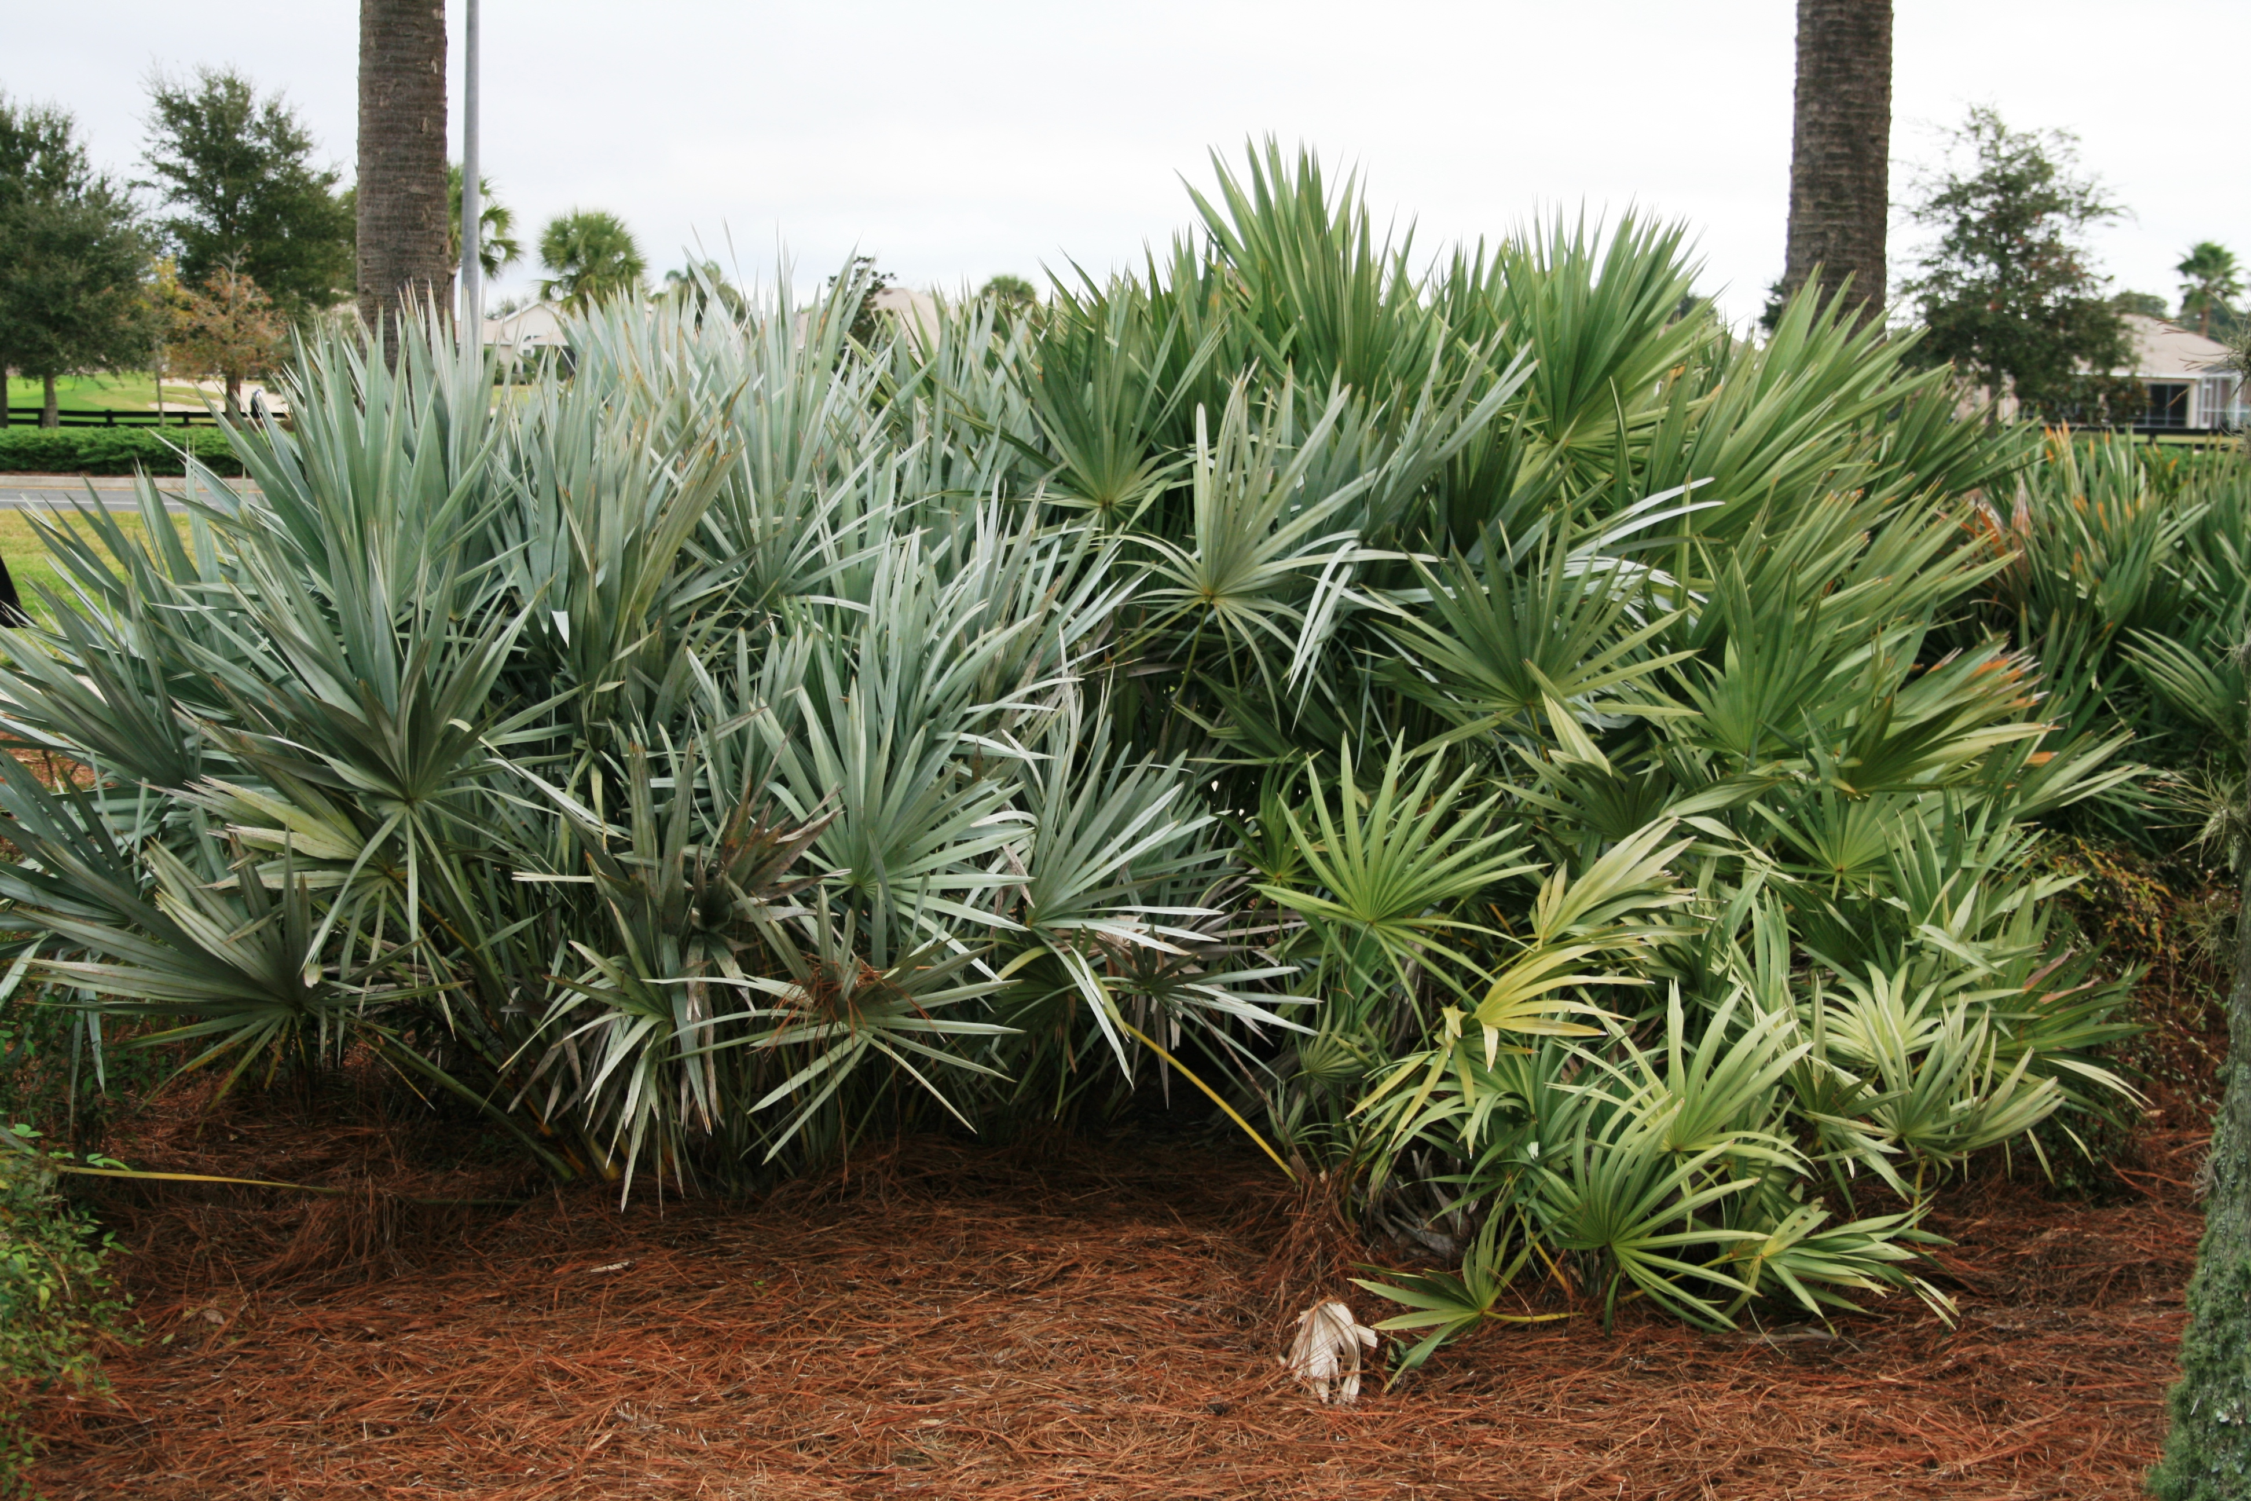
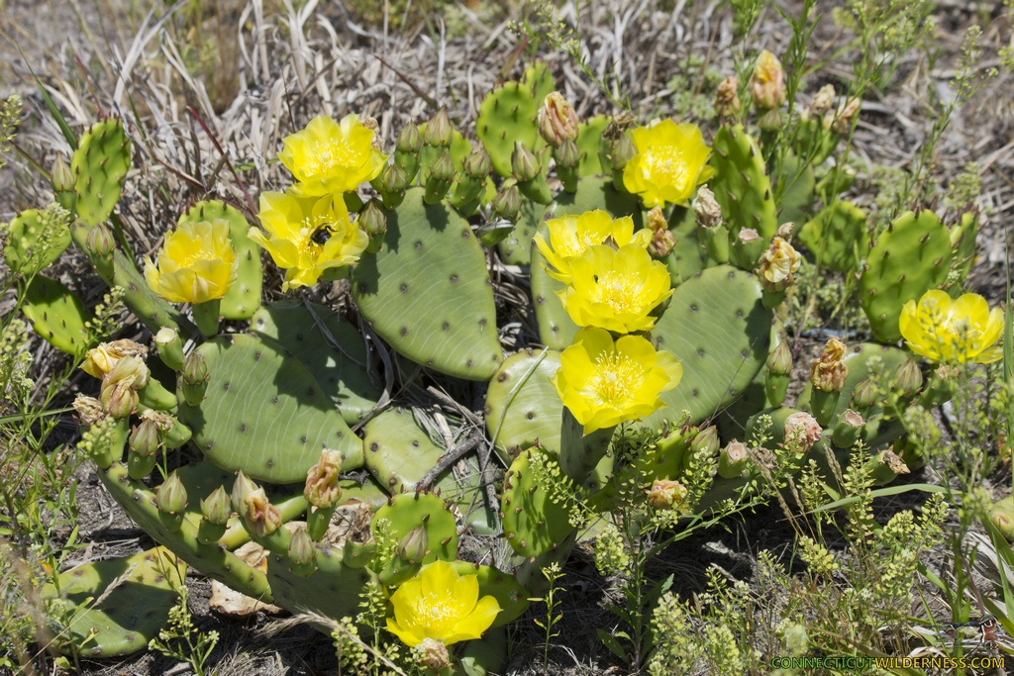
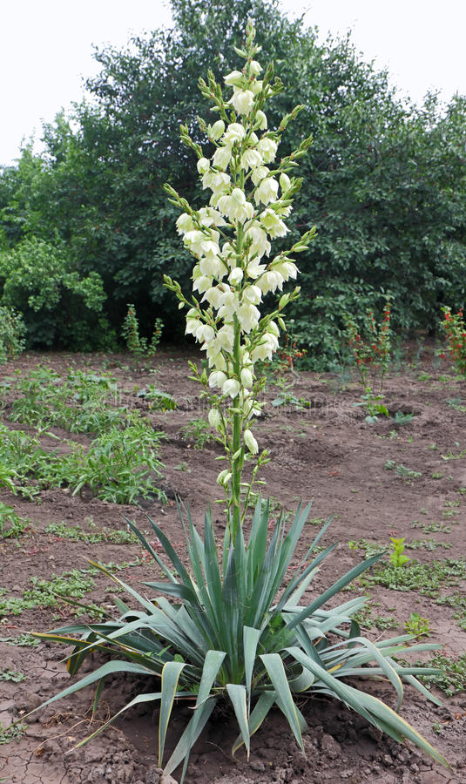
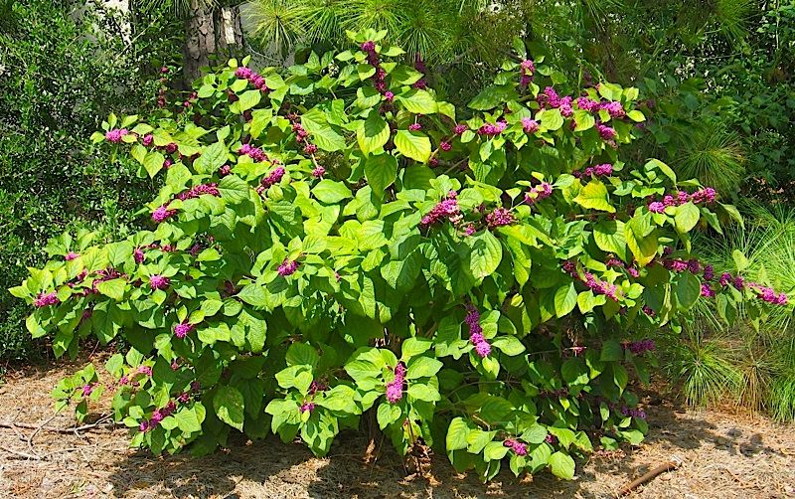
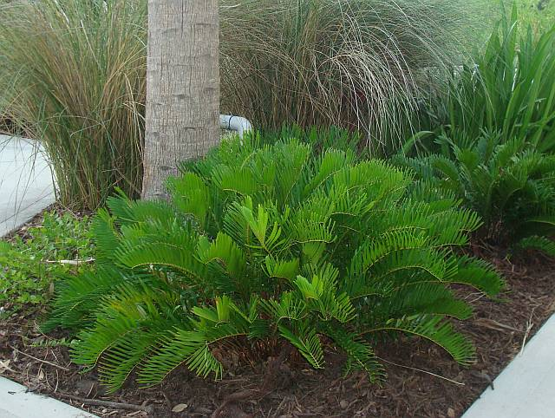
Salt Tolerant - Shrubs
Specific Species Recommendation
Saw palmetto (Saw Palmetto) – moderate salt spray tolerance
Coontie (Zamia floridana) – high salt spray tolerance & low soil salinity tolerance
Eastern prickly pear (Opuntia humifusa) – moderate salt spray tolerance & low soil salinity tolerance
Beauty berry (Callicarpa americana) - moderate salt spray tolerance & low soil salinity tolerance
Adam’s needle (Yucca filamentosa) – spray & moderate soil salinity (not wet)
Eastern prickly pear
Saw palmetto
Coontie
Beauty berry
Adam’s needle

Slide 12
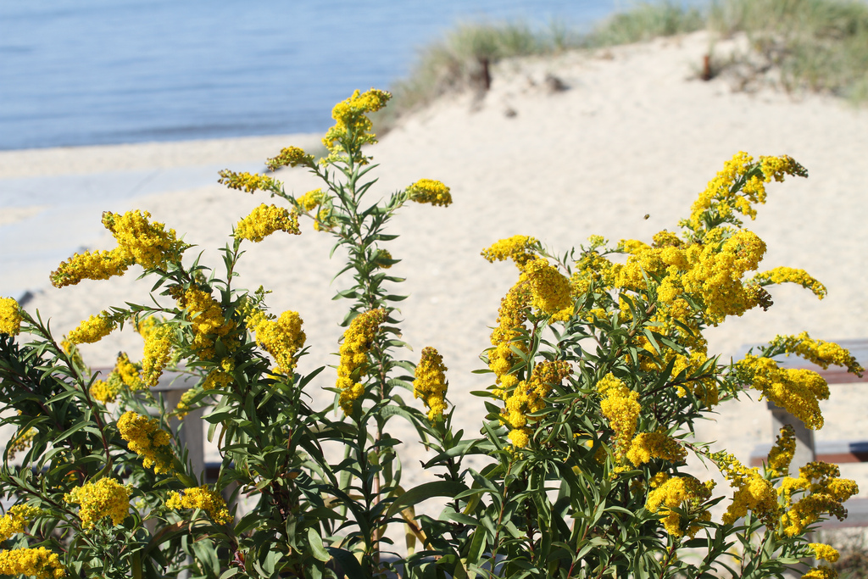
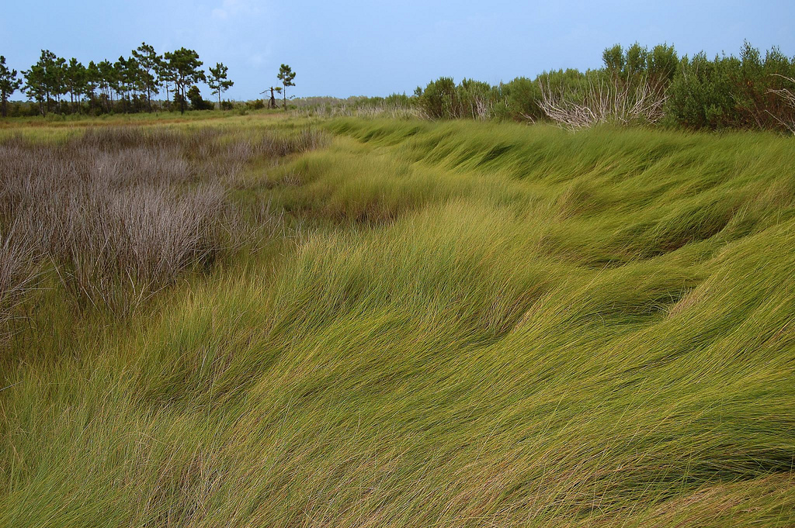
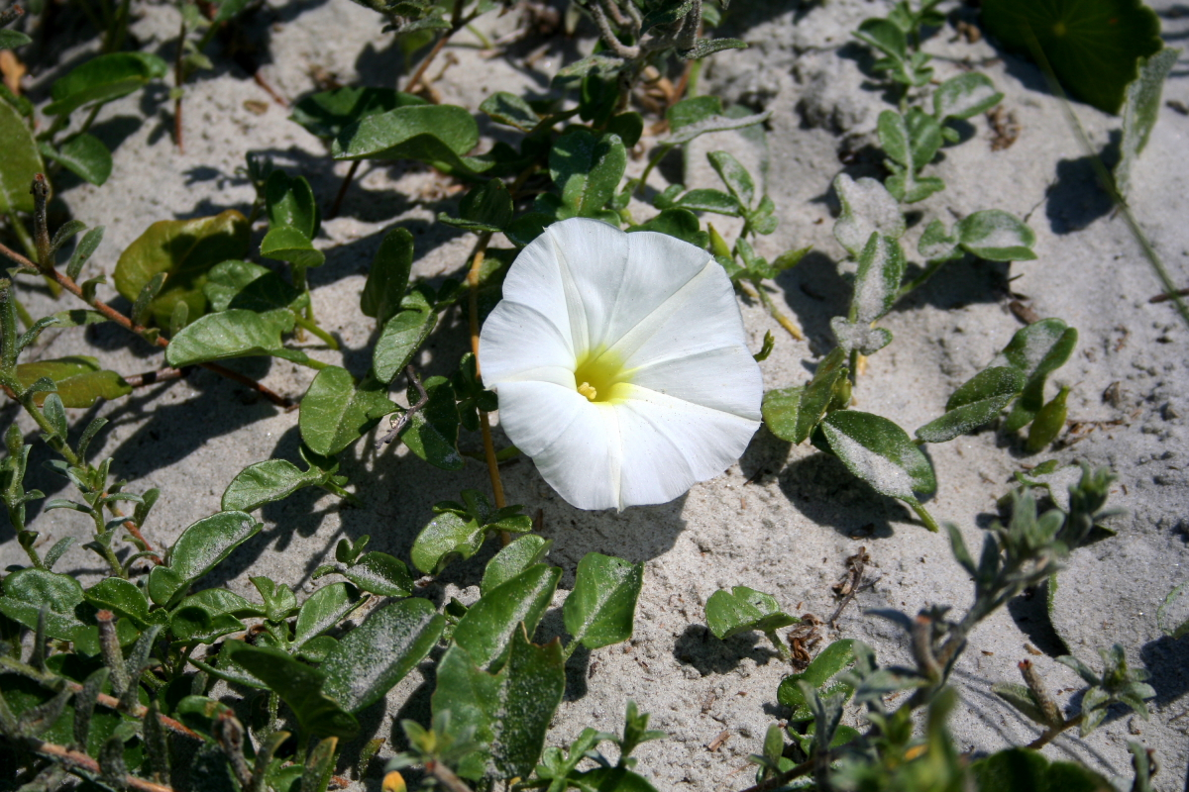
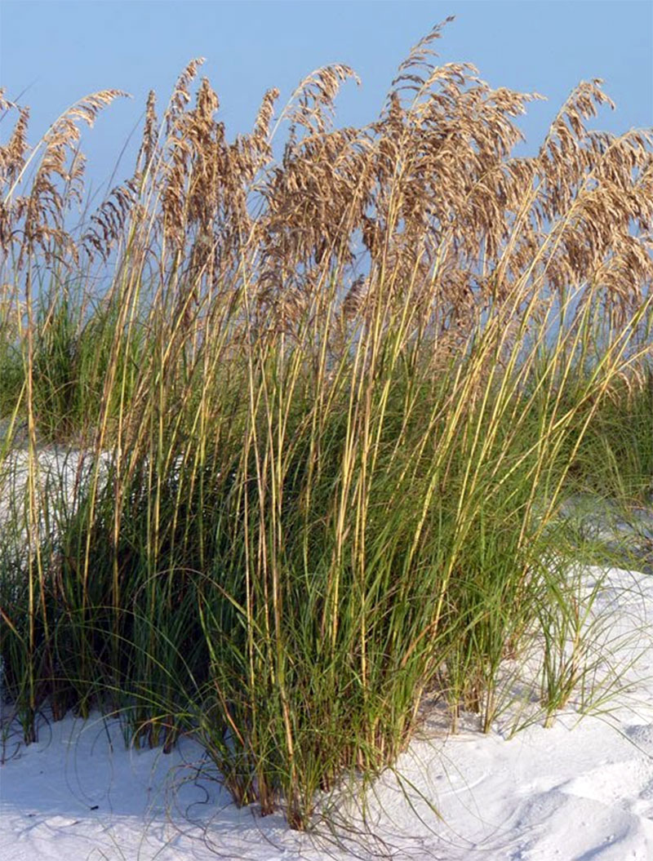
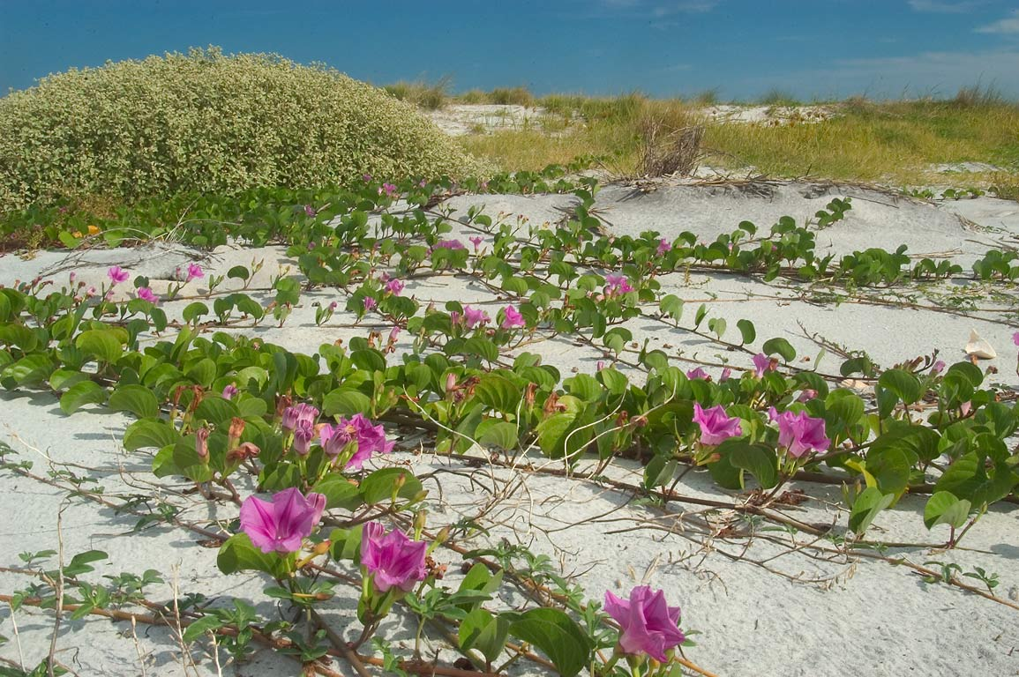
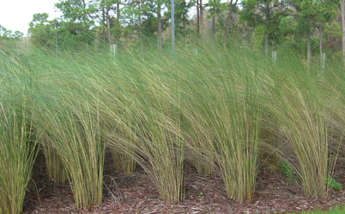
Salt Tolerant – Herbaceous
Specific Species Recommendation
Seaside Goldenrod (Solidago sempervirens) – salt spray & soil
Sand cordgrass (Spartina bakeri) – brackish to freshwater & moderate salt spray
Salt marsh cordgrass (Spartina patens) – salt spray & irregular inundations to 35 ppt
Sea Oats (Uniola paniculata) – salt spray & brief inundations of salt water
Beach morning glory (Ipomea imperati) – high salt spray & soil salinity (not wet)
Railroad vine (Ipomea pes caprae) - high salt spray & moderate soil salinity (not wet)
Seaside goldenrod
Salt marsh cordgrass
Beach morning glory
Sand cordgrass
Sea Oats
Railroad vine

Slide 13
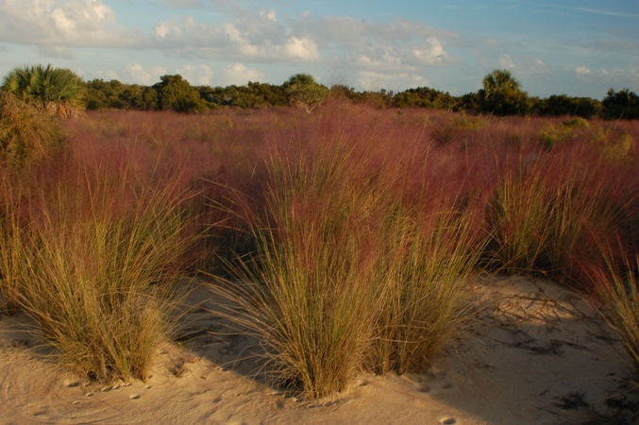
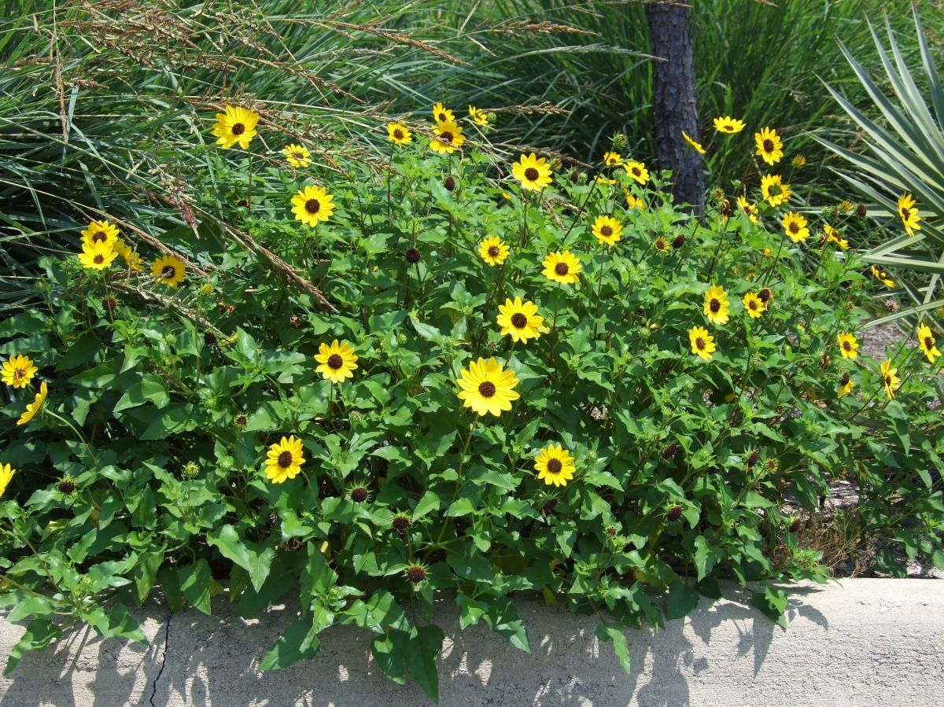
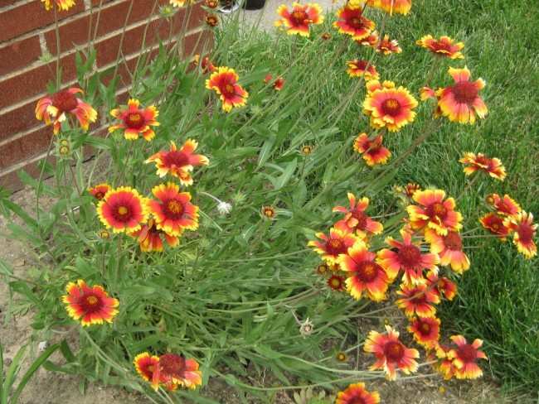
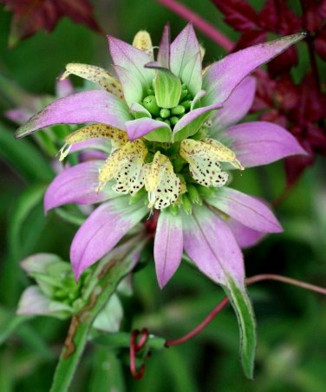
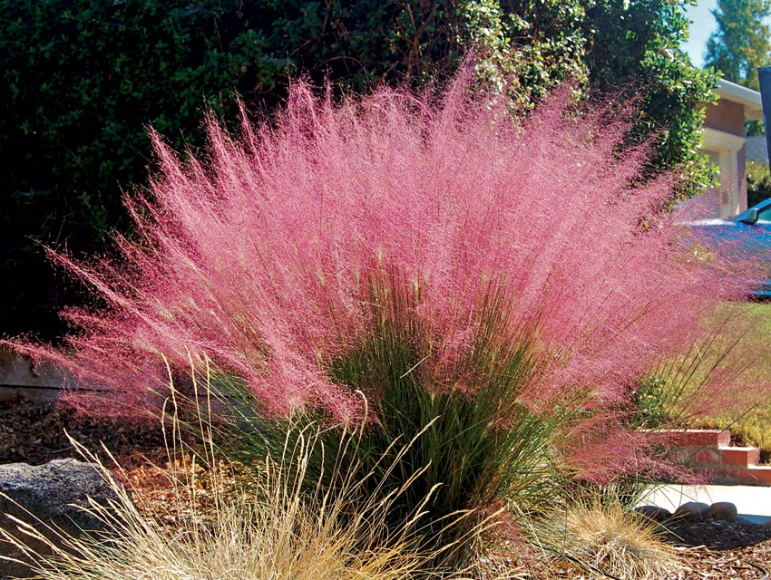
Salt Tolerant – Herbaceous
Specific Species Recommendation
Beach sunflower (Helianthus debilis) – high salt spray & low soil salinity tolerance
Spotted beebalm (Monarda punctata) – moderate salt spray
Blanket flower (Gaillardia pulchella) – high salt spray tolerance
Coral bean (Erythrina herbacea) - high salt spray tolerance & low soil salinity tolerance
Muhly grass (Muhlenbergia capillaris or M. filipies) – high salt spray tolerance
Muhly grass
Dune sunflower
Blanket flower
Spotted beebalm
Coral bean

Slide 14
Deer Tolerant
General rules
Plants with pungent aromas
Plants with prickly or rough leaves
Plants with a bitter taste
Tend to not eat grasses
Group sensitive plants with repellant plants.
Other repellants
Human hair, soap, animal blood or urine
Motion detection devices
Noise, water.
Restrict access
Manage deer

Slide 15
Deer Tolerant - Trees
Specific Species Recommendation
Bald cypress (Taxodium distichum)
Carolina silverbell (Halesia carolina)
Gordonia (Gordonia lasianthus)
Southern Magnolia (Magnolia grandiflorus)
Tuliptree (Liriodendron tulipifera)
Coastal Cedar (Juniperus silicicola)
Gordonia
Southern Magnolia
Bald cypress
Tuliptree
Carolina silverbell
Coastal cedar

Slide 16
Deer Tolerant - Shrubs
Specific Species Recommendation
Dog-hobble (Agarista populifolia)
Needle palm (Rhapidophyllum hystrix)
Osmanthus (Osmanthus americanus)
Pineland hibiscus (Hibiscus aculeatus)
Red Buckeye (Aesculus pavia)
Wax myrtle (Morella cerifera)
Adam’s needle (Yucca filamentosa)
Dog-hobble
Pineland Hibiscus
Osmanthus
Wax myrtle
Needle Palm
Adam’s needle
Red Buckeye

Slide 17
Deer Tolerant - Herbaceous
Specific Species Recommendation
Scarlet Sage (Salvia coccinea)
Blue Sage (Salvia azurea)
Spotted beebalm (Monarda punctata)
Rattlesnake master (Eryngium yuccifolium)
Gaillardia (Gaillardia pulchela)
Butterfly weed (Asclepias tuberosa)
Blazing stars (Liatris sp.)
Goldenrod (Solidago sp.)
Indigos (Baptisia sp.)
Spotted beebalm
Scarlet sage
Goldenrod
Blue sage
Rattlesnake master
Blanket flower
Blazing star
White Indigo
Butterfly weed

Slide 18
Deer Tolerant - Grasses
Specific Species Recommendation
Little bluestem (Schizachyrium scoparium)
River oats (Chasmanthium latifolium)
Pink Muhly (Muhlenbergia capillaris)
Switch grass (Panicum virgatum)
Purple lovegrass (Eragrostis spectabilis)
Little bluestem
Pink Muhly
Purple lovegrass
River oats
Switch grass

Slide 19
Deer Tolerant - Vines
Specific Species Recommendation
Coral honeysuckle (Lonicera sempervirens)
American wisteria (Wisteria frutescens)
Trumpet creeper (Campsis radicans)
Swamp leather flower (Clematis crispa)
Cross vine (Bignonia capreolata)
Carolina jessamine (Gelsemium sempervirens)
American wisteria
Coral honeysuckle
Cross vine
Trumpet creeper
Carolina jessamine
Swamp leather flower

Slide 20
All around tough plants
Passion vine
Specific Species Recommendation
Passion vine (Passiflora incarnata)
Butterfly pea (Centrosema virginiana)
New Jersey Tea (Ceonothus americanus)
Sandhills milkweed (Asclepias humistrata)
Georgia basil (Calamitha georgianum)
Tickseed (Coreopsis sp.)
Coontie (Zamia floridana)
Dwarf Palm (Sabal minor)
Tickseed
Coontie
Sandhills milkweed
Butterfly pea
New Jersey Tea
Georgia Basil
Dwarf Palm

Slide 21
Plant Profiles

Slide 22
Questions?
eamonn.leonard@dnr.ga.gov
NATIVE PLANT NURSERIES
Ernst Southern Native Seeds 1 800 873 3321 1 800 873 3321 www.ernstseed.com
Mail Order Natives www.mailordernatives.com
Thompson’s Garden 6175 GA Hwy South I-16 Exit 127 912 839 2164 912 839 2164 plantguy@bulloch.net
Ann’s and Howard’s Plants Hwy 204 912 748 2719 912 748 2719
Southern Native Plantings 1549 Pryor Rd, Newington, GA 30446 912 857 4571 912 857 4571 www.southernnativeplantings.com

