Slide 1
If You Cut It, Will They Come? Pollinator Response to Chinese Privet Removal
Scott Horn, Jim Hanula, Jacob Hudson, Mike Ulyshen, and
Yanzhuo Zhang

Slide 2
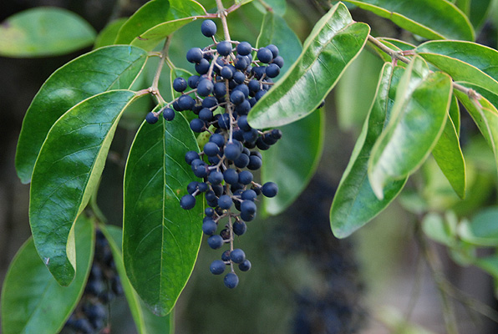
How do a bunch of Entomologists get involved with Chinese Privet?
Notes:
So the first question to ask is………….most entomologists study a specific insect or group of insects…..so how did we get involved in this arena?

Slide 3
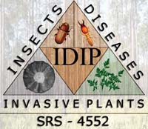
Forest Service
Southern Research Station
Insects, Diseases, Invasive Plants
“To provide the basic biological and ecological knowledge and innovative management strategies required for management and control of native and non-native insect pests, pathogens and invasive plants in changing forest ecosystems”
Notes:
So the best way to describe that is to describe our Project and work mission……...
Explain flow chart……..Our mission statement (read)…….this basically serves as a directive which drives our research priorities.

Slide 4
Insects, Diseases, Invasive Plants
“Yellow star thistle: Volunteers tackle a thorny problem “
“Garlic mustard is a threat to several tree species”
“How to stop honeysuckle invasion”
Kudzu That Ate U.S. South Heads North as Climate Changes
Notes:
In the title of our unit and our mission statement is “invasive plants”……….and you don’t have to look very far in Press and Newspapers to see just what a problem invasive plants have become for many areas of our country. (read these)

Slide 5
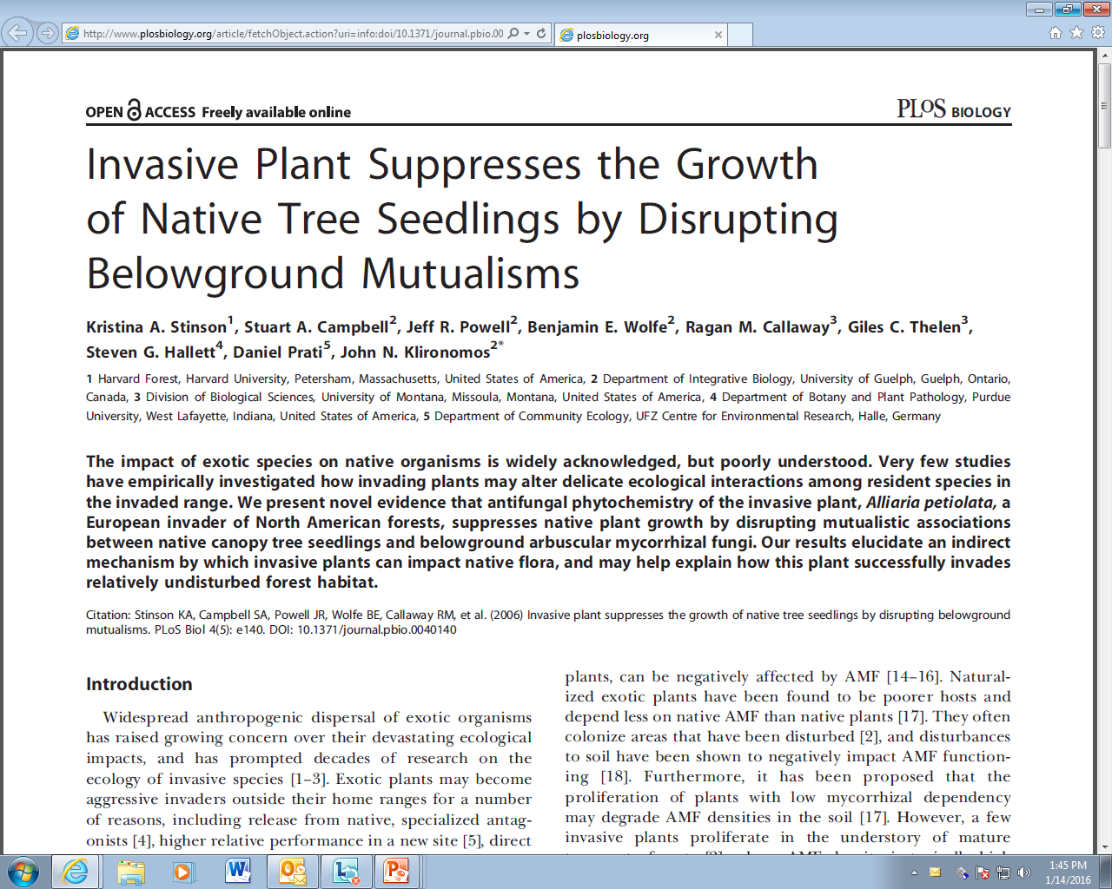
Notes:
And it is not just the popular press…………..all this is supported by science that shows more and more the toll invasive plants are taking on our natural areas………..

Slide 6
Invasive species are considered one the top threats to forest ecosystems in North America.
42% of the decline in native species now listed as endangered or threatened in the US is a result of non-native invasive plants, animals or microbes (Pimentel 2002).
GA-EPPC “Category 1” (20 listed plants)
Exotic plant that is a serious problem in Georgia by extensively invading and displacing native species.
Chinese privet………one of the worst!
Notes:
And what all these studies are showing are that, …………READ

Slide 7
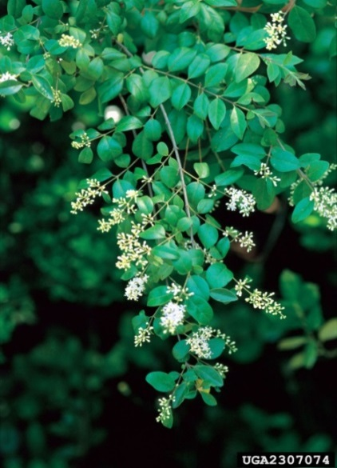
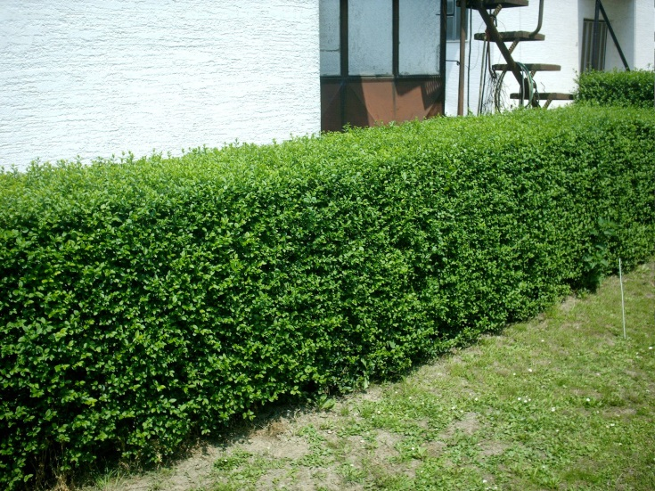
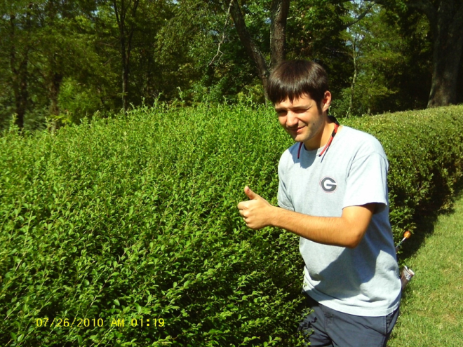
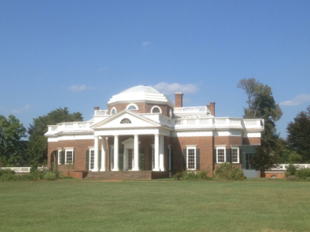
Chinese Privet, Ligustrum sinense
Used in traditional medicine in China
Hard to find in natural areas
8 recognized subspecies
Introduced into the US in 1852
Widely used for hedges and borders
Notes:
And I know among this group of savvy weed killers that most of you probably know at least a little about privet—although being along the coast you get somewhat of a reprieve. But here is a little background…………….

Slide 8
Chinese Privet: “remarkable ornamental?”
Shade tolerant too!
Notes:
Instead of coming up with a list myself of all the negative attributes that make Chinese privet so invasive and repulsive…………I’ll let the great folks of the Southern Living plant collection tell you how great it is!! Because it is the same list!!! THIS PROVES LIFE IS ALL ABOUT PERSPECTIVE!
Deer and Insect resistant---no natural enemies
Drought and heat tolerant---
Fast growing---
Adapts to many soils—
Shade tolerant---
No downside!

Slide 9
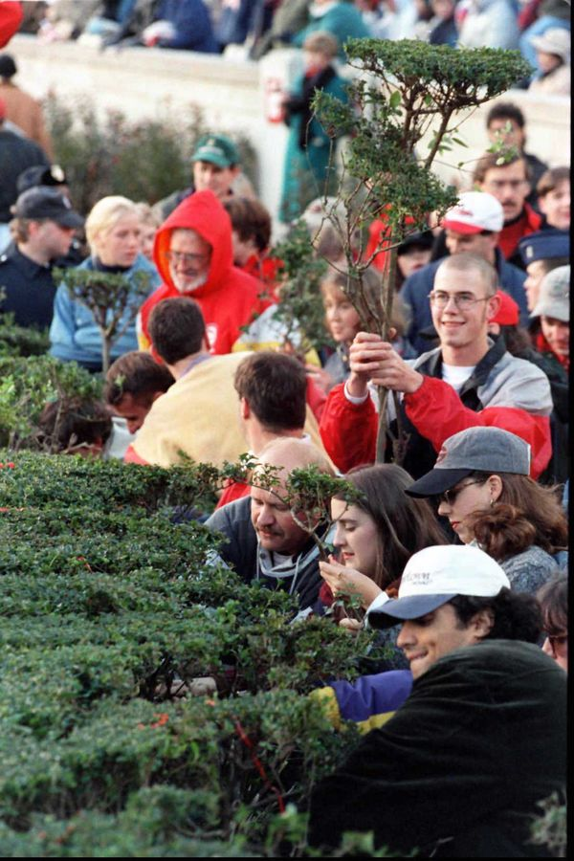
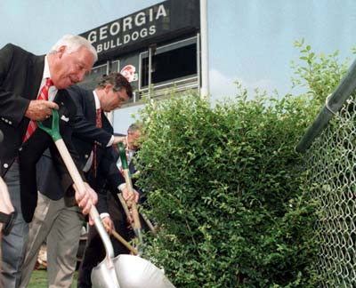
Playing “Between the Hedges”
$30 plus shipping and handling, Dawgs fans can order plants and get their own piece of the hedges in a pot. The product is officially licensed by the school through the Collegiate Licensing Corp.
“If you’re an Auburn fan, it’s just a privet,” said Garrison,63, (owner) “But if you’re a Georgia fan, it’s something special.”
Notes:
To add insult to injury……….the good folks up at UGA decided to plant it in the stadium! So when bulldog fans talk about the heritage of “playing between the hedges” they are talking about Chinese privet………in fact, in 1996 they replaced it before the olympics and someone had the idea to take cutting and sale to dawg fans………read….and it is licensed by UGA!

Slide 10
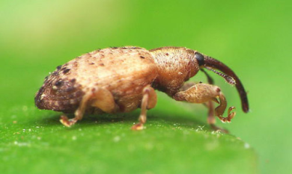
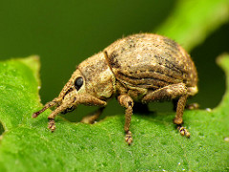
Chinese Privet, Ligustrum sinense
Well established in the Southeast by the 1930’s
Prolific seed producer--seeds dispersed by birds, small mammals, and flooding
No native natural enemies
59% of Oconee river floodplain infested (Ward 2002)
Notes:
So apparently plenty of folks agreed with UGA and others early on about planting privet for hedges because by the 1930’s it had escaped and was becoming established into natural areas. Mainly due to the characteristics I mentioned a minute ago about being a prolific flowerer, seed producer and by having no natural enemies. There are a couple of accidental introductions from Asia……the Ligustrum weevil feeds on the seeds and the Japanese two banded weevil is a leaf feeder……they are a little disappointing though. And to be a little specific to where I am located, It was so successful in fact that by 2002 59% of the Oconee River floodplain contained privet as shown by winter time aerial surveys conducted by WARD…..

Slide 11
Sandy Creek Nature Center
Athens, GA
Notes:
This is basically what he saw in the winter time in our area………everything in this photo that is green is privet so you can see how aerial surveys would be fairly easy to do and provide pretty accurate estimates

Slide 12
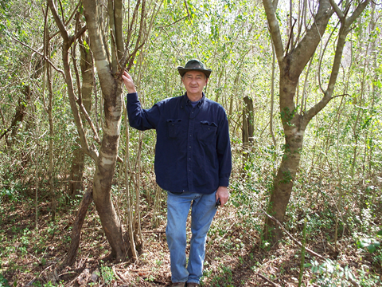
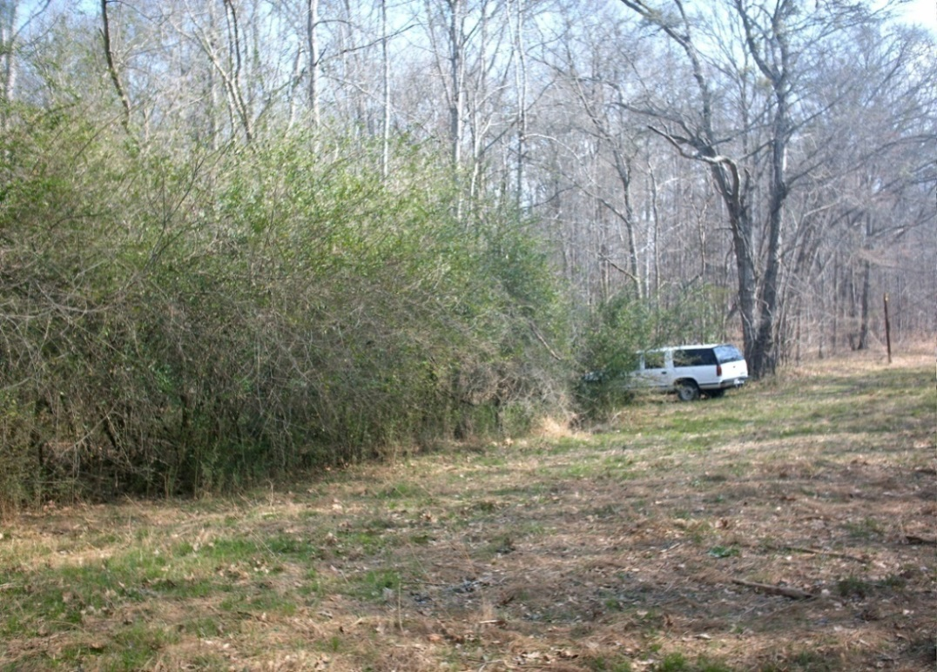
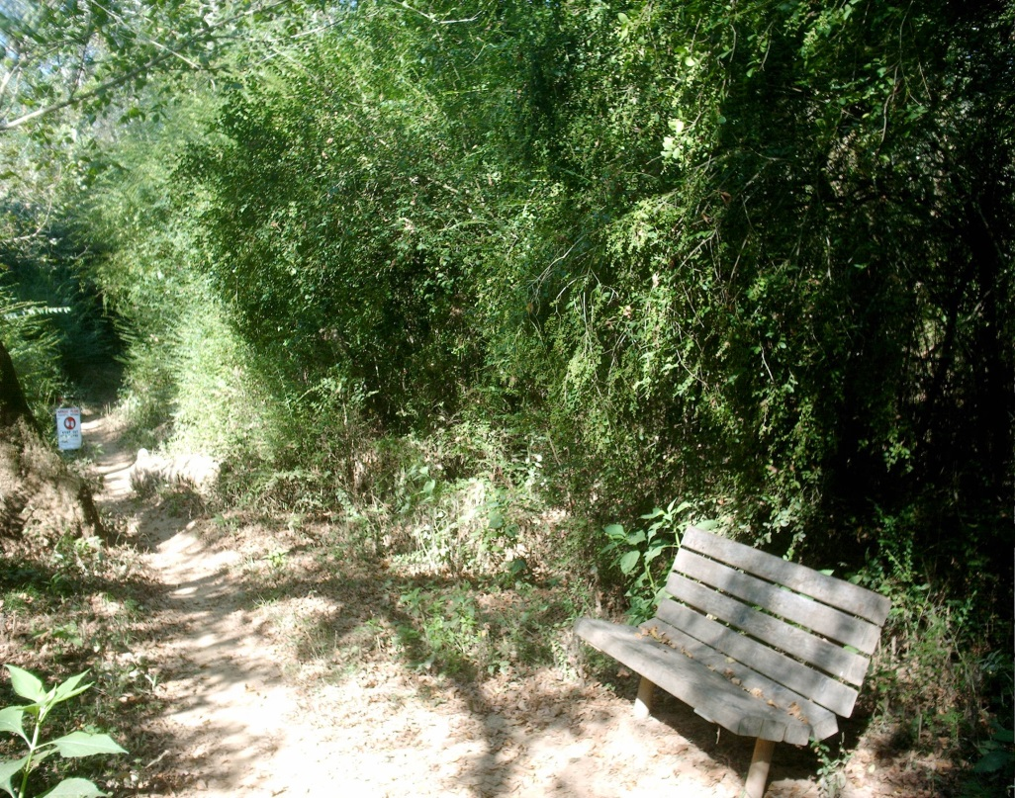
Private land
Ashland, AL
Oconee National Forest
Greensboro, GA
Privet in the forest is an
ecological nightmare.
State Botanical Gardens
Athens, GA
Notes:
The re-ocurring theme no matter where you are in the south is that privet is an ecological nightmare-Lisa and Bart can’t be wrong. Privet is a nightmare for my dad, shown here on his land in Alabama where you can see large and small plants, in the back is a fencepost which shows that an old-field turned into a privet forest………….it is also a problem on National Forests, in addition to nature trails—basically creating a wall so you can’t see into the forest.

Slide 13
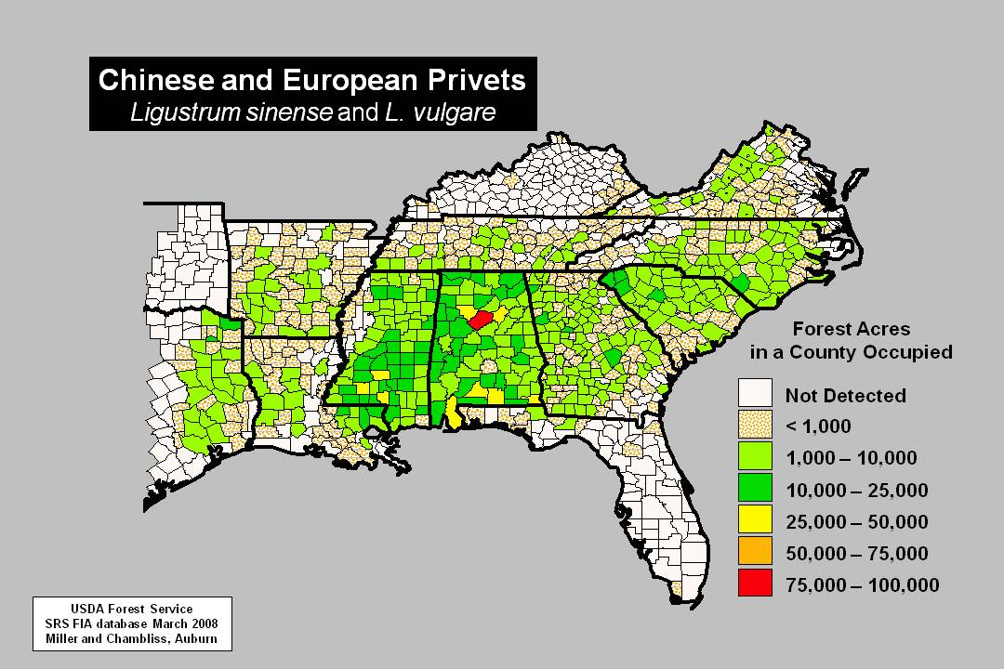
It covers 1-3 million acres of forest land in the Southeast (and growing!!!)
Notes:
Just to give scope to the problem……The numbers back this up……….so what Ward saw in 2002 is happening in floodplain forests and beyond…………..FIA data estimate that up to 3 million acres of forest land in the southeast has Chinese privet………might be conservative when you consider, edges, suburban areas, etc…..

Slide 14
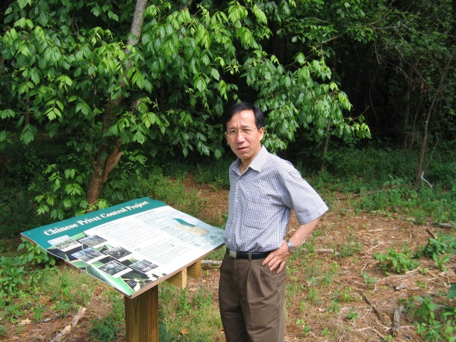
Broad Goals
Increase public awareness
Lay groundwork for biological control project
Understand impacts of privet invasion and its control on forest plant and animal communities
Notes:
So with this in mind and after seeing firsthand how widespread Chinese privet was, along with a seeming lack of hard data on the actual effects on natural communities we set out to answer some basic questions. We had 3 major goals when we first started this project………Increase public awareness of privet and the problems it causes—this was made easier due to the fact we worked in some high traffic areas which allowed us to display some signage. We also wanted to lay the groundwork for a biological control project—I can mention a little more on that later. It was important to understand the response of not only pollinators, but the plants on which they depend…….

Slide 15
Specific Questions
Which method (manual felling vs mulching) of Privet control is most effective?
How does the local plant community respond when Privet is removed?
Plant cover=floral resources=pollinators
How do pollinators respond once privet is removed and native plants return?
How do pollinators in privet cleared areas compare to communities in areas that have never had privet (“desired plots”)?
How do cleared areas change over time?
Notes:
But we had to narrow our focus to more specific questions…..and those were..

Slide 16
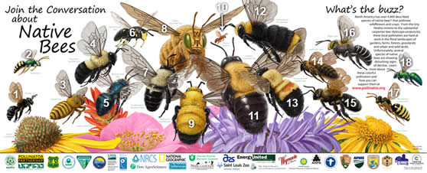
Why study pollinators?
They provide important ecosystem services (pollination)
Leading to estimated economic value in the U.S. (2003) of between 18-27 billion dollars
Natural areas near agricultural fields can serve as a refuge and possibly increase crop pollination……so healthy forests might contribute to higher yields
Declining worldwide
Notes:
Earlier I described how we came to work with Chinese privet……..now the question is why study pollinators-------and this is relatively easy to answer (as we have already heard today)……….READ….and if that is not enough……..on June 20, 2014 we had………….

Slide 17
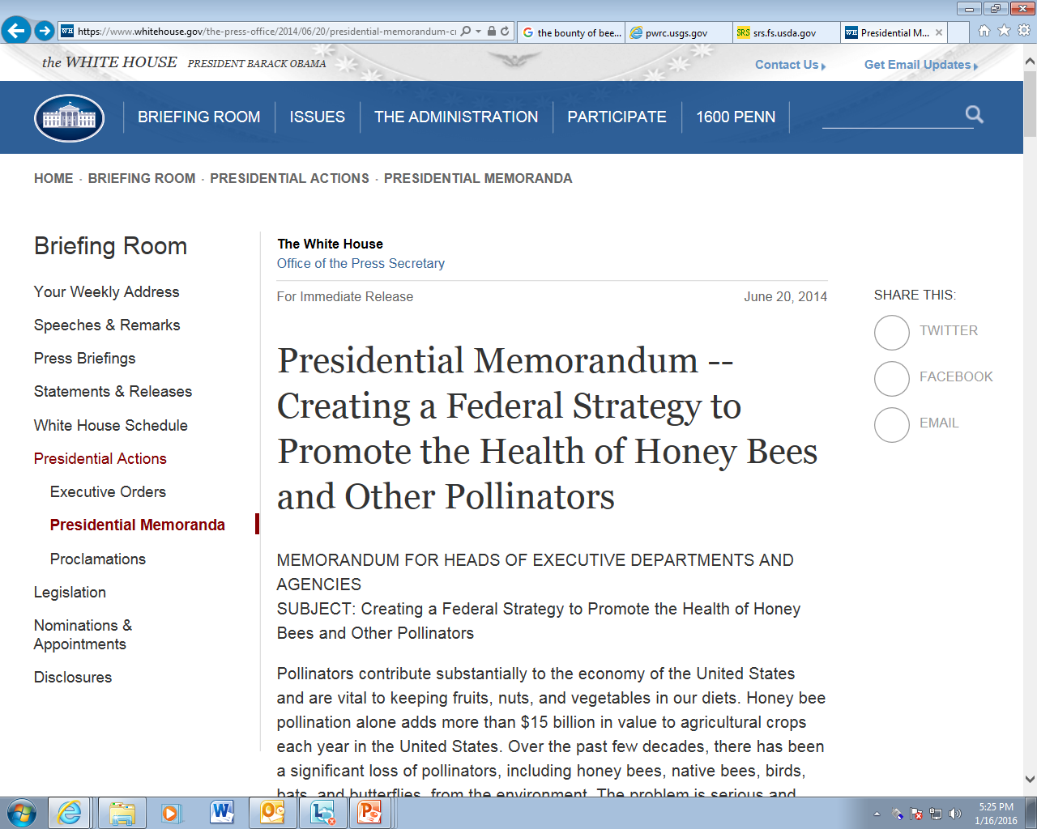
Notes:
……a presidential memo released with the stated goal of focusing Federal efforts on understanding, preventing, and recovering from pollinator losses.

Slide 18
Why Bees and Butterflies?
Bees are the real pollination powerhouses—considered the most efficient (repeatedly visit a plant species on a given foraging trip, ensuring pollination)
Butterflies (larvae) important part of the food chain serving as prey for other species and probably the most important insect “ambassador” (think monarch).
Disturbance creates winners and losers in forests
Question we always get: How does “X” affect insects??
Useful bio-indicators for forest and ecosystem health
We feel that forest management (i.e. privet removal) activities should not be detrimental to pollinators
Notes:
Now in this study and other work we have done we narrowed our focus some to bees………and for good reason…….because Bees are the real powerhouses…………..and we know that disturbance of any kind can create winners and losers in forests (this can be anything from prescribed fire to a timber operation—we are always asked how do these things affect insects???...... in our case it was midstory removal in the form of Chinese privet
It depends because it is not as easy as saying how does a clear-cut affect red-cockaded woodpecker, obviously they need trees……..but a forest can have millions of insects each having different habitat needs so you have to pick a focal group)……and so because they are common, diverse, and ecologically important bees are also useful bioindicators…………

Slide 19
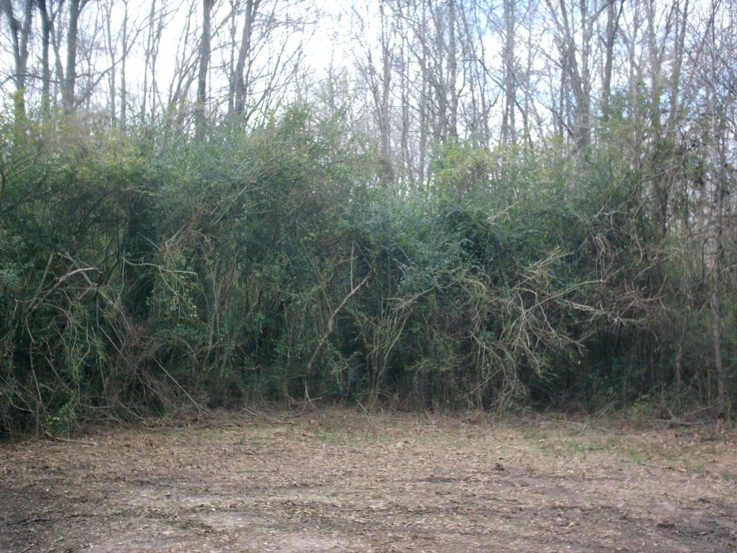
Where did we work?
59% of Oconee River Floodplain infested with privet
Notes:
That takes care of the WHY……….so now the WHERE…….I mentioned we are in Athens, so we initiated a study in 2005 and selected cooperators and study sites that shared one thing in common----a giant problem with privet in the Oconee River Watershed. Remember, I mentioned earlier that almost 60% of the Oconee floodplain has privet and it looks like this……….making it an ideal place to work…………2 of these locations also helped with increasing public awareness since they are in high traffic areas (bot gardens and sandy creek).

Slide 20
What did we do?
Four Treatment Locations (BG, SC, SS, WS)
Three, 5-acre plots at each location
Mulch
Felling
Control
Three “desired” plots
Notes:
Now you know where we worked…………..so what exactly did we do so that we could measure the response of plants and pollinators? Our study design consisted of these four locations, and at each location we had 3—five acre treatment plots. In addition, and to answer the question I proposed on the last slide about how treatments compared to uninvaded areas we added 3 other locations on the Oconee National Forest that we termed “desirable plots” since they had little or no privet. This gave us a total of 15 plots where we applied the treatments and here is a visual of those……….

Slide 21
Treatment #1 Felling + stump treatment
Advantages: Lower cost, lower environmental impact, easier to treat stumps
Notes:
The 1st treatment consisted of a chainsaw/machete felling and herbicide stump treatment. All privet was cut and bucked so that no brush was higher than about 3 feet on the plot.

Slide 22
Treatment #2 Mulching + stump treatment
Advantage: removes ALL debris, cleaner “look”

Slide 23
Gyrotrac Mulcher
Notes:
Everyone usually wants to see this machine so here is another picture………

Slide 24
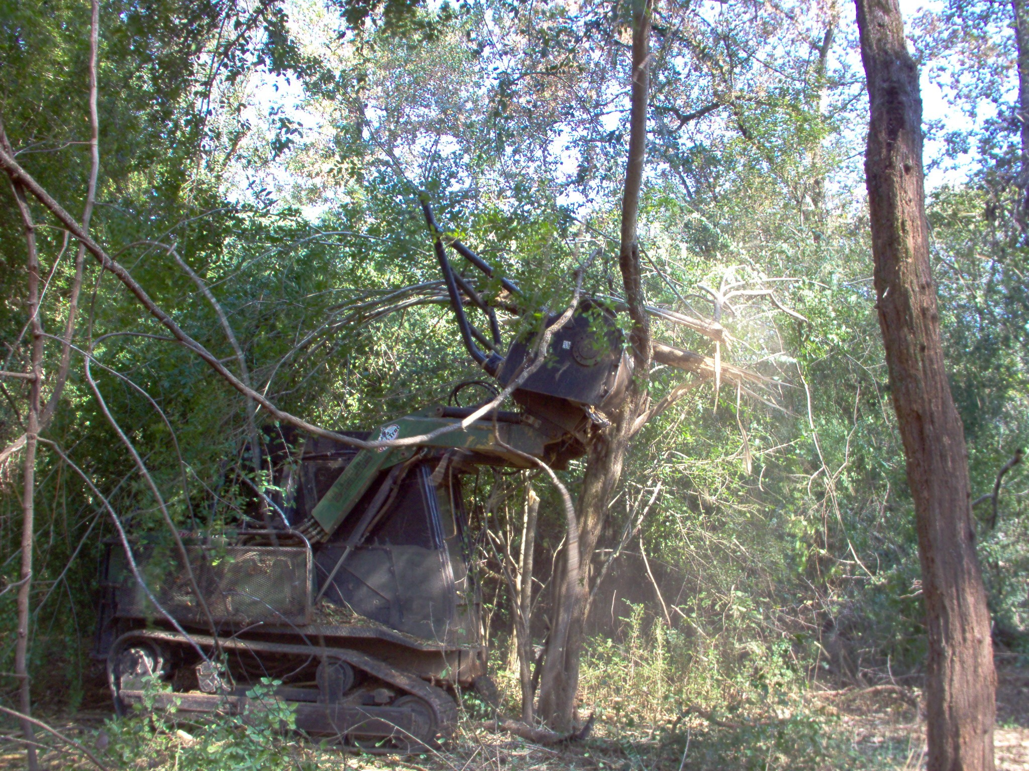
Notes:
And yet another, this time showing the machine taking down a larger tree form privet……..

Slide 25
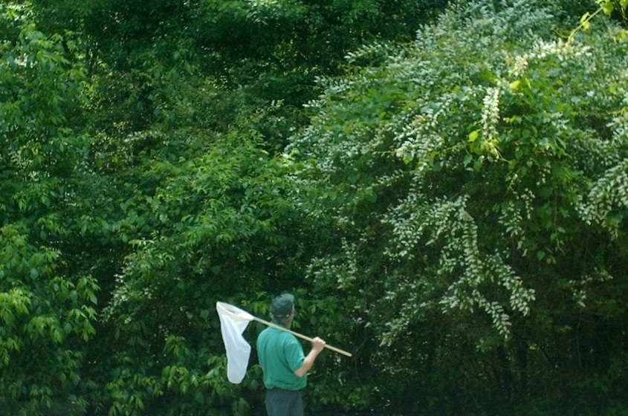
Treatment #3 Control
$*%@!
Notes:
The 3rd treatment is an un-manipulated control in which we left the entire plot intact………………and I can still hear one of our recently retired technicians saying you want me to go where……..

Slide 26
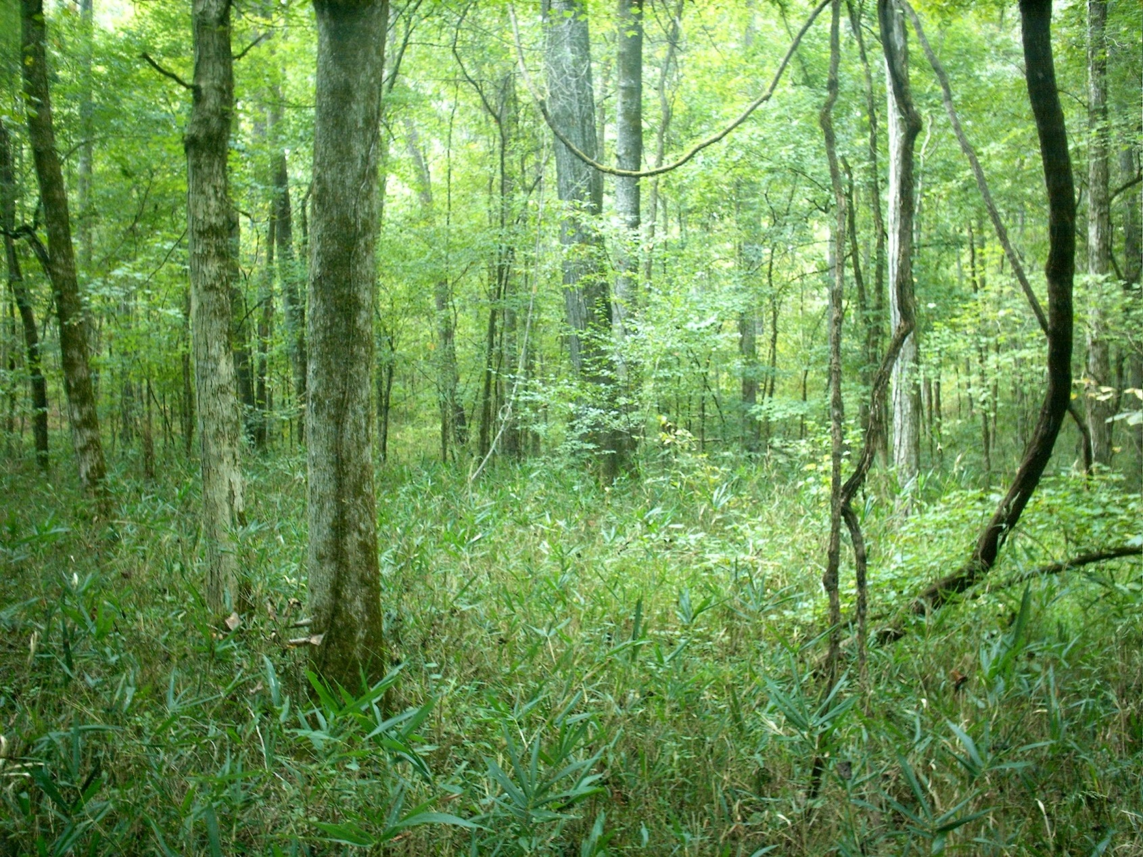
Treatment #4 Desired Plots
Notes:
And finally, the 4th treatment I talked about consisted of un-manipulated areas…which serve as “reference” plots that we could compare to see how successful our privet removal treatments worked……….the best way to think about these are as “what we want to work towards”……for example, here you see a healthy floodplain forest with a pretty open mid-story (opposite of privet infested areas) and a nice, diverse understory (here with switchcane).

Slide 27
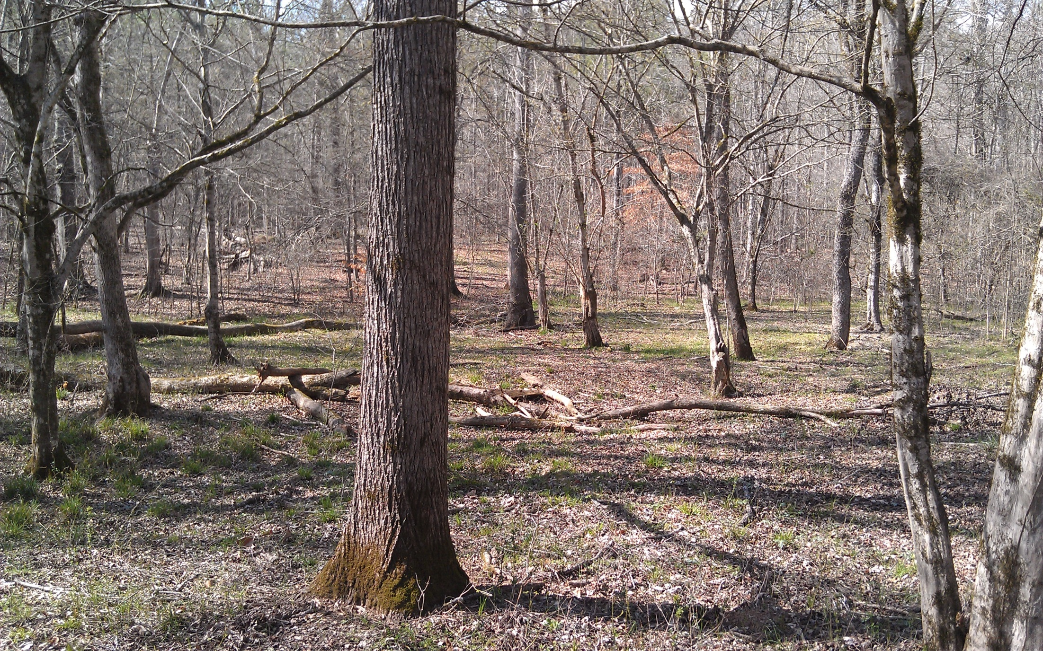
Notes:
Here is another shot of a desirable plot, this time in the winter, but again, NO Privet which allows sunlight to hit the floor for native plants to flourish……

Slide 28
Follow-up Treatments
Initial treatments (Fall 2005) alone didn’t kill all the privet
Foliar application of 2% glyphosate in late fall or early winter of 2006
Maximum impact on privet with minimum impact on native vegetation
Notes:
Quick, but very important note—we knew going in that our initial treatment in the Fall of 2005 would not kill all the privet……….the reason for this is the mostly large, tree-like privet that was present and contains fairly large root systems. The first year is to bring down the canopy, basically which allows a follow-up the second year which is what we did. Picture on the right shows it fairly well—but by the summer of 2006 we had a flush of knee to waist high privet that came back fairly thick. We sprayed all 40 acres by hand using backpack sprayers. This was a great PRELIMINARY test that allowed us to determine the the effectiveness of our treatments.

Slide 29
Foliar Application
Before – November, 2006
After – January, 2007
Notes:
Just a quick visual that shows prefoliar and post foliar

Slide 30
Foliar application worked! % Privet in Herbaceous Layer
10 months after initial treatment
22 months after initial treatment
Summer 2006
Summer 2007
“Hit the reset button”…………. 99% reduction in privet
Notes:
Just a graphical look to say the same thing……………..glyphosate foliar treatments reduced privet on both treatment plots approximately 99%.
This is important because it proves that we could “hit the reset button” on these plots and begin the restoration process and measure how pollinators respond to this restoration.

Slide 31
Biomass and Nutrient Measurements
Established random transects on felling plots and measured amount of residue per square meter to estimate biomass
19.9 tons (dry wt.) of privet per acre
Equal to ~ 28 whole pine trees 12 inch DBH
Process subsamples for nutrient content analysis to estimate nutrients tied up by privet
Privet contains 250 lbs N per acre
Equal to 2500 lbs of 10-0-0 fertilizer
Notes:
One other Preliminary measurement we were able to obtain that is pretty eye-opening is that of nutrients being tied up by privet in floodplain forests and just how much biomass of privet is out there………..READ………..these measurements demonstrate, without a doubt just how much privet is altering these ecosystems……….

Slide 32
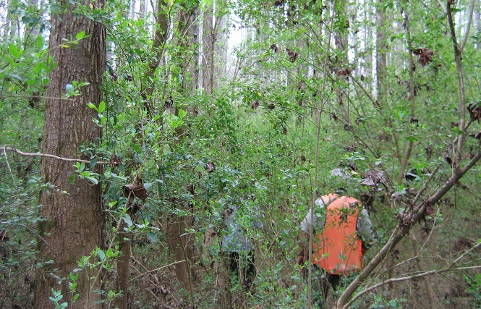
Plant sampling methods
Plants sampled at beginning of project and then again 5 years post-treatment
Established 3 transects across each of the 15 plots
Line intercept method used
Presence/absence
Plant species
Plant height
Shrub cover
Notes:
So with that background on Chinese privet and the preliminary data showing that we had all but eliminated privet from our treatment plots we were ready to begin testing our theory that privet was causing considerable damage to native plant and animal communities. To look at plant restoration and recovery we did the following:………………READ……..this allowed us to determine which plants quickly colonized our plots and how abundant they were. Also, we could compare diversity and abundance between the two treatments.

Slide 33
Pollinator sampling methods
Pollinators sampled at beginning of project and then again 5 years post-treatment
Sampled for one week in each month from March-September (7 sampling periods)
Five subplots were established and equally distributed in each of the 15 plots
Each subplot had 2 pan traps (blue, yellow)
Notes:
We followed a somewhat similar protocol when it came to pollinators…………..READ…….

Slide 34
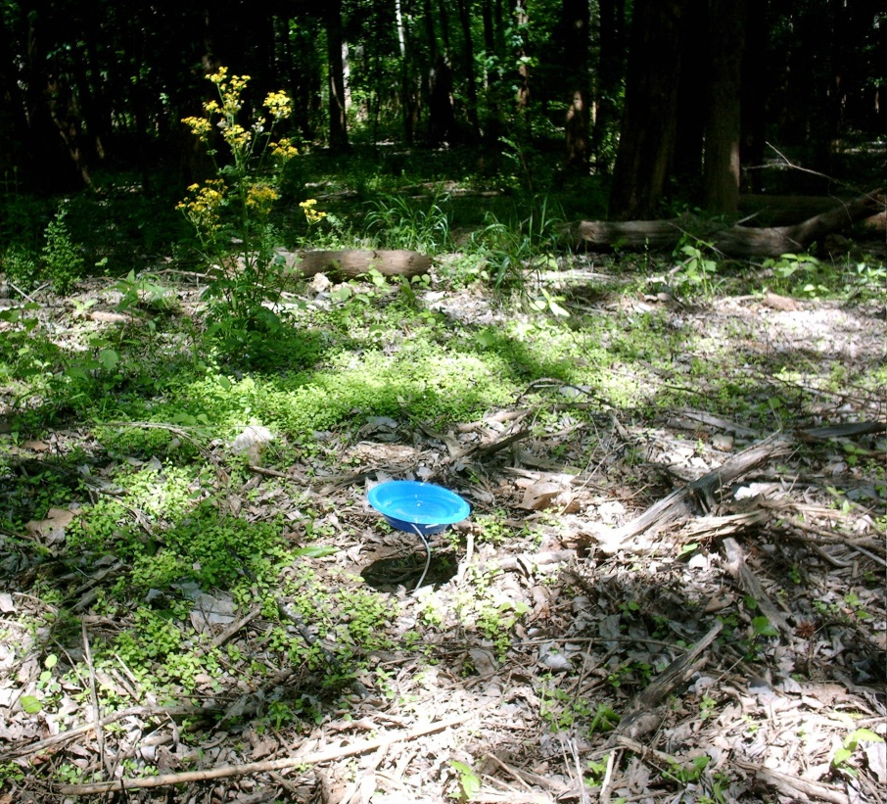
Pan trapping
Widely accepted collection technique
Simple and inexpensive
More time efficient and less biased than sweep netting
Collects pollinators during all activity times
Major downside = Might not attract all pollinators equally
Notes:
So what is pan-trapping (sam discuss?0 18 ounce plastic bowl filled with soapy water, the colored bowl basically mimics and flower, and the bees are attracted and get caught…….we actually support ours with a wire approximately 30cm above the ground…we do that just to simulate a flower stalk and also it helps keep debris out of the bowl if it rains and also keeps some insects from hopping in. READ…..widely accepted, majority of studies employ this technique, simple and very inexpensive costly just a few dollars to operate, this method is way more efficient than most techniques because you don’t actively sample or monitor the bowls, it is completely passive. Also, it is not biased (one person might be better at spotting bees than another on flowers). It collects bees around the clock—the bowls don’t take off for lunch! Only downside is some bees don’t seem to be represented as well……..

Slide 35
Results—Immediate Plant Response
Plant diversity increased, but not significantly
Percent of herbaceous plant cover significantly increased
<20% control
>40% felling
>60% mulch
Mulch plot herb cover similar to “Desired” plots
(good news!)
Early colonizers
*non-privet herbs
Notes:
So those are the methods we used for measuring plant and pollinator recovery……..Now to what we found---We found that by removing privet we didn’t greatly increase plant diversity, although it did go up roughly 5 species for both treatments, but this wasn’t significant………..what it did do what vastly increase the abundance of native plants, with the most dramatic difference being in the mulch plots……….which put the % herbaceous plant cover actually very close to desired plots……….and these were initially early colonizers that you would expect……..pokeweed, fireweed, winged stem and some other asters, though plants in the desired plots were quite different…….And it was obvious to see on the ground……….

Slide 36
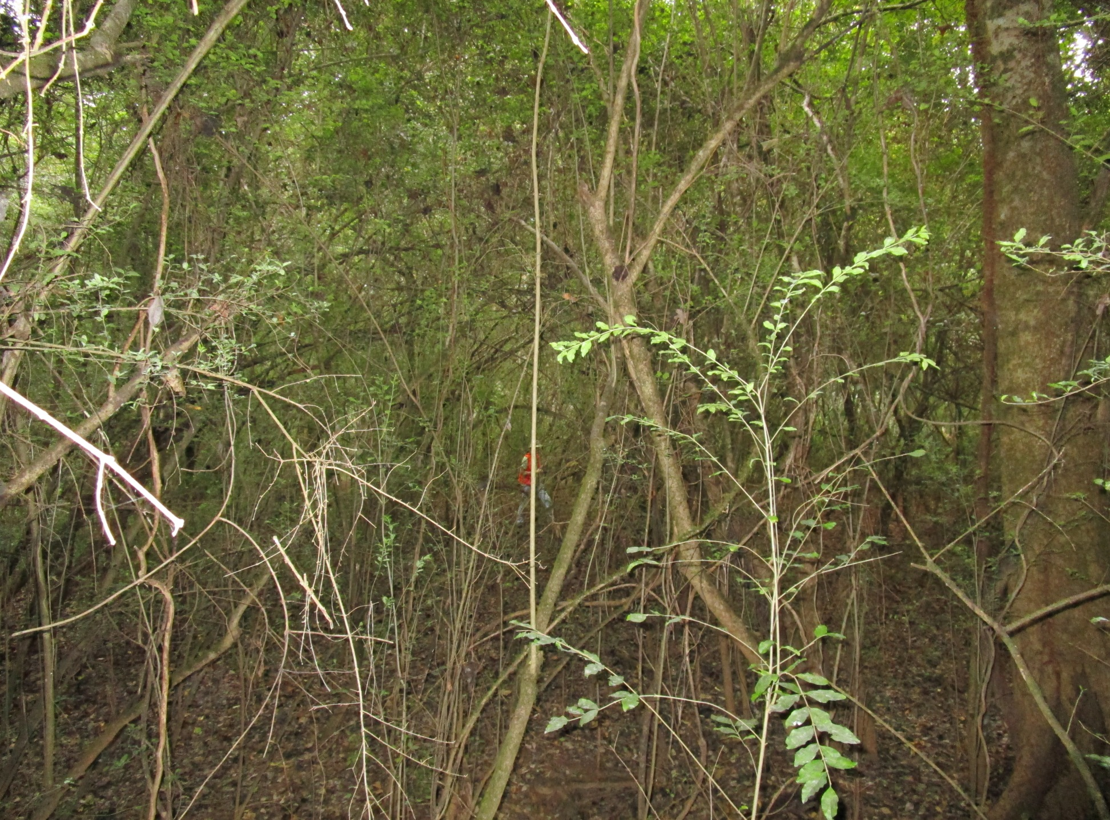
Results—Immediate Plant Response
Notes:
Like I showed before, you go from a completely choked forest like this (human, tree)

Slide 37
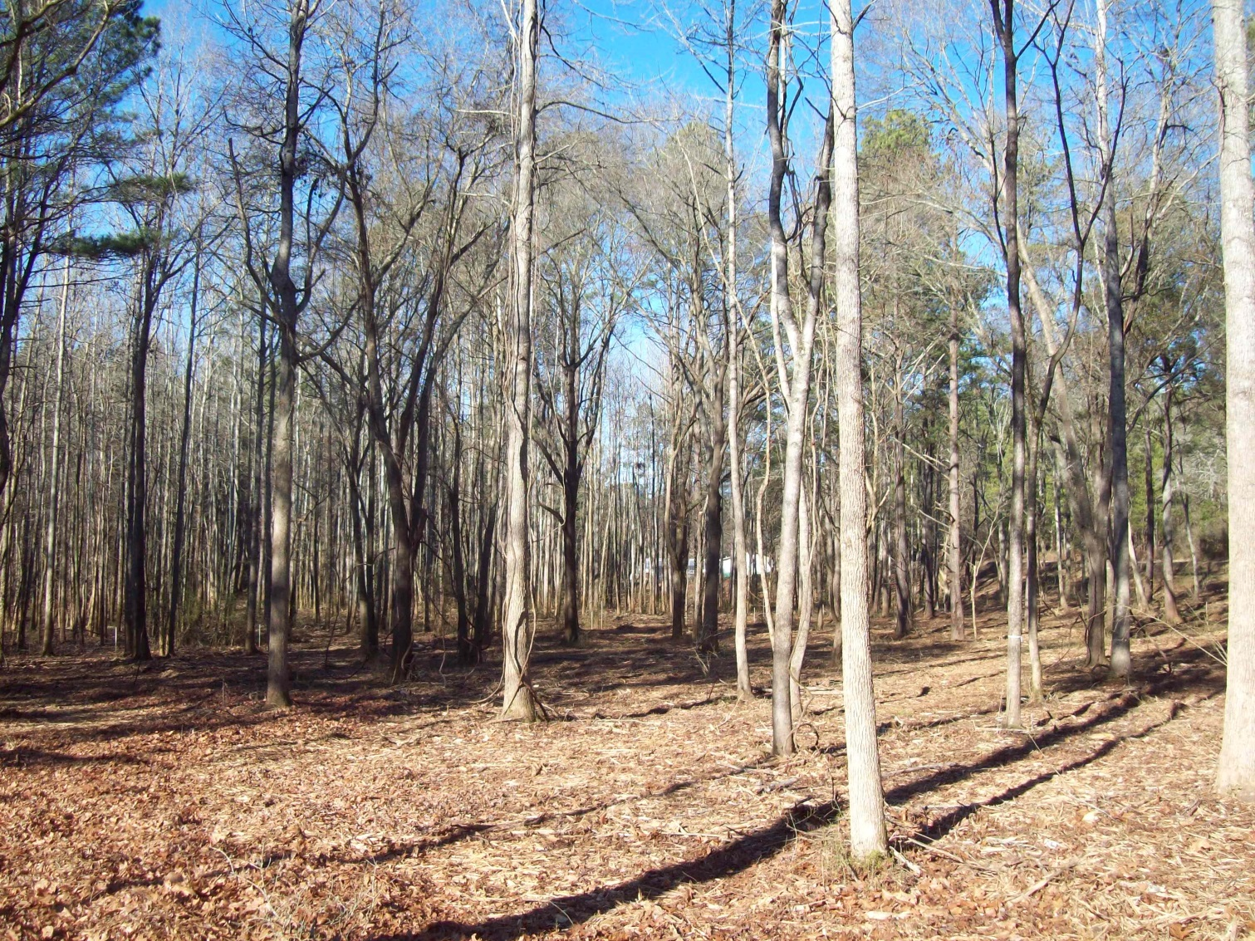
Results—Immediate Plant Response
Notes:
TO THIS, in one day’s time………and then once spring arrives it starts to green up and look like this……….

Slide 38
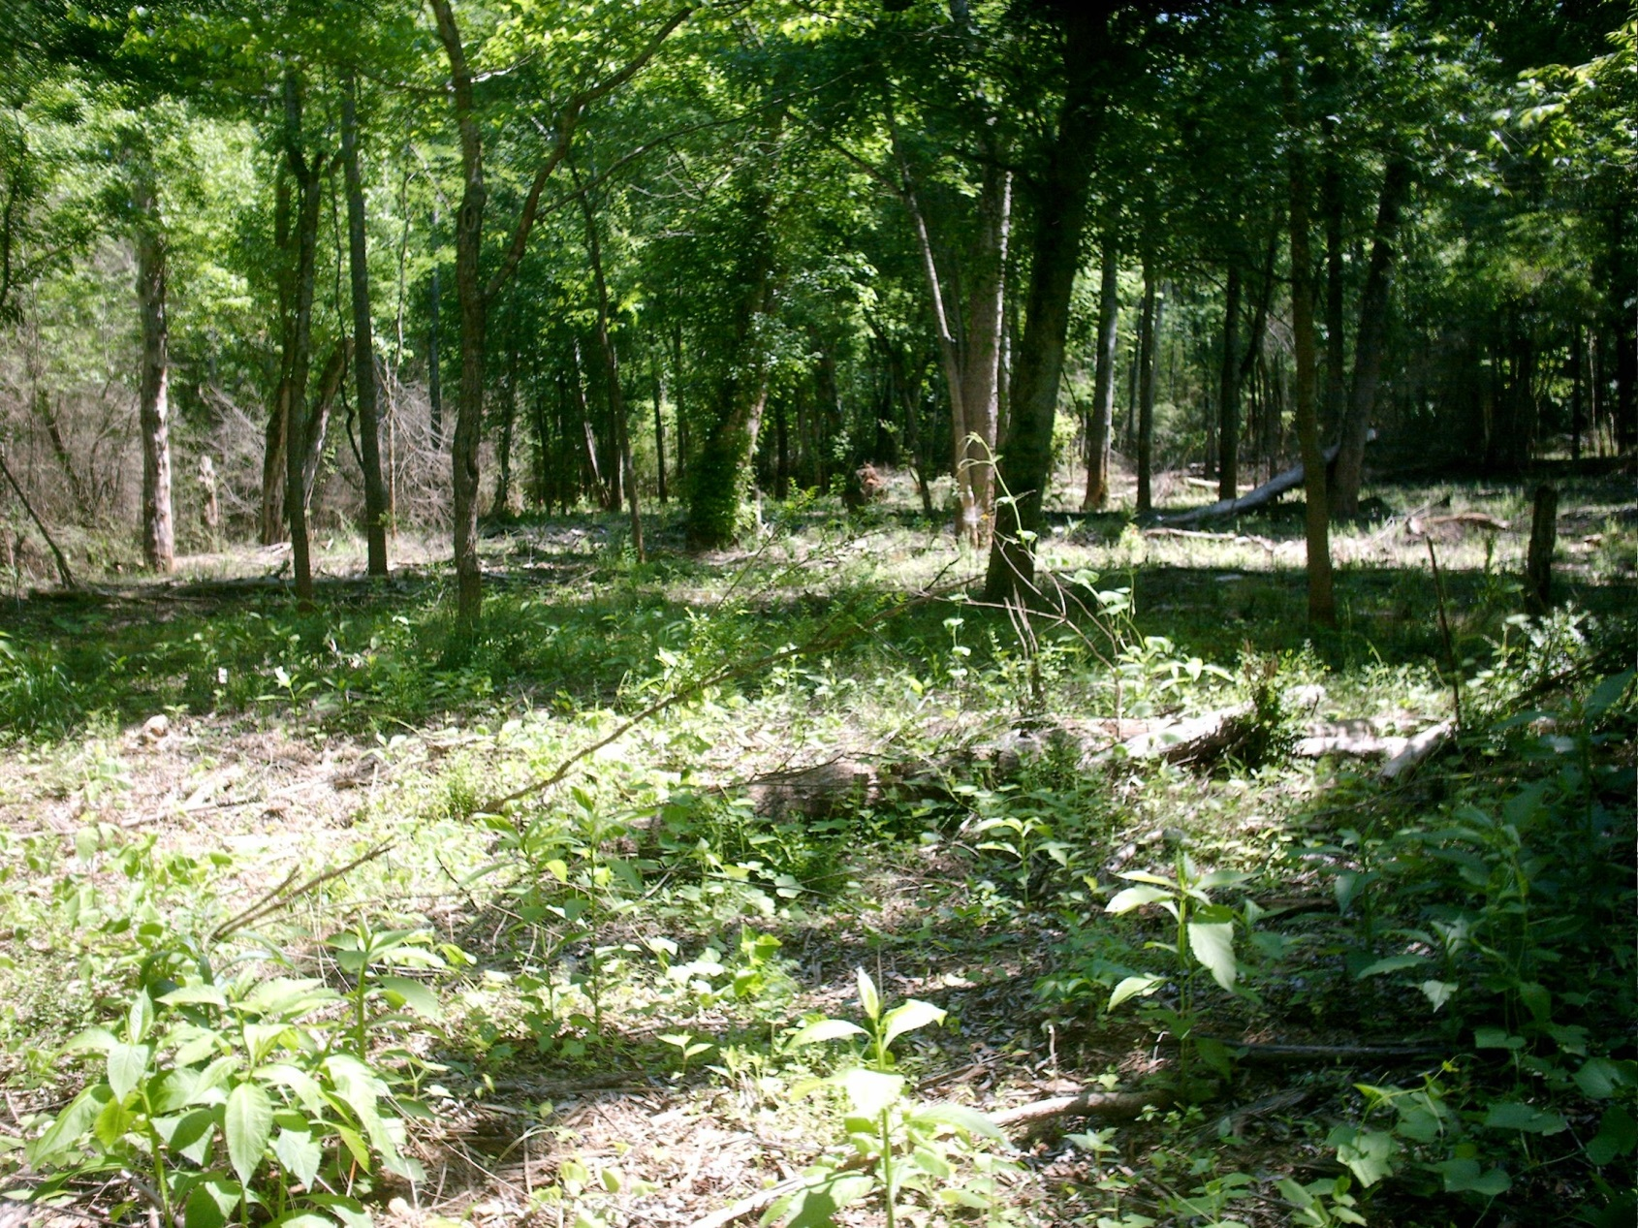
Results—Immediate Plant Response
Notes:
Where you can start seeing some of natives coming back in directly related to sunlight finally reaching the ground for the first time in who knows when………just as an aside, at my dad’s land I showed earlier we cleared privet there and numbers of trout lilies and trillums showed up—I don’t know if seeds were lying in the seedbank just waiting or what, but it was a welcome site.

Slide 39
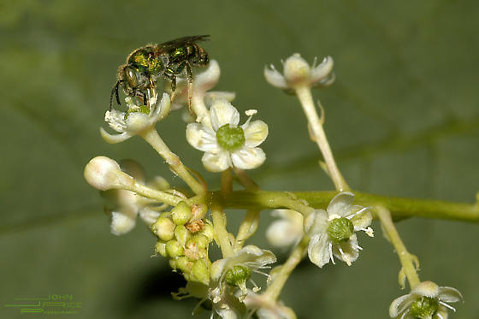
Plants that showed up Post-removal
Herbs/vines
Pokeweed
Fireweed
Winged stem
Nettle
Violets
Aster spp.
Greenbrier
Muscadine
Elderberry
Sedges
Poison Ivy
J. Stiltgrass
Trees/shrubs
Boxelder
Sweetgum
Red maple
Sycamore
Redbud
Red mulberry
Loblolly
Hophornbeam
Ironwood
Slippery elm
Notes:
Here is an abbreviated list of the plants that showed back up…….mostly very common, early colonizers. One disappointment to note that is not surprising is the showing up of Japanese stiltgrass. Yet another exotic that is filling in certain areas right behind Privet—it does seem to be a little worse in some areas than others---even though we don’t like it, better than privet.

Slide 40
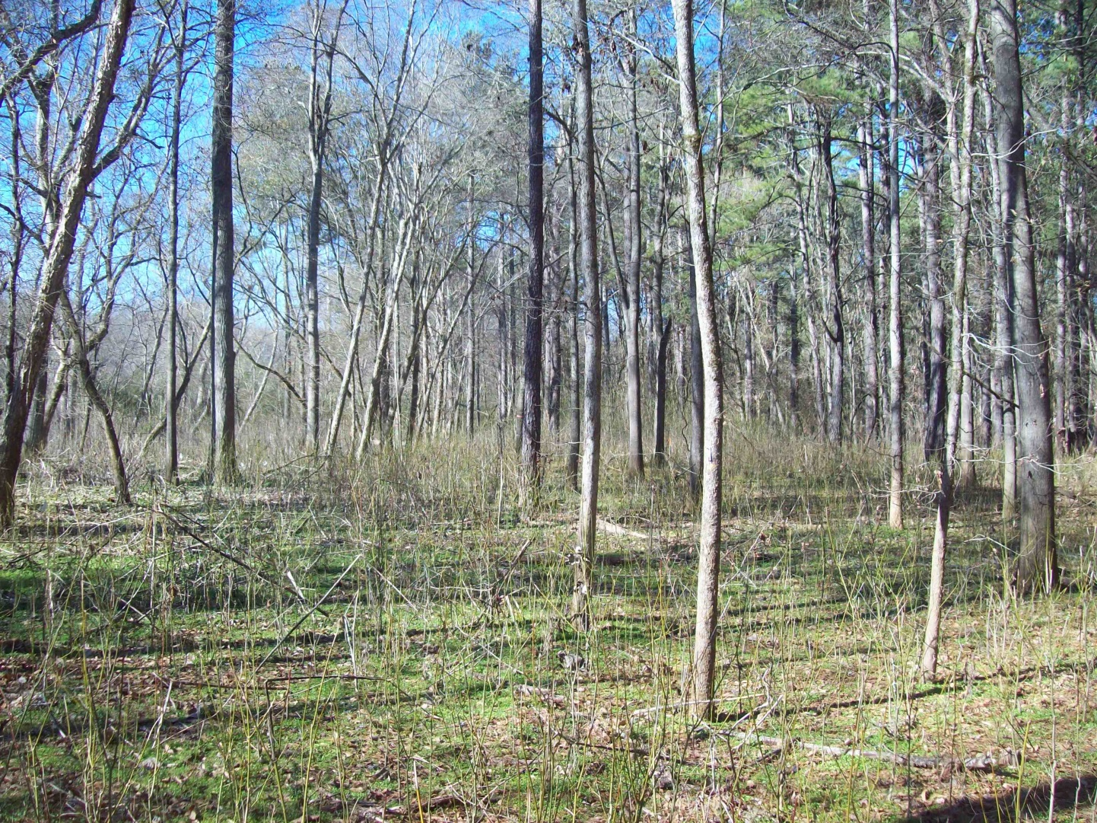
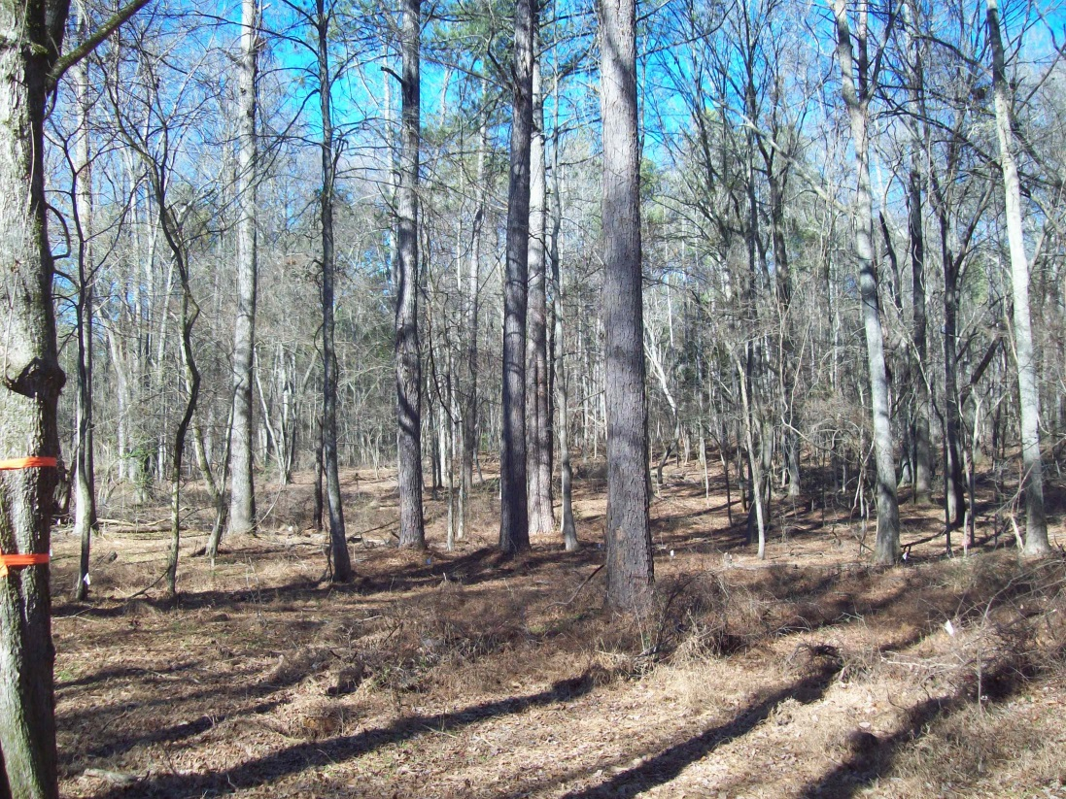
Results—5 yr. Plant Response
January 2012
Very little privet has returned
Boxelder has moved in
Notes:
So remember, we came back and sampled again roughly 5 years later……These pics are from the winter of 2012 and show that not much privet has come back (remember it is evergreen and you would see it if it were here)………what did come back was Boxelder……….basically, the more sunlight, the more boxelder.

Slide 41
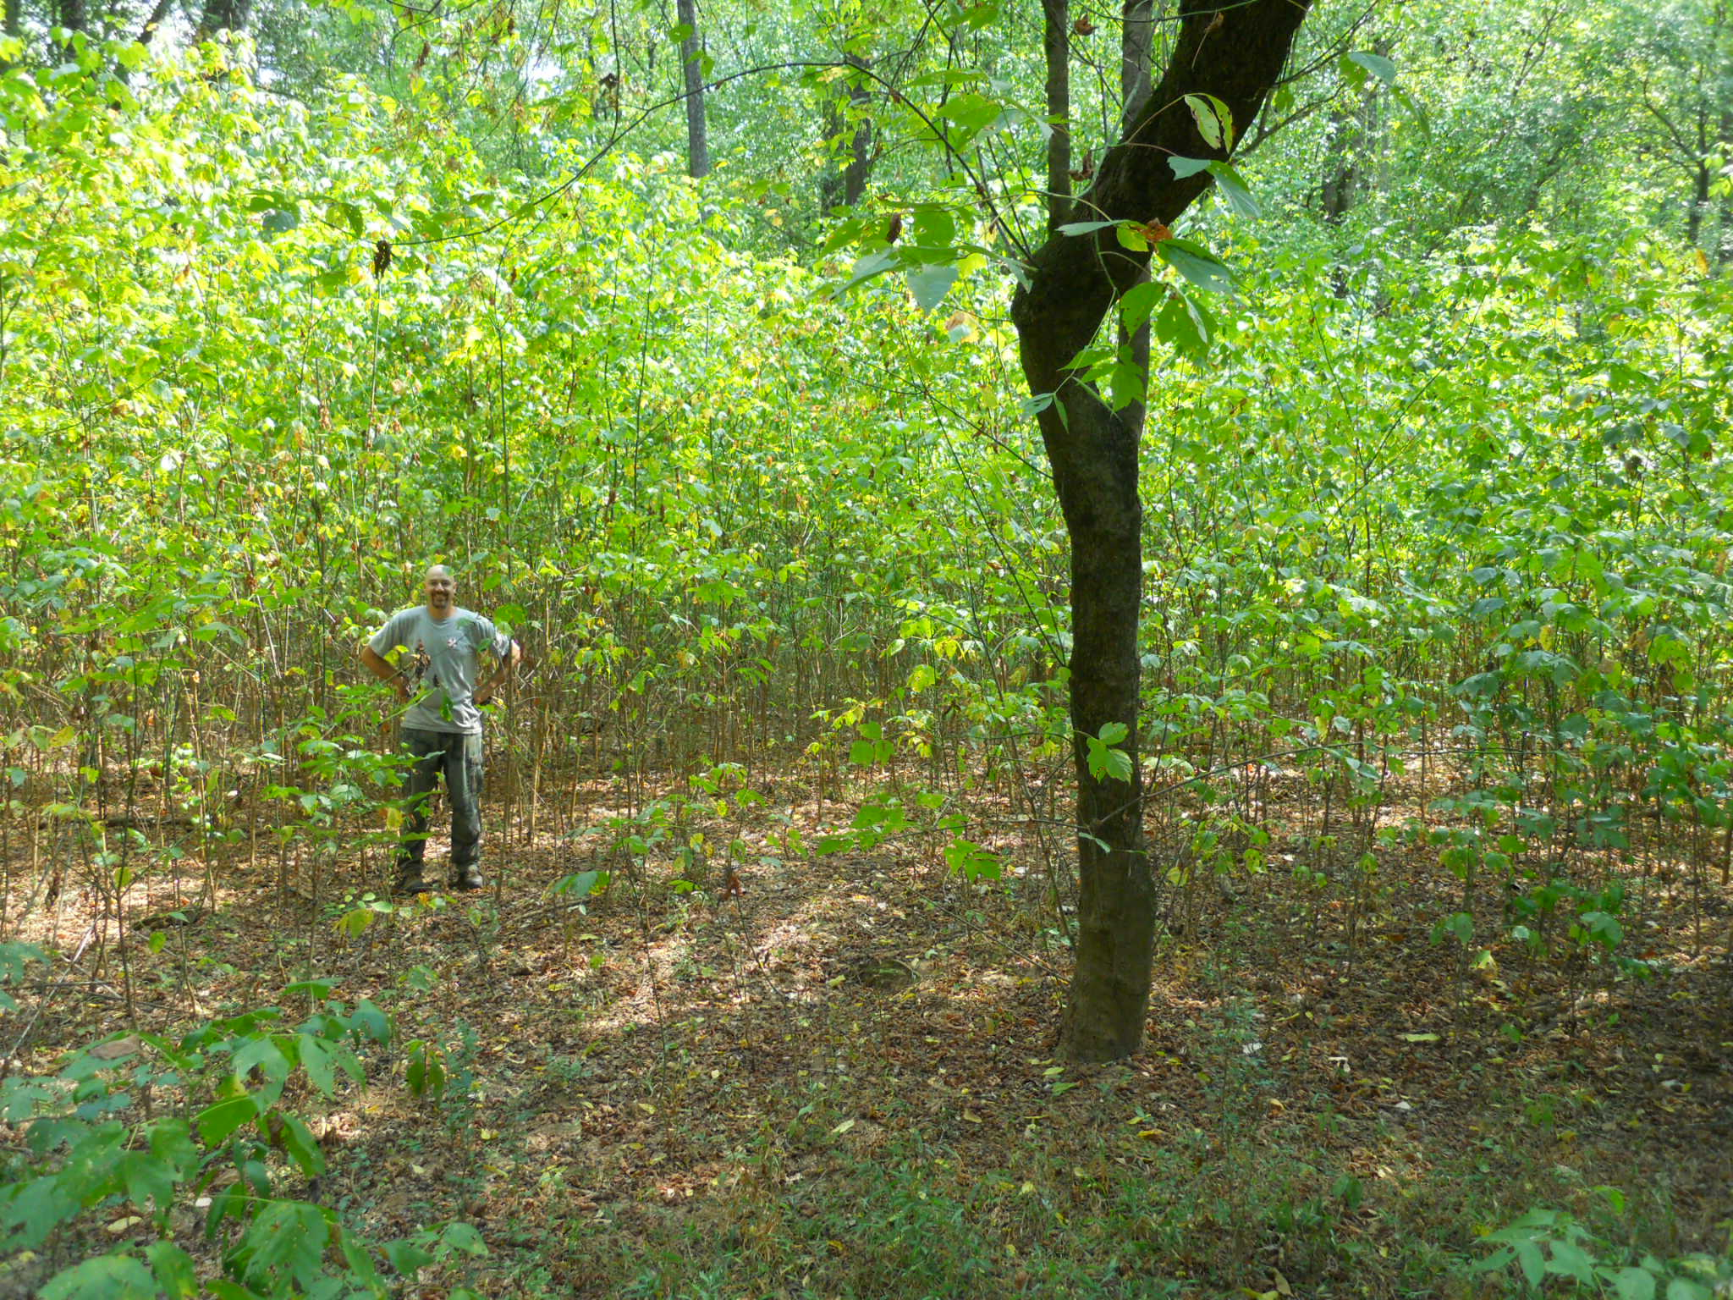
Results—5 yr. Plant Response
Notes:
Which this shows, this was taken last year in one of the chainsaw felling plots……….what happens is where privet has been going strong for decades usually over-story trees that fall don’t get replaced so you end up with nothing but privet……..when we came in and removed all the privet we had large canopy gaps—luckily (although some people might argue), the major native that moved in was boxelder. This small graph just shows that as the number of privet stems increase, basal area of these hardwoods decreases (little to no regeneration over the years-an acorn hits the ground and has no shot).

Slide 42
NMS Ordination for Herbaceous Plants 2007 and 2012
Mulch and Felling plots from both 2007 and 2012 are ecologically similar
Removal technique had little effect on plant community between the two
Both treatment plots moving towards the “desired” plots
sites are plotted so distances between them in the graph reflect the ecological differences between them
Notes:
Lastly, probably the most telling graph is this ordination……it shows exactly how the 15 plots are grouped as far as ecological similarity and species composition……you can see that as expected all desired plots are together in 2007 and 2012 as are control plots……….what is neat is that both mulch and felling plots are together as well for the entire study. In addition, the graph shows that the treatment plots are also closer to the desired plots demonstrating that removing privet is actually driving plant species composition more towards our reference plots which have never been invaded….good news and the outcome we had hoped for. One of the main things the desired plots had that separated it was a diverse and abundant native grass community (cane, river oats, wild rye, panic grasses).

Slide 43
Unexpected Outcome
A rare plant, yellow fumewort (Corydalis flavula), was discovered on one of our removal plots at the State Botanical Gardens. This plant occurs in only 4 counties in Georgia.
Notes:
We also had one unexpected outcome…….that was pretty cool---READ………..this underscores the importance of removing privet……..many plants like this one might not be so rare if we could just open up the forest floor a bit……….in fact, the spot where this plant was first found is expanding and I have even seen bees on it.

Slide 44
Results-Bee Richness
2007
Bee diversity went up almost 5x on mulch and 4x on felling plots
Even surpassed Desired plots—extra sunlight?
2012
Trend continued for 5 year assessment—mulch and felling plots significantly more diverse than control
2007
2012
Notes:
And speaking of bees………how did privet removal and the change in plant communities their diversity on the plots?
In 2007 control plots had 10 species/plot while mulch plots had 48 species/plot and felling was at 38 species/plot. Even desired was only around 32/plot………plant recovery + disturbance and extra sunlight probably accounts for this……….And after several years the trend continued—even though all numbers went up, you can see that bee diversity was still highest on mulch and felling plots.
(*no desired sampled in 2006, that is why we used only 2007)

Slide 45
Results-Bee Abundance
2007
Control 33/plot
Felling 383/plot
Mulch 658/plot
Dramatic results!
2012
After 5 years bee numbers remained significantly higher on privet removal plots
Change in plant cover led to a sustained change in the bee community
2007
2012
Notes:
We saw an even more dramatic response with the numbers of bees……….IN 2007 control plots had just 33 bees/plot while mulch plots had 658!
Felling plots again were not as high but still 383 bees/plot. And just like diversity, abundance stayed significantly higher on treatment plots 5 years post removal………hovering around 400/plot for the two treatments compared to around 30 bees/plot for the controls…..

Slide 46
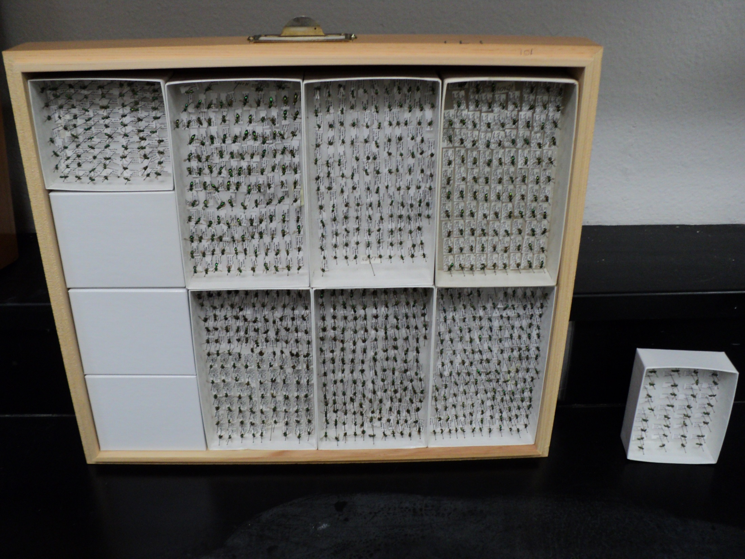
Results-Bee Abundance
Mulch
Control
Notes:
To drive the point home about how the dramatic the differences were…………on the left are the average number of bees from one mulch plot over a week and on the right is what we would get from a control plot for one week……….this really tells the story! Picture worth a 1000 words.

Slide 47
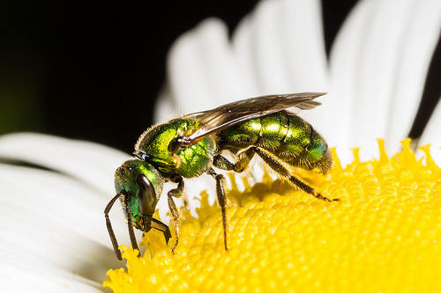
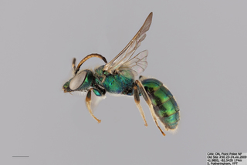
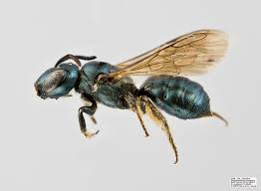
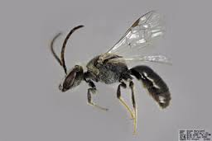
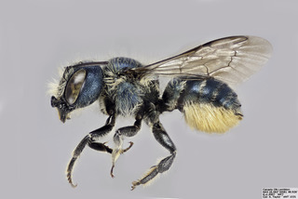
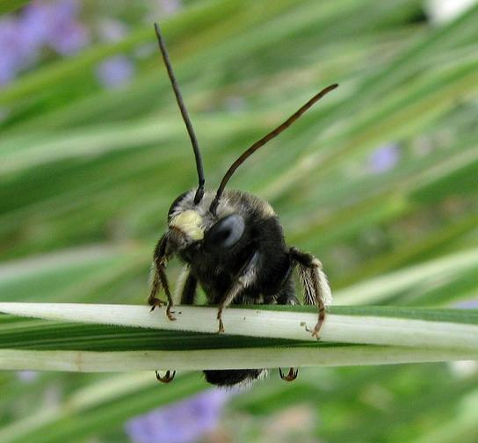
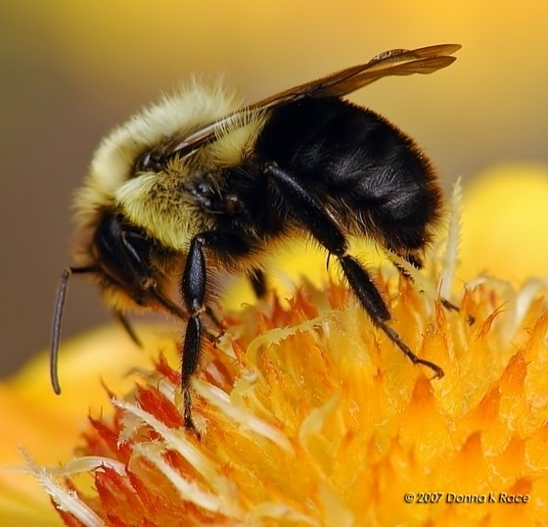
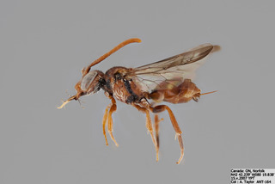
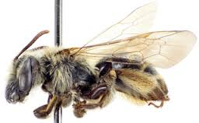
Common bees collected
Augochlora pura
Augochorella aurata
Lasioglossum spp.
Ceratina calcarata
Bombus spp.
Osmia spp.
Andrena spp.
Melissodes spp.
Nomada spp.
10,000 bees
120 species
Notes:
We caught greater than 10k bees during both phases of the study and over 120 species……….Here are some pictures of common bees we collected………it is important to note that most of what we commonly caught were just that, common bees. But removing privet and bringing back native plants increased their numbers tremendously as I just showed. Augochlora pura was the most commonly caught bee which is not surprising since this is a typically super common bee often associated with deciduous forests where it nests in moist logs and stumps. It is also known to visit a wide host of floral resources . Augochorella was the next most common bee and looks very similar– Ceratina are called “small carpenter bees” and known to nest in pithy stems of herbaceous plants. It makes a lot of sense that their numbers would skyrocket with privet gone and an increase in not on floral resources but plenty of nesting habitats. Lasioglossum is one of the most diverse genera of bees and often visit a wide range of plants………they typically nest in the ground. Osmia is a really neat genus of bees known as “mason bees”……because they use mud in the compartments of their nests………and one way the leaf cutter family they are in differs from other bees is by having their pollen holding apparatus on the bottom of their abdomen………these bees utilize pre-existing holes typically in wood (like old beetle holes). They also serve as a great “model” insect to study or observe because if you provide artificial cavities they show up in droves……….these guys are active in spring usually and very important pollinators of apple and other orchard trees………long-horned bees are solitary ground nesters that show up in our area late spring and are known to be important pollinators of cotton and many other crops like watermelon, pumpkin, and cucumbers…..bumblebees, the only social bee up here also benefitted from eliminating privet…….Andrena which is a soil nester common in the spring….we caught many more, but this last one I put up here is known as a cuckoo bee because its ecology revolves around not making its own nest…….but laying its egg in another bees nest (cleptoparasite)…..in our area I think a lot of these guys are actually common in Andrena nests.

Slide 48
Results-Butterflies
2007
Richness went up more than 2x on felling plots and almost 4x on mulch plots
Richness on mulch plots same as desired plots
2012
Similar to bees-
Butterfly communities strongly responded to plant restoration over the long term
Larval host plants?
2007
2012
Notes:
Those are the bees, so what about the butterflies…….I talked about the importance of bees because of their pollination efficiency but butterflies are important as well and they are also great insect “ambassadors”……….we found that butterflies benefitted just as much as bees from removing privet……2007………Control plots =4 species/plot………….Mulch = 15 species/plot…………Felling = 10 species/plot…………Desired = 15 species/plot.
So mulching had the greatest immediate benefit to butterflies being equal in richness to Desired plots. Again, the neat thing you can see was that over 5 years the trend stayed the same again showing restoration of the butterfly community.

Slide 49
Results-Butterflies
2007
Control 22/plot
Felling 92/plot
Mulch 157/plot
Mulch plot again was very similar to desired plots in the number of butterflies caught
2012
The trend continued demonstrating a positive response to privet removal and to the return of native plants.
2007
2012
Notes:
Again, it is like a broken record, but butterfly abundance was greatest on mulch in 2007 having 157/plot. Felling had 92/plot and Control had 22/plot.
Yet again, you can see that the mulch was very similar to the desired plot (178/plot). After 5 years you can see the numbers came back down a little, but so did the desired plot so it was probably a seasonal trend rather than a treatment effect.

Slide 50
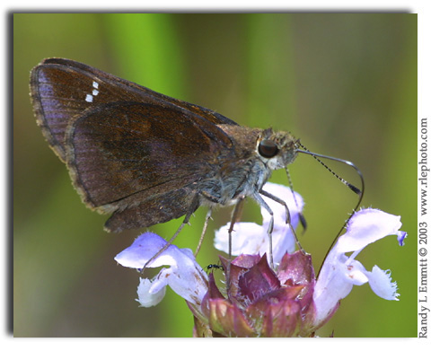
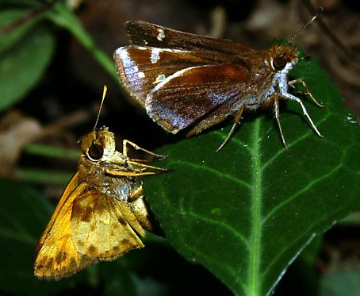
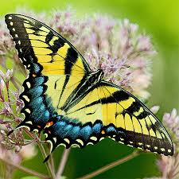
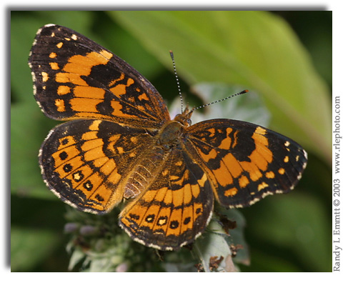
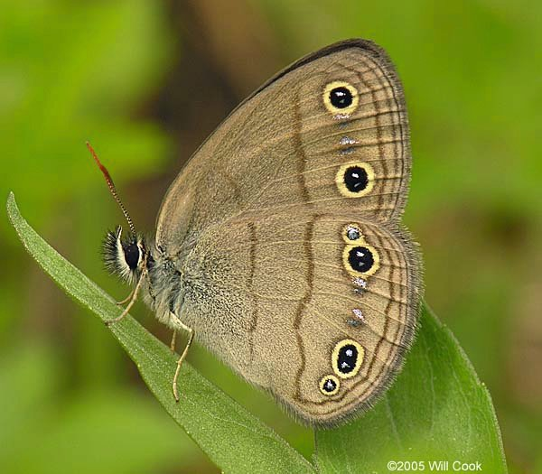
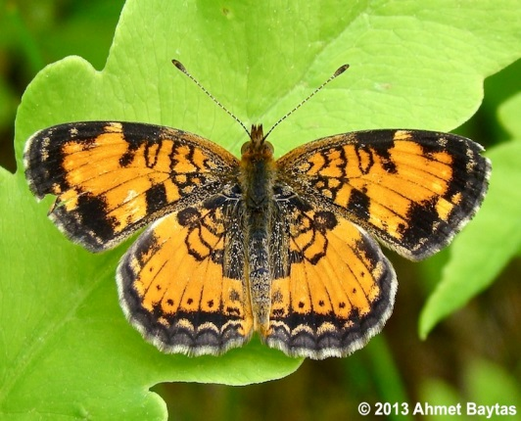
Common butterflies collected
Clouded skipper
Zabulon skipper
Silvery checkerspot
Tiger swallowtail
Carolina satyr
Pearl crescent
Notes:
We caught over 3000 butterflies from 6 families, 28 genera and 35 species ……….here are some of the most common .
By far the most common was the clouded skipper…….a member of a mostly tropical genus. It is known to frequent open woods usually near rivers and streams, and like most skippers its larvae feeds on various grasses (something that definitely does not grow below stands of privet)….Zabulon is sexually dimorphic and has a similar natural history……..the other that was very common and benefitted from privet removal was the carolina satyr…..

Slide 51
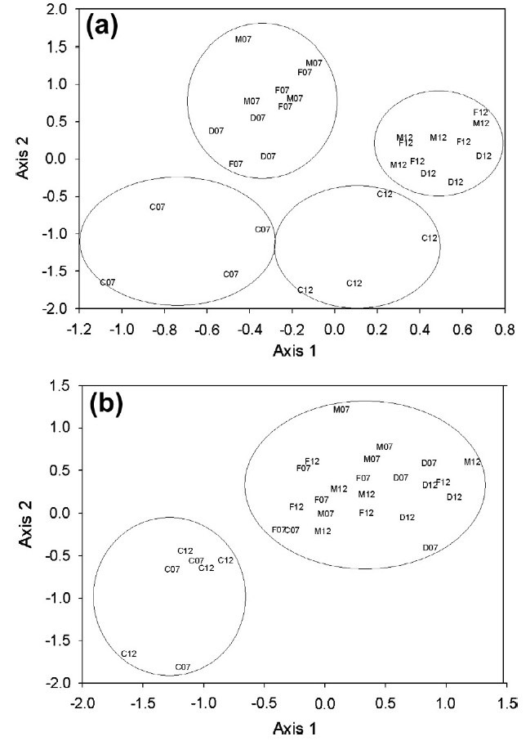
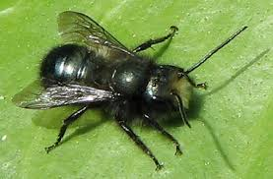
NMS Ordination for Bees and Butterflies 2007 and 2012
Notes:
Here is one final slide which combines bee and butterfly communities for both 2007 + 2012. What this shows is bee communities of both removal and desired plots were grouped together within years but separated by sampling years. It clearly shows that even in years where bee communities are dissimilar within plot type, they are still vastly different from control plots. Butterfly communities from both sampling years were similar on both removal plots and desired plots but again easily distinguished from control plots.

Slide 52
Summary
Chinese Privet…..
Reduces the number of native trees
Reduces the number of native shrubs
Reduces herbaceous plant species and number
Reduces bee diversity and abundance
Reduces butterfly diversity and abundance
It has been 10 years since we first cleared our treatment plots and privet re-invasion is still limited
Notes:
That is a mouth full……….just to sum it up………READ…………..it is coming back, but way more slowly than we anticipated. We believe most that has returned is due to spread by birds—personally seen flocks of American Robins moving through and eating privet berries. Other work we have done shows a distinct edge effect, meaning that the closer you are to the edge of a privet stand (in our case the river since we did not clear all the way to the river) to quicker it moves back in.

Slide 53
Is There Light at the End of the Privet Tunnel?
Notes:
READ………..I think so, at least based on our research big improvements are possible…………also, I mentioned earlier about setting the stage for biocontrol…we’ve worked on this now for more or less 6 years so I would like to briefly mention it…….3 million acres of privet in the southeast is a lot…….spraying or mulching that is probably not going to happen and so they only long-term option for widespread control is biological control.

Slide 54
Long-term options- Biological Control?
3 million acres in the Southeast
Eradication with mechanical and herbicide treatments not practical (physically or economically) on such a large scale
Biological control offers the best long-term option
No native Ligustrum species in U.S.
Lilac closest relative in the Oleaceae (not native)

Slide 55
Exploration in China
Notes:
Project initiated in China in cooperation with the Chinese Academy of Sciences……….remember when I said it was hard to find it in natural areas? This is mostly where they looked…….over a hundred insects found and 2 were chosen based on their life histories and the damage they caused—a flea beetle and a lacebug……..they were shipped to the U.S. and tested in quarantine.

Slide 56
Lacebug Leptophya hospita
Testing completed and petition submitted to APHIS
Notes:
The beetle was not specific enough but the lacebug was…………we are still keeping a colony and waiting to hear from APHIS. The lacebug is easy to rear and causes substantial damage.—we are keeping our fingers crossed for eventual releases. So with that……….

Slide 57
“Native Americans ran the continent as they saw fit.………..
If there is a lesson it is to think like the original inhabitants of these lands and we should not set our sights on rebuilding an environment from the past but concentrate on shaping a world to live in for the future.”
From:
1491: New Revelations of the Americas Before Columbus
By Charles C. Mann
Notes:
Leave with a thought from Charles Mann from the book 1491…….READ……….I really believe this, I constantly hear people try to achieve some past glory or that things used to be so great…………I think we need to always concentrate on the future and just like this project always have “desirable” plots in mind……..they are not perfect, but something admirable to aim for………

Slide 58
Thanks
Notes:
So with that in mind I’ll end with this………..This is near the area I showed with my dad where he was standing in a privet thicket on his property………we decided we had plenty of forested but since privet was so bad there with no overstory trees……..we decided to make a bee meadow which has been in for a few years and looks great. Sometimes there are so many bees and butterflies I can’t imagine where they are coming from???? Questions…..

